Slide 1

Safeguarding PHI with Wireless Technology
A balancing Act
Stacey Guthrie
Athabasca University
NURS/MHST 602
March 17, 2014

Slide 2
Personal Health Information
Personal health information (PHI) as according to Rouse (2010), involves demographics, medical history, insurance information, lab and test results and any other related data that is gathered by health care providers to identify and guide practice associated with a client.
PHI is highly sensitive information that is greatly beneficial for improving health care through improved access as well research practices.
Although greater access leads to increased risks associated with the privacy and confidentiality associated.

Slide 3

Health Care Professionals’ Responsibility
Health care providers' have a professional and legal obligation to ensure the information they receive throughout their practice remains safe and confidential
The protection of the privacy of patients' personal health information (PHI)stems back to Hippocratic Oath, circa 4th century, B.C. and continues to be incorporated into professional standards associated with healthcare providers today.
The Canada Health Act in 1984 involves principles of universality, comprehensiveness, pubic administration, portability and accessibility, which collectively help create a publicly funded, universal health system. The national system is dictated by federal government, but is managed independently within each province and territory. (Weitz, Drummon, Pringle, Ferris, et al. 2003).

Slide 4
Advancing Technology
As technology has evolved over the years, health care professionals' responsibility to protect personal health information has continued to be an area of focus and potential concern
Wireless devices are among the advancing technology within health care, they provide great benefits, but if not properly protected pose a major risk.

Slide 5
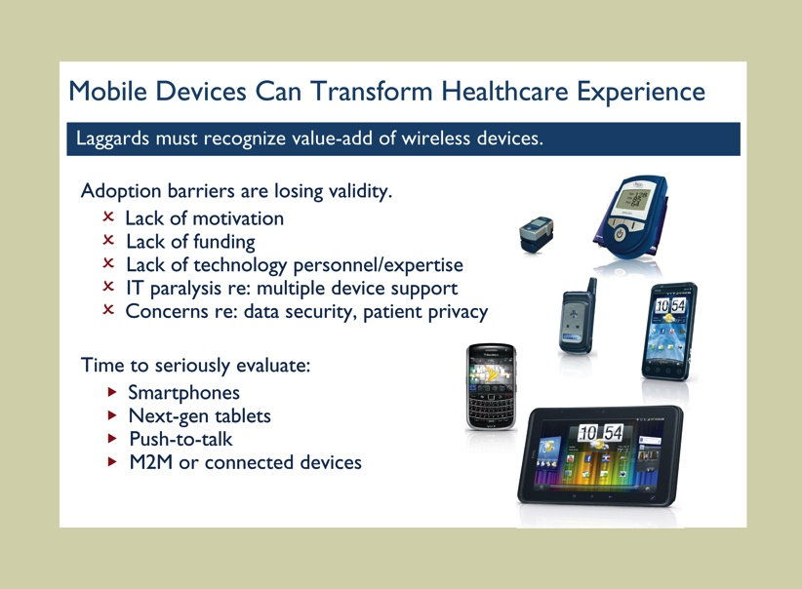
Wireless Devices
The three most commonly used devices are:
Personal Digital Assistants (PDAs)
Laptops/Tablets
Cell phones
          (Cavoukian, 2007; Campbell & Durigon, 2003)

Slide 6
Wireless Technology
Wireless technology uses radio signals rather than hardwired systems to transmit data, which allows the system to be available in real time as the system is continually connected (Newbold, 20003)
Essentially wireless technology allows health care professionals to access information anytime, anywhere.
Common technology currently in practice:
Wireless Fidelity (Wi-Fi)
Mobile Communications
Blue Tooth
              (Campbell & Durigon, 2003)

Slide 7
Benefits
Mobile Technology allows both care providers and clients greater access to PHI, which improves services and client autonomy of their own health.
Increased efficiency
Reduced costs
Accessibility to information
(Cavoukian, 2007)

Slide 8
Risks
While wireless technology advancement assists with improving health care services and ultimately health outcomes, there are also concerns related to increased mobility leading to higher risk exposure
Hackers
Failed security/safeguard measure(s)
Exposure of PHI
(Radack, 2003 & Campbell & Durigon, 2003)

Slide 9
Safeguarding
The evolving wireless trend in healthcare requires numerous measures (physical, administrative, technical) to be in place to ensure personal health information is protected; safeguards
Without appropriate and effective safeguards, Cavoukian (2007) explains the process of sharing information wirelessly can be similar to utilizing an open filing cabinet in a waiting room

Slide 10
Safeguard- The Law
There are many Laws and Acts that enforce the privacy and confidentiality of personal health information, particularly with regards to health care providers.
Personal Health Information Protection Act (PHIPA)
Freedom of Information and Protection of Privacy Act (FIPPA)
Health Insurance Portability and Accountability Act (HIPAA)
Health Information Technology for Economic and Clinical Health Act (HITECH)
                (McGonigle & Mastrian, 2012)

Slide 11

(HIPPA Exams, 2012)

Slide 12
Safeguard- Administrative
Policies and Procedures
Staff education/training
Confidentiality agreements
Organizational Culture that supports safeguarding of PHI
A designated staff member responsible for security
Clear written security rules
Security clearances
Access restrictions
Routine audits
        (Information and Privacy Commissioner of Ontario, n.d; McGonigle & Mastrian, 2012 & Radack, 2003)

Slide 13
Safeguard- Physical
Physical approaches to safeguarding mobile devices can include:
Screen protectors
Maintaining physical control of mobile devices
Locking and turning off devices when not in use
Ensuring no one is looking over your back/shoulder surfing Label and maintain inventory of fielded wireless and mobile devices
Store the least amount of information for the shortest length of time possible
(Information and Privacy Commissioner of Ontario, n.d; McGonigle & Mastrian, 2012 & Radack, 2003)

Slide 14
Technical
Wireless technology and associated devices require various technological related safeguards:
Strong passwords
Encryption
VPNs
Use of firewalls and anti-virus software
Perform routine security testing and assessment of wireless network
(Cavoukian, 2007: IPCO, n.d. & Radack, 2003)

Slide 15
Protecting Mobile Device Use in Healthcare
https://www.youtube.com/watch?v=Vz1ddGJn1PM
(Department of Health & Human Services USA,n.d.)

Slide 16
Common Mistakes
(Top 10 mistakes in implementing wireless technology in healthcare,2013)

Slide 17
7 Essential Steps
(IPCO, 2002)

Slide 18
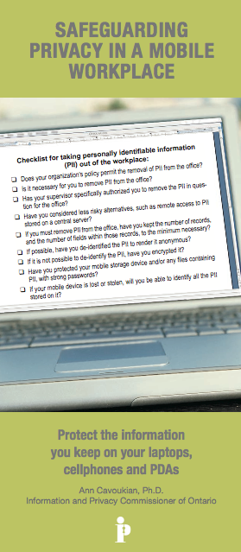
Check lists
Anytime you leave the office or access information consider the following:
Am I permitted to remove, access and use PHI through this route (mobile devices)?
Am I complying with the associated P&Ps?
Am I using strong passwords and encryption?
Only take/use the least amount of PHI via wireless routes necessary
Be sure to use secured networks
Mobile devices should use protective software
Beware of shoulder surfing, or eavesdropping
keep your mobile device with you at all times
Report any stolen devices immediately
(Cavoukin, 2013 & Saskatchewan OIPC, 2009)

Slide 19
Dealing with Confidential Information
https://www.youtube.com/watch?v=_ITU377uuJY

Slide 20
E-Health Ontario
In 2008 Ontario ventured into a provincial project- E-Health Ontario
An independent agency from Ministry of Health and Long Term Care
Focuses on establishing and maintaining electronic health records for all Ontarians
                (eHealthOntario, 2008)

Slide 21
E-Health Ontario
http://www.youtube.com/watch?v=H-gLN08cbT8

Slide 22
Microsoft Vault
Provide individuals a space to “gather, store, use and share health information…” as a method to assist individuals gain control over their health information (Microsoft, 2014).
Individuals are able to upload their own information, use apps and devices that are offered through the vault as well as share their information with others, if they so choose.

Slide 23
Wireless World
They are all around us, we use them in our personal life as well as our professional.
Sometimes without even realizing or acknowledgement
  Is your PHI shared?
  Do you trust that your PHI is secured and safeguarded appropriately?
  Are you familiar with wallet apps- they allow all information from the cards within your wallet be stored in an application on your phone…is this similar?

Slide 24
Moving Forward
Wireless technology and associated devices are here to stay and will only continue to increase
There are definite benefits (cost, efficiency, etc.) from the use of wireless technology, but for the benefits to be sustained, there needs to be a culture of privacy created.
Routine, ongoing risk assessments need to take place to ensure protection of information through effective safe guards
      (Radak, 2003 & IPCO, 2011)

Slide 25
Discussion A
Do you use wireless technology to share and store PHI, if so what safeguards are used within your organization? Do you participate in routine training? Audits? How often do these take place?

Slide 26
Discussion B
Considering the various security related technology available today, where do you see safeguards in the future?

Slide 27
Discussion C
Do you feel mock scenarios would be an effective approach to ensure safeguards are properly put into place? Enhance staff awareness and understanding? Have you participated in such activities related to safeguarding wireless devices?

Slide 28
Discussion D
Are you familiar with a situation where PHI was breached while using a wireless device? Could stronger safeguards been put into place to change the outcome?

Slide 29
Reference
Al Ameen, M., Liu, J., & Kwak, K. (2012). Security and privacy issues in wireless sensor networks for healthcare applications. Journal of Medical Systems, 36(1), 93-101. doi:http://dx.doi.org/10.1007/s10916-010-9449-4
American Medical Association. (2010). HIPAA Security rule: frequently asked questions regarding encryption of personal health information. Retrieved from http://www.ama-assn.org/resources/doc/washington/hipaa-phi-encryption.pdf
Blazek, N., Kluge, E., & Siegal, G. (2012). mHealth: Innovative collaboration between physicians, patients and technologists. Infectious Diseases in Children, 25(7), 1-11. Retrieved from http://search.proquest.com/docview/1030169122?accountid=8408
Campbell, R. J., & Durigon, L. (2003). Wireless communication in health care: Who will win the right to send data boldly where no data has gone before? Health Care Manager, 22(3), 233-240. Retrieved from http://0-search.ebscohost.com.aupac.lib.athabascau.ca/login.aspx?direct=true&AuthType=url,ip,uid&db=rzh&AN=2004019975&site=ehost-live
Cavoukian, A. (2007). Wireless communication technologies: safeguarding privacy and security. Retrieved from http://www.ipc.on.ca/images/Resources/up-1fact_14_e.pdf
Cavoukian, A. (1998). Safeguarding health information. Health Law in Canada, 18(4), 115-117.
Colpas, P. (2013). Securing PHI. Health Management Technology, 34(2), 18-20. Retrieved from http://search.proquest.com/docview/1326218014?accountid=8408

Slide 30
Reference
Department of health & human services USA. (n.d.) Privacy & security. Retrieved from http://www.healthit.gov/providers-professionals/your-mobile-device-and-health-information-privacy-and-security
eHealth Ontario. (2012). About eHealth Ontario. Retrieved from http://www.ehealthontario.on.ca/en/videos
eHealth Ontario. (2008).What we do. Retrieved from http://www.ehealthontario.on.ca/en/about
HIPPA Exams. (2012). Why is HIPAA training beneficial. Retrieved from http://www.youtube.com/watch?v=YwSgDxNg5LI
Information & Privacy Commissioner of Ontario. (2011). Safeguarding personal health information when using mobile devices for research purposes. Retrieved from http://www.ipc.on.ca/images/Resources/cheo-mobile_device_research.pdf
Microsoft. (2014). Microsoft vault. Retrieved from https://www.healthvault.com/ca/en

Slide 31
Reference
Mobile devices in the workplace.(2014). Alberta RN, 69(4), 13-14. Retrieved from http://0-search.ebscohost.com.aupac.lib.athabascau.ca/login.aspx?direct=true&AuthType=url,ip,uid&db=rzh&AN=2012465924&site=ehost-live
Newbold, S. K. (2003). New uses for wireless technology. Nursing Management, , 22-3, 32. Retrieved from http://search.proquest.com/docview/231382857?accountid=8408
Office of Information and Privacy Commissioner Ontario. (2002). 7 Essential steps for designing privacy into technology. Retrieved from http://www.ipc.on.ca/images/Resources/up-17steps.pdf
Office of the Saskatchewan Information and Privacy Commissioner (Saskatchewan OIPC). (2011). Best practices: mobile devices. Retrieved from http://www.oipc.sk.ca/Resources/Helpful%20Tips%20-%20Best%20Practices%20-%20Mobile%20Device%20Security%20-%20March%202011.pdf
Radak,S. (2003). Security for wireless networks and devices. Retrieved from http://csrc.nist.gov/publications/nistbul/march-03.pdf
Rouse, M. (2010). Personal health information. Retrieved from http://searchhealthit.techtarget.com/definition/personal-health-information
Top 10 mistakes in implementing wireless technology in healthcare.(2013). Biomedical Instrumentation & Technology, 47(3), 215. Retrieved from http://search.proquest.com/docview/1366370252?accountid=8408
Walsh, D., Passerini, K., Varshney, U., & Fjermestad, J. (2008). Safeguarding patient privacy in electronic healthcare in the USA: The legal view. International Journal of Electronic Healthcare, 4(3-4), 311-326.
Weitz, M., Drummond, N., Pringle, D., Ferris, L. E., & et al. (2003). In whose interest? current issues in communicating personal health information: A canadian perspective. The Journal of Law, Medicine & Ethics, 31(2), 292. Retrieved from http://search.proquest.com/docview/223507909?accountid=8408
WeComply. (2012). Guidelines for dealing with confidential information. Retrieved from http://www.youtube.com/watch?v=_ITU377uuJY

