Slide 1
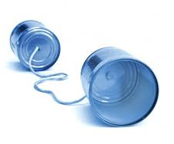
Open Dialog and Open Access
Communication is a essential part of a technology coming out of the lab and into society. Creators of emerging technologies, like genetically engineered products, could benefit from granting the public access to the dialog surrounding a product. The strength of a product’s brand will come from its ability to resonate positively with diverse consumers that feel an association with the brand. Engaged consumers might also be compelled to help collectively create, strengthen, and sustain a product’s brand (Fuller et al., 2013).
What other techniques can be utilized to create a dialog about products that consumers maybe uncertain about? How best can you make this dialog open access?
Image Sources: http://insigniacomms.com/proof-almost-that-swift-and-open-crisis-communication-preserves-business-value/
Source:
Füller, J., Schroll, R., & von Hippel, E. (2013). User generated brands and their contribution to the diffusion of user innovations. Research Policy, 42(6-7), 1197–1209. doi:10.1016/j.respol.2013.03.006

