Slide 1
ALAM/GlobalMET Mini-Conference & Workshop Comprehensive Revision of STCW: The Way Ahead for Regional MET & Maritime Industry Proposed Changes to Chapter III (Engine department) & Chapter V (Special training requirements for certain types of ships)
M. A. Ganesen Chief Executive Officer,
Malaysian Maritime Academy (ALAM)

Slide 2
Introduction
We are undertaking continuation of the work that was initiated in 2006 with the aim of comprehensively reviewing the STCW Convention and the Code.
The outcome should ensure that the changes we make meet today’s challenges facing the shipping industry and prepare us for the foreseeable future growth of the maritime industry in the region.

Slide 3
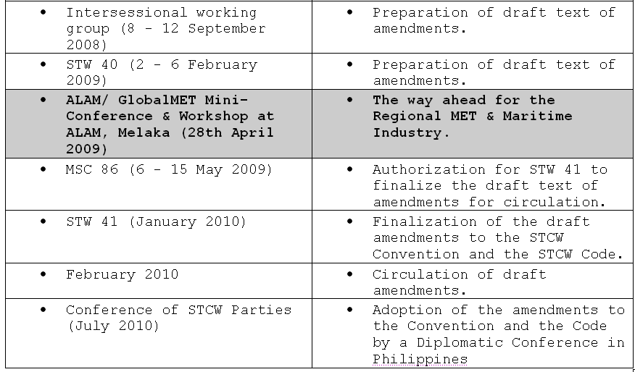
Provisional Road Map for Revision

Slide 4
Major Areas of Review in Chapter III
Methods of demonstrating competence
Emerging and contemporary technologies
Deletion/reduction/amendment in the period of education and training for engineers
“Upgrading” seagoing service requirements
Introduction of new competence for Electro-technical officers
Training and certification requirements for personnel serving on steam-powered ships
Marine environment awareness training
Able Seafarer (Engine)
A-III Engine Room Resource Management

Slide 5
Major Areas of Review in Chapter III
Methods of demonstrating competence
The proposal refers to Ship-in-Campus, a shore-based engine-room. The facility of a ship in campus aims to equip students to work as marine engineers on seagoing ships using current in-service technology and time tested skills. It is proposed as one of the means for demonstrating competence of various functions at the operational level and provided details of equipments and machineries required for that purpose.
Participants are encouraged to look through this document STW 40/7/14 during Workshop

Slide 6
Major Areas of Review in Chapter III
Emerging and contemporary technologies
STW 40/7/18 proposed amendments to tables A-III/1 and A-III/2 of the STCW Code with a view to reorganizing the existing functions and to include a new function “Engineering watch” in order to meet the requirements of contemporary and emerging technologies.
Sub-Committee agreed that some elements of the proposal could be included in the existing tables of competence but that it was not necessary to reorganize the tables as proposed.

Slide 7
Major Areas of Review in Chapter III
Deletion/reduction/amendment in the period of education & training for engineers
Changes proposed to Regulation III/1 & Regulation III/2

Slide 8
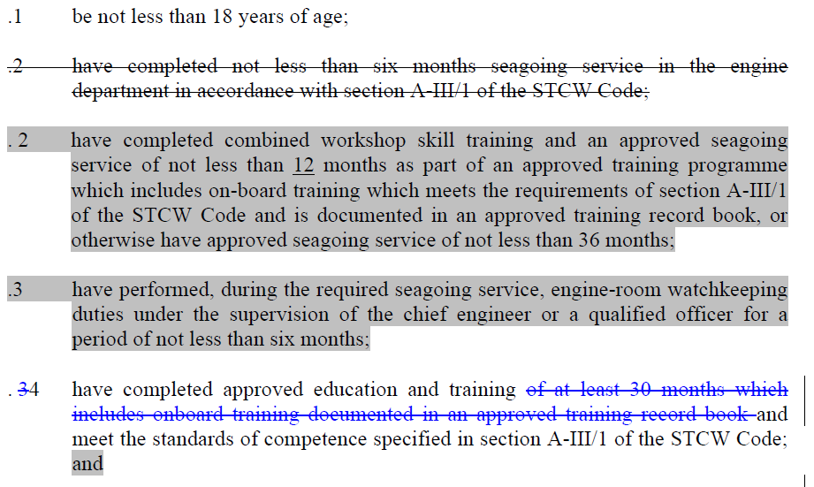
Regulation III/1

Slide 9
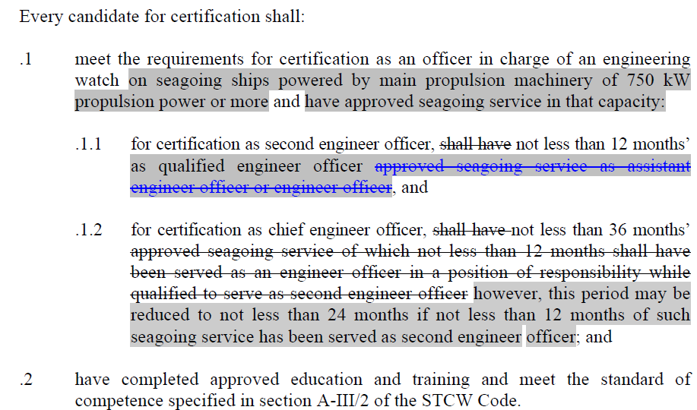
Regulation III/2

Slide 10
Major Areas of Review in Chapter III
New Competence for Electro-technical officers
A case in point could be the use of 3.3 kV /6.6 kV power supply, which is becoming more common in many vessels now.
When similar systems are routinely used in cruise ships, a group of electrical engineers (at least six in number) are available for the upkeep of the power plant.
So, there could be a distinct need to provide competent personnel in-charge of such installations.

Slide 11
Major Areas of Review in Chapter III
New Competence for Electro-technical officers
After discussion the Sub Committee decided that competences for electro technical officers were required. It was agreed:
training requirements developed by the ad hoc Intersessional STW Working Group (ISWG) in Sep 2008 should be carried forward.
training requirements for “Able-Seafarer electro-technical” should also be considered.
The workshop participants can go through these documents and provide their comments in this area.

Slide 12
Major Areas of Review in Chapter III
Training and certification requirements for personnel serving on steam-powered ships
In consideration of STW 40/7/28 and STW 40/7/37 (India) which proposed new training and certification requirements for engineers serving on steam-powered ships.
Some 20 delegates were of the view that there was not enough emphasis on having seagoing service on steam powered ships before sailing on such ships.
Other delegates were of the view that it was covered in the present text and that exceptions should not be made for steam-powered ships as opposed to other propulsion machinery.

Slide 13
Major Areas of Review in Chapter III
Training and certification requirements for personnel serving on steam-powered ships
The group did not reach agreement on this issue.
Due to time constraints, the group was unable to discuss the changes to existing tables of competency to strengthen the existing knowledge, understanding and proficiencies.

Slide 14
Major Areas of Review in Chapter III
Marine environment awareness training
awareness training
STW 40/7/45 proposed amendments to amend table A-III/1 of the STCW Code to provide training in marine environment awareness.
The Sub-Committee, noting that this proposal did not require any principle decision of the Sub-Committee, referred it to the relevant working group for consideration in detail.

Slide 15
Major Areas of Review in Chapter III
Able Seafarer (Engine)awareness training
Consequential to the proposed amendments relating to “able seafarer deck”, the document STW 40/7/53 proposed similar amendments to the draft text related to training and certification of ratings as “able seafarer engine”.
The Sub-Committee agreed that the discussions and decisions relating to “able seafarer deck” were also applicable for “able seafarer engine” and should not be considered further by the working group.

Slide 16
Major Areas of Review in Chapter III
A-III Engine Room Resource Management
STCW Code Sections A-III engine department, to increase emphasis on engine room resource management;
provide training on maritime legislation to assist in protecting the crew, owner/operators and ships from breaching the increasing legislative requirements;
promote a "safety culture" to embrace all levels and further emphasis on management training,
including enhanced knowledge of occupational health and safety issues;
and increase emphasis on fatigue management;

Slide 17
Major Areas of Review in Chapter V
Tanker training
Dynamic positioning systems (DP)
Training associated with offshore supply vessel (OSV)
Anchor handling
Competence standard for FPSO – FSO [STW39]

Slide 18
Major Areas of Review in Chapter V
Tanker training
STW 40/7/19 proposed a number of amendments in this area.
In the workshop, the participants could review the relevant documents to get an overview of the proposed changes.
I am going to show some extract of the proposed regulations.

Slide 19
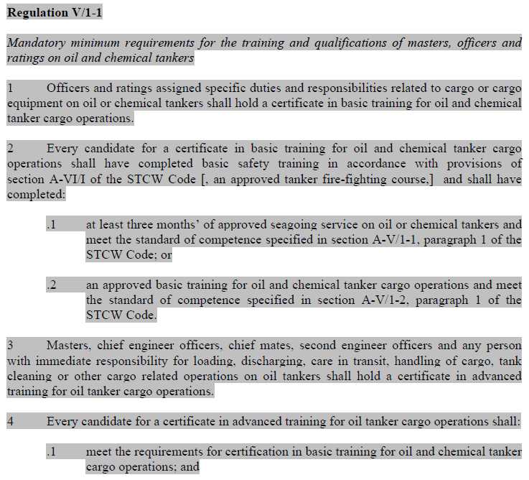
Major Areas of Review in Chapter V

Slide 20
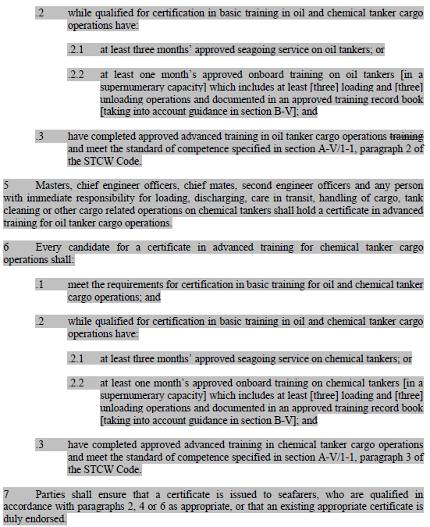
Major Areas of Review in Chapter V

Slide 21
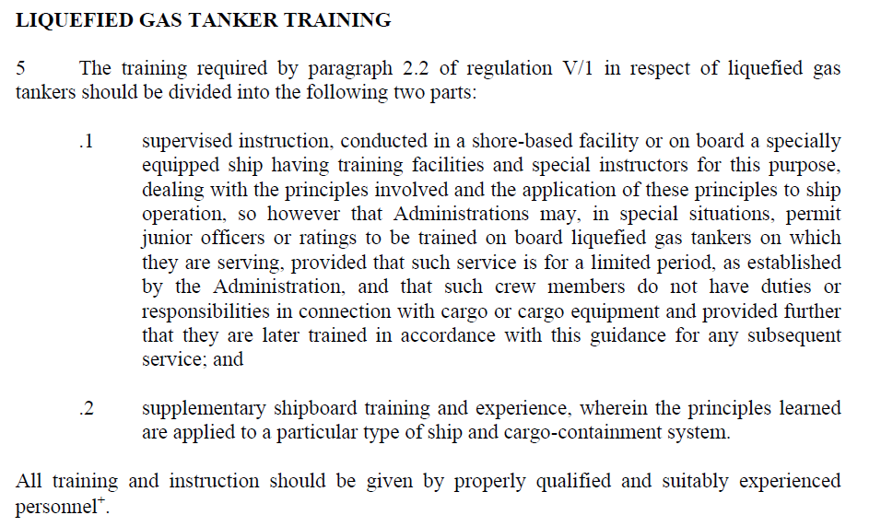
Major Areas of Review in Chapter V

Slide 22
Major Areas of Review in Chapter V
Dynamic positioning systems (DP))
STW 40/7/15 proposed competence requirements for personnel operating DP systems and maintaining a DP watch on board a ship which should lead to an appropriate endorsement.
The Sub Committee advised India, IMCA and OCIMF to jointly develop revised and expanded guidance relating to personnel operating DP systems, taking into account the Sub Committee's discussion and submit further information to STW 41.

Slide 23
Major Areas of Review in Chapter V
Training associated with
offshore supply vessel (OSV)
This matter was discussed in detail by a working group which agreed that guidance for training and certification of Offshore Supply/Support Vessels (OSV) personnel should be included in section B of the STCW Code.
This should include training for anchor handling. In the new revised text there will be two new sections in square brackets (one from India and one from Norway) for further consideration at STW41.

Slide 24
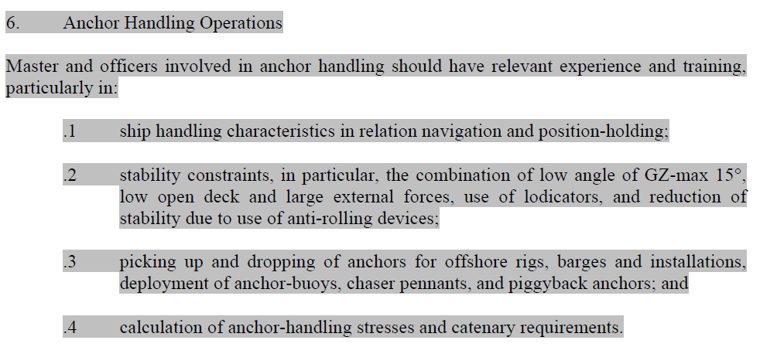
Major Areas of Review in Chapter V
Anchor Handling

Slide 25
Major Areas of Review in Chapter V
Competence Standard for FPSO – FSO [STW39]
At STW 39, proposals were submitted for new competence standards for officers of FPSO & FSP.
Due to lack of time, these could not be discussed.

Slide 26
Conclusion
After these two presentations, you would agree, that we need to cover a lot ground to complete this STCW comprehensive review process.
The questions which could perhaps be raised at this point:
Can the comprehensive review be completed by 2010?
How much additional time will be required to complete this review?

Slide 27
Conclusion
It should however be clear for all of us that we need to be actively involved and contribute to the review process by sharing our experiences of the implementation of the convention .
This will ensure that the revision will be conducted with inputs from all stakeholders reflecting the interests of shipping industry, training institutes and maritime administrations of this region.

