Slide 1
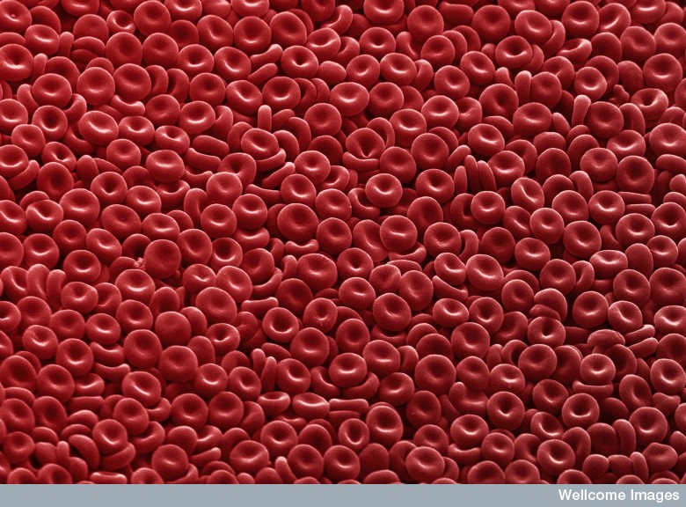
Polycythemia
Group C: Melanie, Michele, Sarah

Slide 2
Polycythemia
Polycythemia is an increase in RBC production (erythrocytosis) and can be relative or absolute (McCance & Huether, 2006). This causes the blood to become more viscous and can predispose a patient to thrombosis (Merck, 2005).

Slide 3
Relative Polycythemia: is a temporary condition related to dehydration. It typically affects obese, hypertensive individuals but can be corrected with adequate fluid resuscitation
Absolute Polycythemia: is a chronic condition that results from abnormal bone marrow stem cells. It can be primary (also known as Polycethemia Vera) or secondary.
(McCance & Huether, 2006)

Slide 4
Polycythemia Vera (PV) is a chronic non malignant condition characterized by an increased production of RBC’s, WBC’s and platelets. RBC production increases independently of erythroipoietin. Blood volume expands, becomes more viscous and has the potential to cause a thrombus. Platelet dysfunction may occur and increase the risk of bleeding. Depending on treatment PV can transform into acute Leukemia.
(Merck, 2005)

Slide 5
Criteria for Diagnosis of Polycythemia Vera
Erythrocytosis, absence of secondary polycythemia, and characteristic bone marrow changes (panmyelosis, enlarged megakaryocytes with clumping)
Plus any of the following:
Splenomegaly
Plasma erythropoietin level < 4 mUnits/mL
Platelet count > 400,000 μL
Positive endogenous colonies
In the absence of infection, neutrophil count > 10,000/μL
A clonal cytogenetic abnormality in the marrow
(Merck, 2005).

Slide 6
Secondary Polycythemia is more common and is caused by an increase in erythropoietin. This increase in erythropoietin can be caused by an erythropoietin-secreting tumour or as a normal physiological response to chronic hypoxia such as:
lung disease (COPD),
high altitude,
intracardiac shunts,
hypoventilation syndromes,
abnormal Hb,
smoking-induced carboxyhemoglobinemia
(Merck, 2005).

Slide 7
Thrombocytopenia
Thrombocytopenia is a platelet count below 100,000/mm3 of blood. As the platelet count drops the risk of hemorrhage increases. Spontaneous bleeding can occur with a count less than 15,000. In an individual with a count less than 10,000 severe bleeding can occur and can be fatal if it occurs in the GI tract, Respiratory system or the CNS.
(McCance and Huether, 2006)

Slide 8
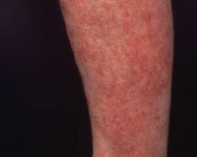
Spontaneous bleeding can result in petechiae, ecchymoses, large purpuric spots, or bleeding from mucous membranes (McCance and Huether, 2006). It can also cause blood in urine, stool and prolonged and heavy menses. The can also be prolonged bleeding with any cut or profuse bleeding with surgery or procedure (MayoClinic,2008).
Petechiae (taken from MayoClinic.com)

Slide 9
Thrombocytopenia can occur due to immunologic and nonimmunologic causes.
Immunologic causes include:
  Immune thrombocytopenic purpura (ITP)
  Post blood transfusion
  Viral infection (HIV, EBV, CMV, rubella)
  Connective tissue (SLE) or lymphoproliferative diseases

Slide 10
Nonimmunologic causes:
Gram negative sepsis
Acute Respiratory Distress Syndrome
Drug induces (Quinidine, Sulfa preparations, carbamazepine, methyldopa, ASA, Oral antidiabetic drugs, gold salts, rifampin and heparin, chemo agents).
(Merck, 2005)

Slide 11
Immune Thrombocytopenic Purpura (ITP)
In ITP autoantibody target platelet glycoproteins. The platelets coated with antibodies are removed from circulation by phagocytes in the spleen resulting in a decrease in circulating platelets. The autoantibodies are also thought to affect platelet development within bone marrow.
(McCance & Huether, 2006)

Slide 12
Thrombotic Thrombocytopenic Purpura (TTP)
TTP is a manifestation of thrombocytopenia in which platelets aggregate to form occlusions affecting the small arteries and capillaries of the microcirculation. The thrombi formed are composed mostly of platelets with minimal fibrin and red cells.
Chronic relapsing TTP: is a rare form more commonly seen in children
Acute idiopathic TTP: more common, severe type that can rapidly become fatal.

Slide 13
TTP
Chronic relapsing TTP: is a rare form more commonly seen in children
Acute idiopathic TTP: more common, severe type that can rapidly become fatal. Pts have severe thrombocytopenia, hemolytic anemia and develop signs of ischemia related to CNS involvement.
(McCance & Huether, 2006)

Slide 14
References:
MayoClinic (2008). Diseases and Conditions: Thrombocytopenia (low platelet count). Retrieved Febuary 17th 2009 from:
http://www.mayoclinic.com/health/thrombocytopenia/DS00691/DSECTION=symptoms
McCance, K.L., & Huether, S.E. (2006). Pathophysiology: The Biologic Basis for Disease in Adults and Children (5th ed.). St. Louis: Elsevier Mosby.
Merck (2005). Thrombocytopenia. Retrieved February 14th 2009 from: http://www.merck.com/mmpe/sec11/ch133/ch133f.html.
Merck (2005). Polycethemia Vera. Retrieved February 14th 2009 from: http://www.merck.com/mmpe/sec11/ch141/ch141d.html.
Photo of RBC’s retrieved February 13th 2009 from: http://www.internetphotos.net/red-blood-cells-photo.html

