Slide 1


A Dynamic, Systems Approach
for Integrating
Ecological and Human Dimensions
in Fish and Wildlife Management
Jody W. Enck
Human Dimensions Research Unit
Department of Natural Resources
Cornell University

Slide 2
Presentation Guide
Situate the presentation in the context of engaging people in conservation
  Critically assess the assumptions about how that engagement is modeled and measured
Describe key social science concepts used as theoretical foundation in HDRU research
Demonstrate application in structured decision making using a coupled- systems approach
Present examples of hypothesis development and testing via adaptive management

Slide 3
Unexamined Premise
People who are exposed to wildlife through nature-based activities will be more passionate toward wildlife and will want to do more (financially, politically, physically) to sustain wildlife.
Apathy,
Greed
People
Wildlife
Want to do
more for
wildlife
Exposure
Passion

Slide 4
Context
Fish and Wildlife Management Agencies have long-term interest in recruitment and retention of participants for pragmatic reasons:
financial, political, management assistance
Citizen Science Programs also need to recruit and retain participants to provide:
  financial, political, research assistance
Birding Organizations want to recruit and retain members who are passionate enough to provide:
  financial and political support
Notes:
Quote 1 [Arizona Game and Fish Department]
Projections of declining hunters and shooters are disturbing, because these people provide the social, financial and political support for wildlife management in North America.
Quote 2 [Citizen Science Canada]
Its primary purpose is to give stewards the skills to monitor their community wetlands, and to raise public awareness of wetland values. But it also has a larger goal to foster a land ethic among the public at large. By caring for the land, we begin to care about it and to assume responsibility for its protection. As recently as a decade ago, conservation policies and practices were left largely in the hands of government. Today many private citizens play a key role in conservation initiatives both as advocates and as volunteer workers, and the need for more public participation is growing.
Quote 3. [Tropical Birding]
Conservation objectives can be achieved in many different ways, land purchase, habitat management and making conservation viable for communities living adjacent to them.. However, there is another method to achieve conservation objectives, arguably in a much more powerful way: by simply getting people outdoors and enjoying birds and nature. It is a very simple equation: once people develop an interest in the hobby, they have a good chance to become passionate about it, and passionate birders are almost always strong supporters of conservation.

Slide 5
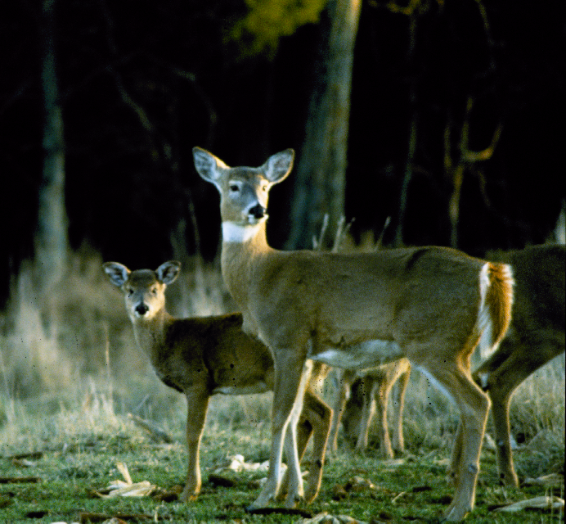
Rhetorical Question
How can we get more people to do what we (managers and scientists) need them to do?

Slide 6
Underlying Theme of Conservation
A desire exists to have more people be so passionate about wildlife that they actively participate in actions that contribute to wildlife conservation.
People who “actively participate” has been the focal point for both governmental agencies (e.g., hunters) and NGOs (e.g., birders, citizen scientists)

Slide 7
“Participation” as an Index
Historically, research on the concepts of recruitment and retention focused on singular behaviors of indicator participants:
hunters (buy a hunting license)
citizen scientists (provide data)
birders (go birding)
Participation in these activities became short-hand for recruitment and retention.
How do you think about and measure participation?

Slide 8
Social Science Concepts related to Participation Research
  Theories of “Reasoned Action” and “Planned
  Behavior”
  e.g., attitudes, beliefs, norms as predictors of behavior
  Motivations and Constraints
  e.g., personal goals and barriers to achievement
  Multiple Satisfactions
  e.g., fulfillment of personal goals
  Activity Innovation-Adoption
  e.g., New York Apprentice Hunter Program

Slide 9
Activity Innovation-Adoption
Stages of innovation and adoption
Climb each stage to reach continuation
“pinnacle” to be called a “hunter”
But if “fall down the other side” into cessation stages;
No longer participate; No longer a hunter
Awareness
Interest
Trial
Continuation
Temporary Cessation
Sporadic Participation
Permanent Cessation
or Dropping-out

Slide 10
Activity Innovation-Adoption
Components are not “stages”
Rather they are what happens between stages
Recruited hunter
Continuation
Apprentice
hunter
Trial
Temporary Cessation
Sporadic Participation
Potential
hunter
Interest
Permanent Cessation
Dropping-out
Nonhunter
Awareness

Slide 11
RECAP
Participation used as a behavioral indicator of
conservation engagement
Activity innovation-adoption reflects a process
of behavioral transformation…
Potential
hunters
Apprentice
hunters
Recruited
hunters
Retained
hunters
Non-hunters
becoming
AWARE
developing
INTEREST
TRYING
it out
CONTINUING
to do it
…but what fuels the process?

Slide 12
Key Concepts
Potential
hunters
Apprentice
hunters
Recruited
hunters
Retained
hunters
Non-hunters
becoming
AWARE
developing
INTEREST
TRYING
it out
CONTINUING
to do it
Social Support
Apprenticeship

Slide 13
Basic Ideas
Apprenticeship – unskilled persons become skilled through a formalized process of instruction by a skilled person; provides opportunities for interested person to try out and engage in an activity.
Social support – unskilled person’s interests are nurtured by others; includes development of positive attitude about activity by family and friends of unskilled person.

Slide 14
Apprenticeship -- definition
“Apprenticeship is the means of imparting specialized knowledge to a new generation of practitioners. It is the rite of passage that transforms novices into experts. It is a means of communicating things that cannot be communicated by conventional means. Apprenticeship is employed where there is implicit knowledge to be acquired through long-term observation and experience.”
From Coy (1989, p. xi-xii)
Notes:
Here is a definition that I like from Coy’s book.
Coy, M. W., ed. 1989. Apprenticeship: from theory to method and back again.
State Univ. of NY Press. Albany, NY 310pp.

Slide 15
Apprenticeship – 2 basic elements
Technical Competence
Learning a role by developing specific skills and techniques
Understanding how to apply skills in different situations
Social Competence
Recognition and adoption of implicit qualities (values and norms) associated with a role
Notes:
More helpful is to consider what Haas considers 2 important competencies.
Haas, J. 1989. The process of apprenticeship: ritual ordeal and the
adoption of a cloak of competence. Pages 87-105 in Coy, M. W., ed. Apprenticeship: from theory to method and back again. State Univ. of NY Press. Albany, NY 310pp.

Slide 16
Technical Competence
Learning about a skill as much as learning how to do a skill.
Requires 2 kinds of learning:
  Practical know-how
  gained through diagnosis, prescription,
  and evaluation.
  Theoretical knowledge needed to make
  know-how operational
  gained through application, integration,
  and derivation of meaning
  (Hamilton 1990; Merle 1994)
Notes:
Technical competence has 2 parts to it – that require 2 very different kinds of “education” and thus “learning.”
Hamilton, S. F. 1990. Apprenticeship for adulthood: preparing youth for the
future. The Free Press. New York. 223pp.
Merle, V. 1994. Pedagogical objectives and organisation of alternative
training. Pages 29-40 in Anonymous. Apprenticeship: which way forward? Organisation for economic co-operation and development. Paris. 157pp.

Slide 17
Social Competence
Understanding the rights, responsibilities, functions, and societal context (i.e., culture) of a role.
Requires 2 kinds of social processes:
  Socialization – apprentice takes on new role and
  experiences personal change:
  shows increasing initiative, “proves” him/herself
  to others by accomplishing tasks (Mortimer 1979).
  Social Control – keeping the apprentice “in line”
  to prevent threats to “social harmony” within role.
  e.g., preventing dangerous situations, loss of
  long-standing access agreement, loss of “face”
  of others through ethical breach (Graves 1989).
Notes:
Just like the development of technical competence involves 2 kinds of education and learning, the development of social competence involves 2 different but related processes.
Process of Socialization
Process of Social Control
Mortimer, J. T. 1979. Work experience and occupational value socialization:
a longitudinal study. American J. of Sociology. 84:1361-1385

Slide 18
Social Support -- background
Pertains to social context and environment in which apprenticeship activities occur.
Bronfenbrenner (1979) developed and Garbarino (1982) refined concept of social support in context of “children at risk” of not striving in society.
Here, applied to idea of people not fully developing
their ideas and interests relating to some subject or activity.
Notes:
Shift gears and discuss this other term “social suppport.”
I think there is great value in thinking about social support in recruitment and retention along the lines of how Bronfenbrenner and Garbarino think about it with “children at risk”…

Slide 19
Social Support – basic elements
Social support consists of a set of 4 levels of “systems” (people and social contexts). Each successively higher-level “system” encompasses >1 examples of each of the lower-level “systems.”
From Garbarino (1982)
Notes:
Garbarino describes social support like this.

Slide 20
Social Support – Microsystems
Microsystems – settings in which person is an active participant (e.g., family, peer groups, clubs, etc.)
Church group
Classmates at school
Family
Apprentice
Boy or Girl
Scouts
Kids on the block

Slide 21
Social Support – Mesosystems
Mesosystems – people/social contexts providing interfaces between 2 or more micosystems (e.g., common threads, and “social glue”)
Uncle’s Rod and Gun club
Church group
Classmates at school
Family (Uncle)
Apprentice
Uncle’s hunting pals
Boy or Girl
Scouts
Kids on the block

Slide 22
Social Support – Exosystems
Exosystems – influential social contexts in which person (apprentice) does not participate in (e.g., job responsibilities of parent)
Uncle’s Rod and Gun club
Church group
Father works 60 hours per week
Classmates at school
Family (Uncle)
Apprentice
Uncle’s hunting pals
Boy or Girl
Scouts
Kids on the block

Slide 23
Social Support – Macrosystems
Macrosystems – “broad ideological and institutional patterns of a particular culture or subculture”
(suburbanization, animal rights, gun violence)
Uncle’s Rod and Gun club
How can you
shoot Bambi?
Church group
Father works 60 hours per week
Classmates at school
Family (Uncle)
Hunting? Ewww!
Apprentice
Uncle’s hunting pals
Boy or Girl
Scouts
Kids on the block
Only shoot firearms
on a shooting range
Did you meet the
4 new families?

Slide 24
RECAP -- Concepts
Activity innovation-adoption reflects a process
of behavioral transformation
Potential
hunters
Apprentice
hunters
Recruited
hunters
Retained
hunters
Non-hunters
becoming
AWARE
developing
INTEREST
TRYING
it out
CONTINUING
to do it
Social Support
Apprenticeship
Social support and apprenticeship are 2 key concepts
helping to fuel the transformation process

Slide 25
Implications of the Social Science Foundation – So Far
Behavioral transformation process is a system
Participation basis means hunter = citizen scientist = birder
Participation in any of these activities reflects passion for wildlife
Potential
birders
Apprentice
birders
Recruited
birders
Retained
birders
Non-birders
becoming
AWARE
developing
INTEREST
TRYING
it out
CONTINUING
to do it
Social Support
Apprenticeship

Slide 26
Revisit the Premise
People who are exposed to wildlife through nature-based activities will be more passionate toward wildlife and will want to do more (financially, politically, physically) to sustain wildlife.
Apathy,
Greed
HD
system
People
Wildlife
Want to do
more for
wildlife
Exposure
Passion

Slide 27
Does participation in specific behavior
lead to passion for wildlife?
OR
Does passion for wildlife
lead to participation in specific behavior?

Slide 28
Passion for Wildlife as part of One’s Identity
Premise: persons become “recruited” into the ranks of those who are passionate about wildlife through process of identity production
  Behavior is important, but having a self-perception is key:
    Some who hunt do not consider themselves to be hunters
    Some who stop participating temporarily may still consider themselves to be hunters

Slide 29
Identity Theory
Identity development is a process
Identity as a hunter/birder/citizen scientist can be defined in terms of characteristic attributes:
  e.g., patient, respectful, tenacious, ethical,
  observant, sharing, passionate, etc.
Not just one set of characteristic attributes; overlapping sets mean several identities exist
Identity differs from legal status or label
  e.g., “husband” vs. “male”

Slide 30
Being a hunter means having certain characteristics
Characteristic attributes are produced through specific experiences (i.e., activities or events) referred to as rites of passage
  rites of passage differ from rituals
    ritual: repeated behavior done in a very specific way because of tradition, enjoyment, or for good luck
    rite of passage: behavior that is transformative in nature because it helps “build character” (i.e., characteristic attributes)

Slide 31
What “powers” the transformative process?
Whether any particular event or activity is a rite of passage depends on the definition of a hunter according to culturally important individuals or groups who act as sources of productive power:
  determine which characteristic attributes are associated with the identity
  give meaning to rites of passage (make them transformative; social competence vs. technical competence)
  facilitate transformative rites of passage

Slide 32
What comes before identity?
  No one is “born a hunter”
  No one is a duck hunter because they “married a duck”
  Each hunter starts out as a non-hunter,
  transforms to potential hunter,
  apprentice hunter,
  recruited hunter
  retained hunter.

Slide 33
Revealing the Conceptual Model
Non-hunters
Awareness that ID
is possible
becoming potentials
Characteristic attributes
communicated to others
Potential hunters
Hunting culture,
Including all Sources of Productive Power
[provide social support]

Slide 34
Revealing the Conceptual Model
Non-hunters
Awareness that ID
is possible
becoming potentials
Characteristic attributes
communicated to others
Potential hunters
Personal
motivations
Consistency between
motivations and
characteristic attributes
becoming apprentices
Hunting culture,
Including all
Sources of
Productive Power
Interest in
developing ID
Hunting apprentices

Slide 35
Revealing the Conceptual Model
Non-hunters
Awareness that ID
is possible
becoming potentials
Characteristic attributes
communicated to others
Potential hunters
Personal
motivations
Consistency between
motivations and
characteristic attributes
becoming apprentices
Hunting culture,
Including all
Sources of
Productive Power
Interest in
developing ID
Hunting apprentices

Slide 36
Revealing the Conceptual Model
Non-hunters
Repeatedly
trying hunting
Potential hunters
Apprentice hunters
Developing
technical
competence
Attaining
characteristic
attributes
becoming recruits
Developing
social
competence
Recruited hunters
Hunting culture,
Including all
Sources of
Productive Power
Retained hunters

Slide 37
Revealing the Conceptual Model
Non-hunter
Potential hunter
Apprentice hunter
Tolerable levels of
dissatisfaction
Recruited hunter
prevent
Sufficiently desirable
levels of satisfaction
retaining recruits
ensure
Satisfaction defined
In currency of
characteristic attributes
Hunting culture,
Including all
Sources of
Productive Power
Retained hunter

Slide 38
Conceptual Model of the Social System
Many wrong ways to conceive of the social science concepts.
Social science involves the same need to pay attention
to what is appropriate as ecological science concepts

Slide 39
Conceptual Model of the
Coupled Social-Ecologial System

Slide 40
From Conceptual Model of a Dynamic Coupled System for
Decision-making
Setting the stage…
“New” birder aware that a birder ID is possible.
Interested in becoming a birder, even interested in
bird-related citizen-science project.
Decides to try-out birding (i.e., is Apprentice Birder)
Starts out trying to develop some technical competency

Slide 41
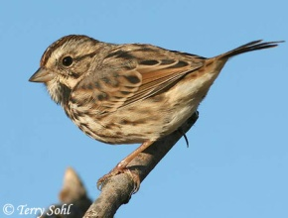
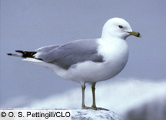
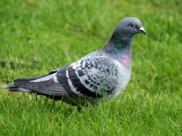
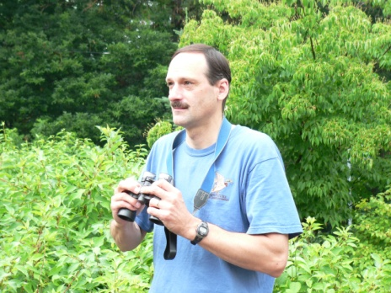
A day in the field…
Apprenticeship can
help one develop
technical
competencies

Slide 42
Apprenticeship help: Getting unstuck
Trying to work out bird ID
Building confidence

Slide 43
Does it matter how mentors “do” Apprenticeship?
Developing technical competencies…
…bird identification skills
Apprentices (birders, citizen scientists) are volunteer
not graded on their effort
not paid a salary
So, motivations of individual are key
Motivations vis-à-vis characteristic attributes

Slide 44
Articulating Hypotheses
H: Field trips to high diversity areas will make apprentices into real birders
H: Field trips focusing on taking notes of common species will make apprentices into real birders
Technical competence in terms of finding and IDing birds?
Social competence in terms of characteristic attributes?

Slide 45
Field trips to high-diversity areas:
Fun and Exciting
or Overwhelming and Confidence destroying?

Slide 46
Focus on common species:
Learn to Observe

Slide 47
Recap
Recruitment and Retention can be defined in terms of a
combination of behavior and identity attributes
Interactions between ecological components (e.g., species
presence/absence, species diversity habitat types, etc.) and
social components can be depicted in conceptual models.
Identity and associated behaviors hinge on comparing
experienced levels of attributes with minimum
desirable (or maximum tolerable) levels – which all
can be measured quantitatively.
Conceptual models can be simulated.
Hypotheses can be articulated and examined experimentally.

Slide 48
Why don’t more birders use
e-bird and report birds they see?

Slide 49
People report birds to contribute
data to science, right?
Birders loving
birds to death

Slide 50
Thank You

