Slide 1
Presented by:
Cristhian A Quintero R.
Theme:
Fable

Slide 2
The Eagle and the Fox

Slide 3

An eagle and a fox who were close friends decided to live together with the idea that this would strengthen their friendship. Then the eagle chose a tree too high for their eggs, while the fox let their children under some bushes on the ground at the foot of the tree.

Slide 4
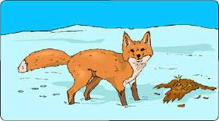
One day the fox went out to forage for food, the eagle was hungry fell on the bushes, took the zorruelos, and then she and her offspring will be rejoicing with a banquet.

Slide 5
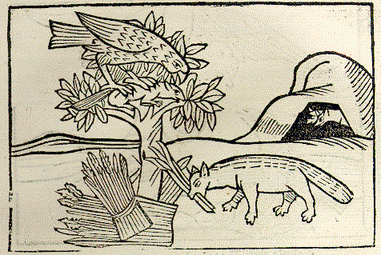
He returned the fox and more it hurt not being able to retaliate, to learn of the death of their young; How could she, being a land animal, unable to fly, chasing a flying? He had to settle for the usual consolation of the weak and powerless: curse from far away to the enemy.

Slide 6
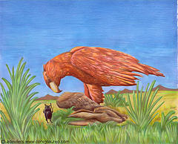
But it was not long for the eagle to receive payment of his betrayal of friendship. They were shepherds in the field by sacrificing a goat fell eagle on it and took an organ that still had fire, placing it in its nest.

Slide 7
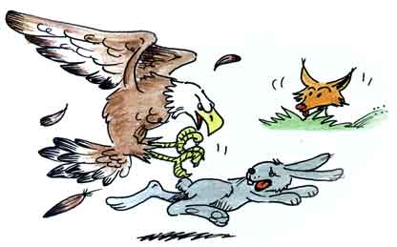
A strong wind came and passed the fire to the straw, also burning their little eaglets, which did not yet know little fly, which came to the ground. Then ran the fox, and calmly ate all the hawks in the eyes of his enemy.

Slide 8
END

Slide 9
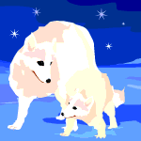
Moraleja.
Never betray the sincere friendship, because if you did, sooner or later there will come a punishment from heaven.

