Slide 1
Best Moments
Presented by: Michael
Notes:
Narrator: Best Moments. Presented by Michael Chung. –CLICK
Audio: Olympic Fanfare… Beginning
Transitions: Ripple: Duration: 1.5 s
Animations:
1. Play: Olympic Fanfare.mp3
Entrance Effect: Flip: Title 3: Best Moments
Entrance Effect: Bounce: Presented by: Michael Chung

Slide 2
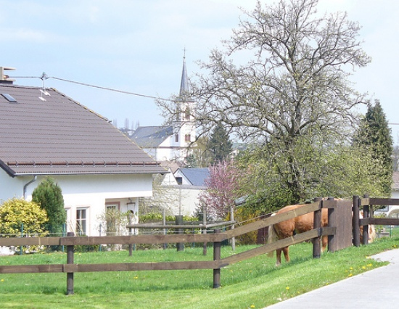
Notes:
Narrator: On a peaceful day at a small village in Binsfeld, Germany, everything was quiet and lonely. It was a very rural-like area near the border of Luxembourg. Some houses, few shops and a small church was the only thing in the silent and sad neighborhood. Nearly nothing seems to happen in the town. It was so boring that we decided to travel somewhere in Europe. –CLICK
Audio: Olympic Fanfare… Continuing
Transitions: Switch: Duration: 2s
Animations:
Entrance Effect: Zoom: Picture 2
Emphasis Effect: Grow/Shrink: Picture 2

Slide 3
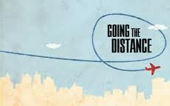
?????WHERE?????
to
GOING
Notes:
Narrator: But going to where? We planned for 1 week about where we are going. We already been to Paris, London, Rome, Berlin, and lots of cities in Europe. My family thought… what about somewhere toward nature instead of cities? So, we have decided to go to –CLICK
Audio: Olympic Fanfare… Continuing
Transitions: Flip: Duration: 1.2 s
Animations:
Entrance Effect: Bounce: Picture 2
Bounce: Rectangle 4
Bounce: Rectangle 3: GOING
2. Entrance Effect: Wipe: Right Arrow 7: to
3. Entrance Effect: Swivel: Title 1: ?????WHERE?????

Slide 4
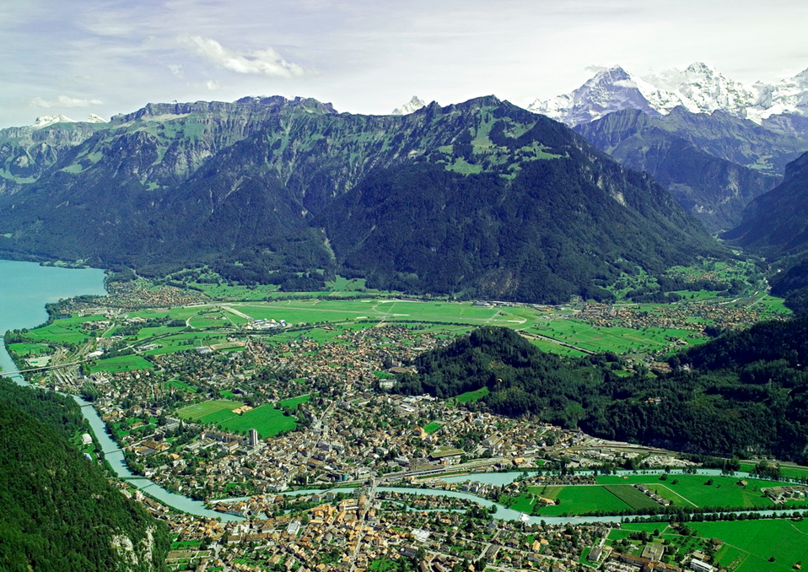
Notes:
Narrator: Interlaken, Switzerland!! We rode our Odyssey and drove for 6 hours. It took a really long time, but it was worth the trip! When I got out of the car I saw this spectacular view.
Audio: Olympic Fanfare…Continuing
Transitions: Gallery: Duration: 2.5s
Animations:
1. Entrance Effect: Float: Picture 2

Slide 5
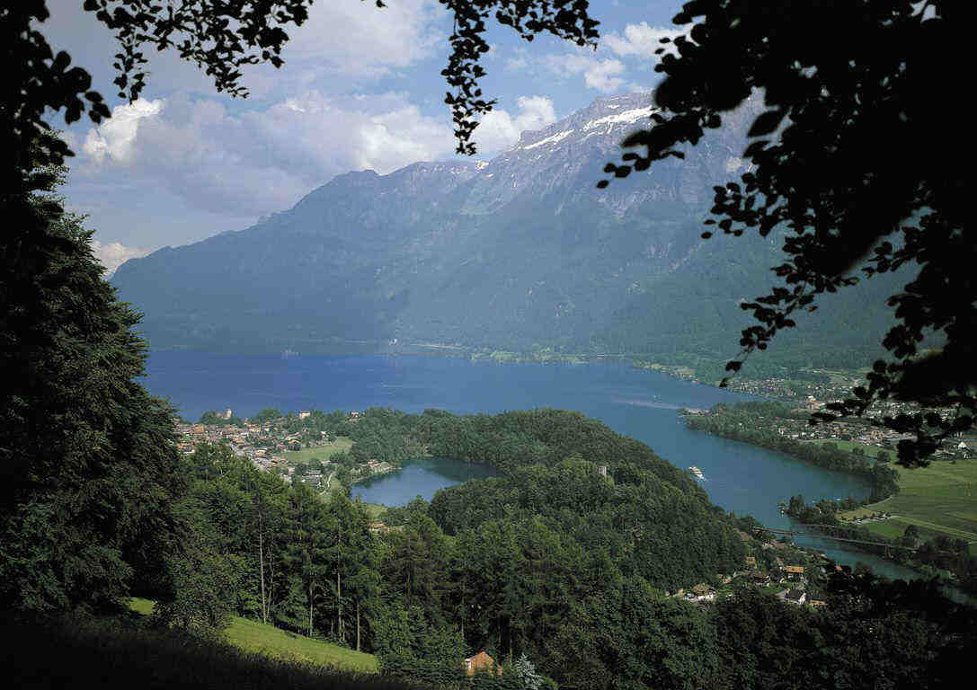
Notes:
Narrator: The mountains stretch everywhere: the air is fresh to breathe and the trees cover everywhere. It was the best and beautiful place I have ever been.
Audio: Olympic Fanfare…Continuing
Transitions: Cube: Duration: 2s
Animations:
1. Entrance Effect: Boomerang: Picture 2

Slide 6
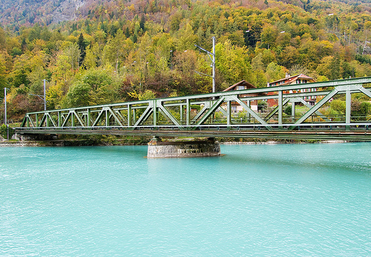
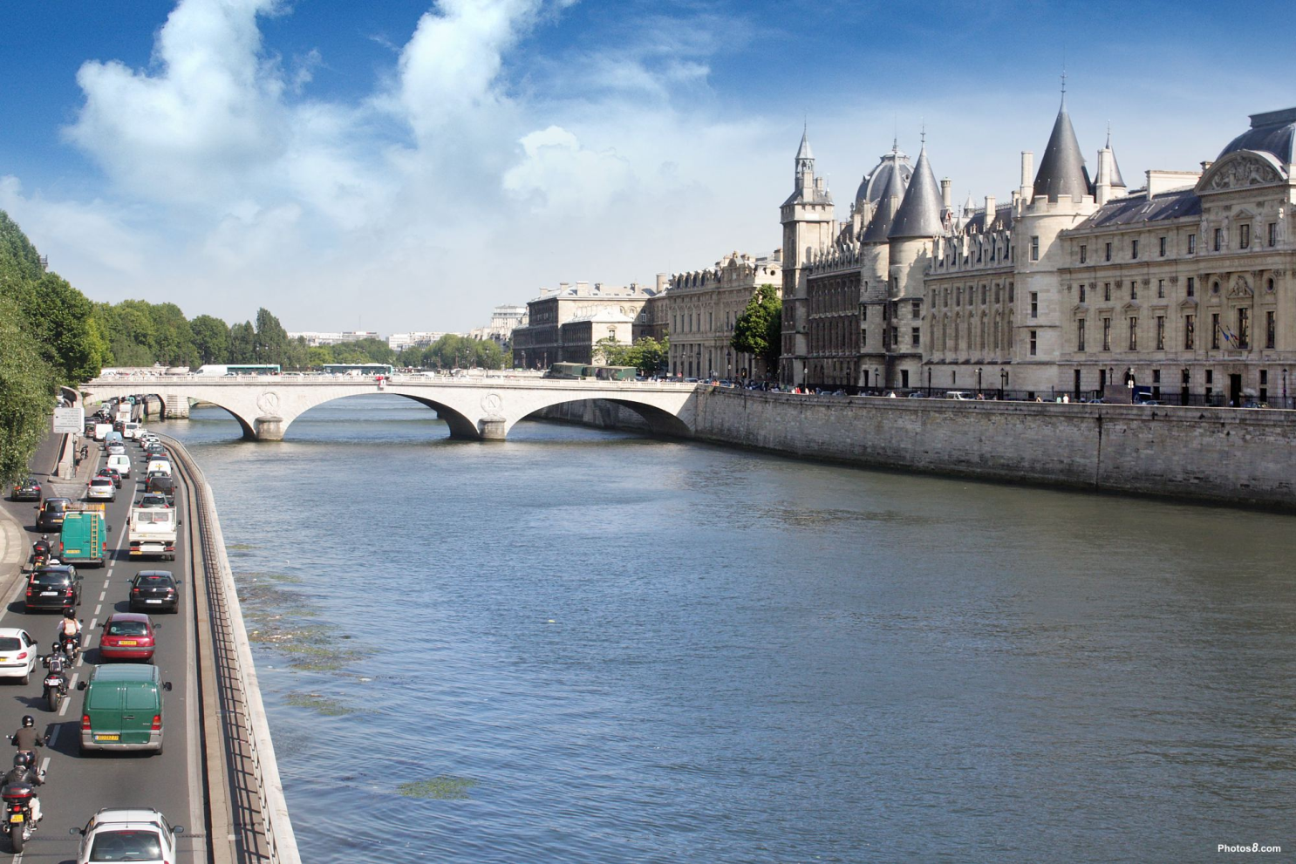
Notes:
Narrator: The rivers and streams of Interlaken was clear as crystal and blue with rich minerals. The rivers of cities like Paris and London are dirty like sewage.
Audio: Olympic Fanfare…Continuing
Transitions: Doors: Duration: 2 s
Animations:
Entrance Effect: Spinner: Picture 2
Exit Effect: Circle: Picture 2
Entrance Effect: Circle: Picture 3

Slide 7
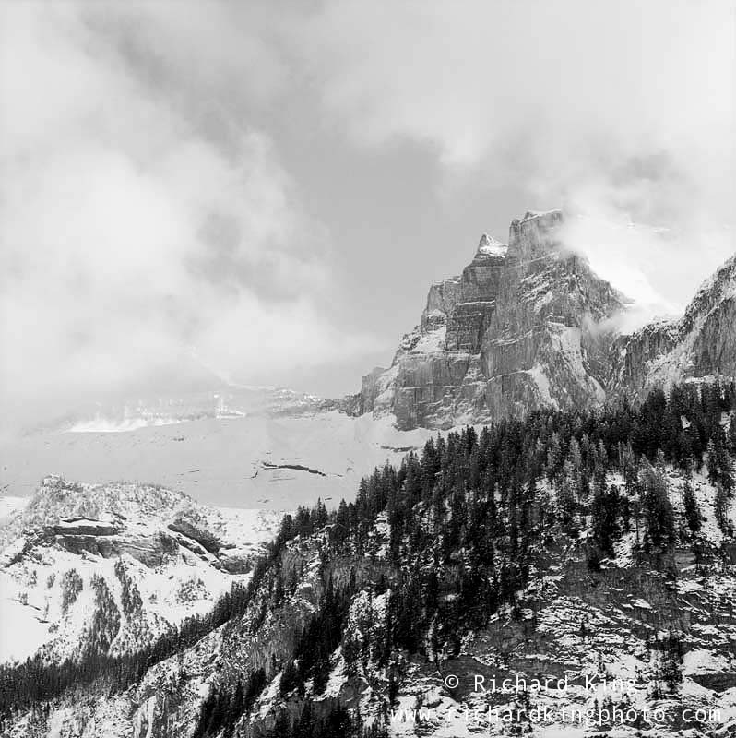
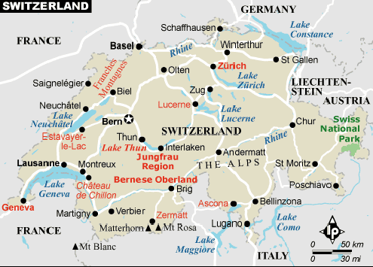
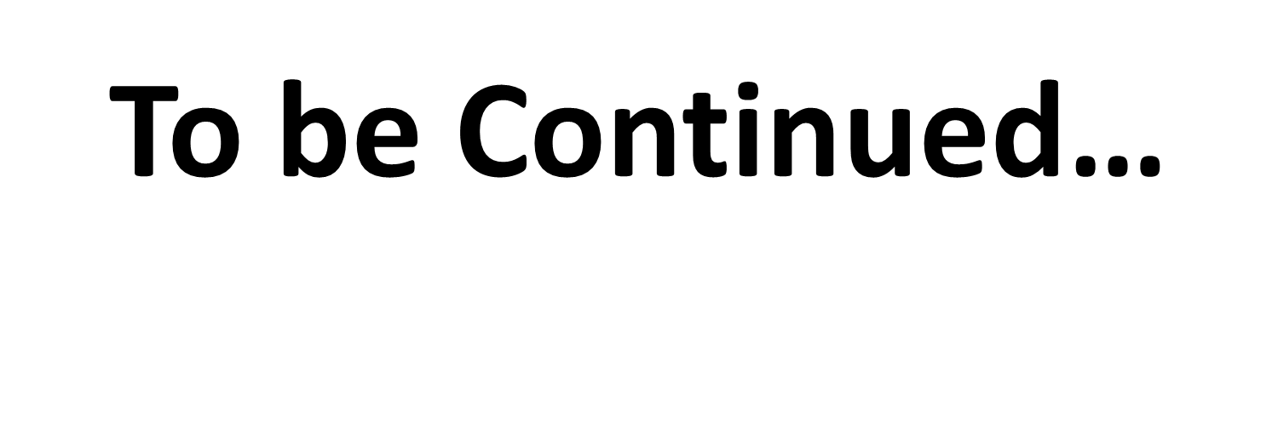
Notes:
Narrator: After one week, we had to leave. I desperately didn’t want to leave. But, we have to. I know that Switzerland is my favorite place in the world. I wonder if Interlaken is still like how it was before. I will visit someday… I will.
Audio: Olympic Fanfare…Continuing
Transitions: Box: Duration: 2 s
Animations:
Entrance Effect: Wheel: Picture 3
Exit Effect: Shrink and Turn: Picture 3
Entrance Effect: Fade: Picture 5
1. Entrance Effect: Zoom Picture 4
4. Entrance Effect: Fade: Picture 6

