Slide 1

MyIPFWAdvisor
Project Status Presentation,
6 February 2012

Slide 2
Who Are We?
Marat Kurbanov
  Project Leader, Application Architect, Web Developer
Trent Forkert
  Asst. Project Leader, System Architect, System Dev.
Alek Bouillon
  Network Architect, Web Developer
YeiSol Woo
  Database Manager, Business Logic Dev.
Connor Becker
  Documentation Manager, Business Logic Dev.

Slide 3
Outline
Project Recap
Member Status Reports
  Marat
  YeiSol
  Connor
  Trent
  Alek
Project Status
Questions

Slide 4
Project Recap
For Those Not Familiar With The Subject,

Slide 5
What is MyIPFWAdvisor?
The goal of the MyIpfwAdvisor project is to create an intelligent software system that will guide a student through course schedule construction from matriculation through graduation.
This will alleviate some of the pressure that advisors have been subjected to in recent years.
This will provide a standard first-response automated scheduling system for students.

Slide 6
Member Status Reports
To Get An Idea Of What We’ve Been Doing,

Slide 7
Marat Kurbanov
Created, Updated, and Modified Basic Flow Use Case Model

Slide 8
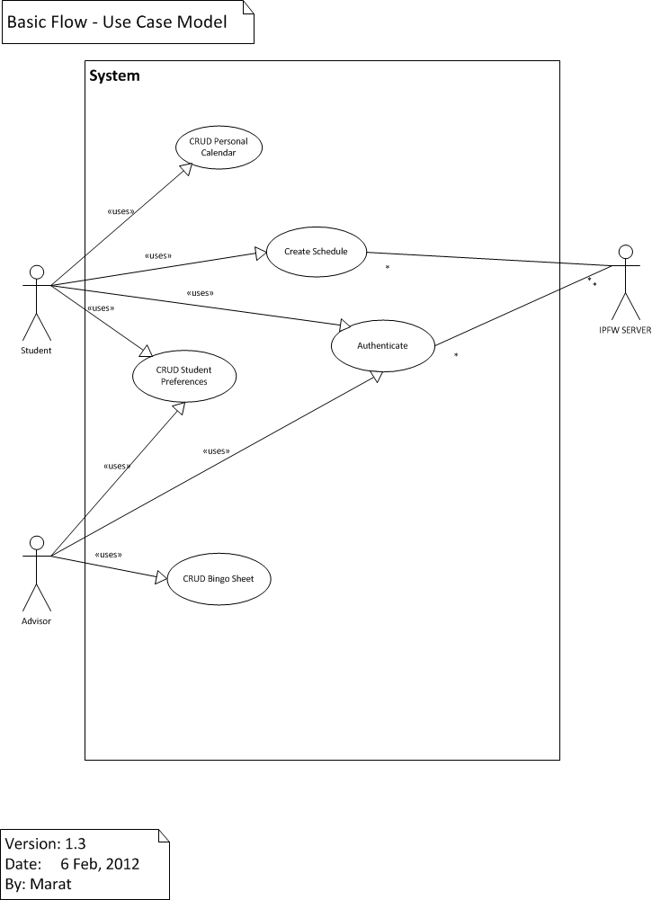

Slide 9
YeiSol Woo
Create Individual Cmap
Usecase Model/Specification: User Login

Slide 10
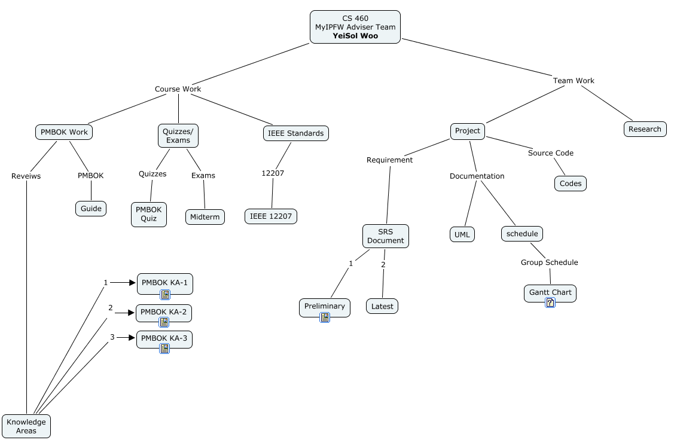
Individual Cmap

Slide 11
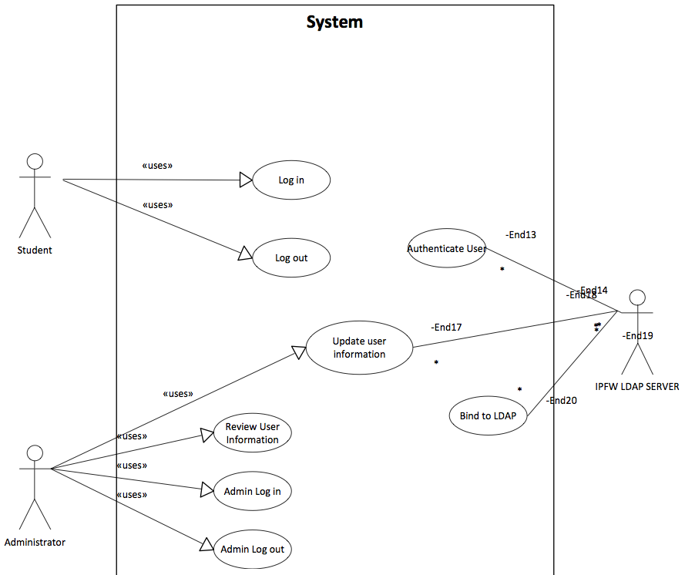
Usecase Model: User Login

Slide 12
Connor Becker
Helping get concept maps up and onto the public servers
Use-case specification for “Generate Student Preferences”

Slide 13
Student Preferences?
Hard Data
Soft Data
Enrollment information
Dates and Grades for Taken Classes
Class standing
Student Availability
  Specified as an iCalendar file
Particular Course Choices
  What science classes to take
  What electives, etc.
Min/Max Credit Hours

Slide 14
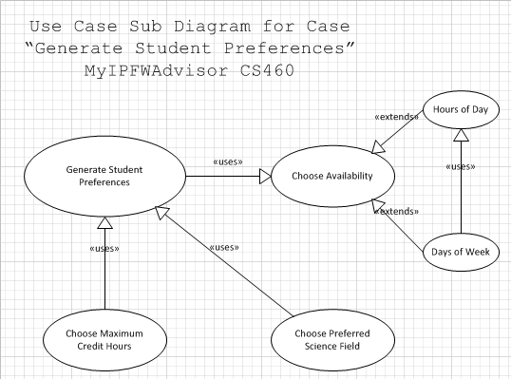
UML Use-Case Diagram

Slide 15
Trent Forkert
  Use-Case specification for "Generate Schedule"
  Setting up Git repository for source code management
    Eclipse Integration
    Basecamp Integration

Slide 16
Use-Case: Generate Schedule
  Connect the other parts of our system
    Preferences
    Bingo Sheet
    Course Schedule
    Sugar Constraint Solver
  Produce a potential schedule of courses

Slide 17
Git
  Private repository on Bitbucket
    Includes Issue tracker and Wiki
  Integration into Eclipse IDE
    Full SCM support
    Partial Issues support
  Integration into BaseCamp
    Posts commit messages to BaseCamp

Slide 18
Alek Bouillon

Slide 19
Project Status
To Get An Idea of Where We’re Going,

Slide 20
Project Status
Following our completion of use-case specifications, our project has moved into the RUP Construction phase.
In the process of building a tentative timetable (as a Gantt Chart) of how the sub-tasks will be scheduled
Our sponsor is confident we can get a working system up by the end of the semester!

Slide 21
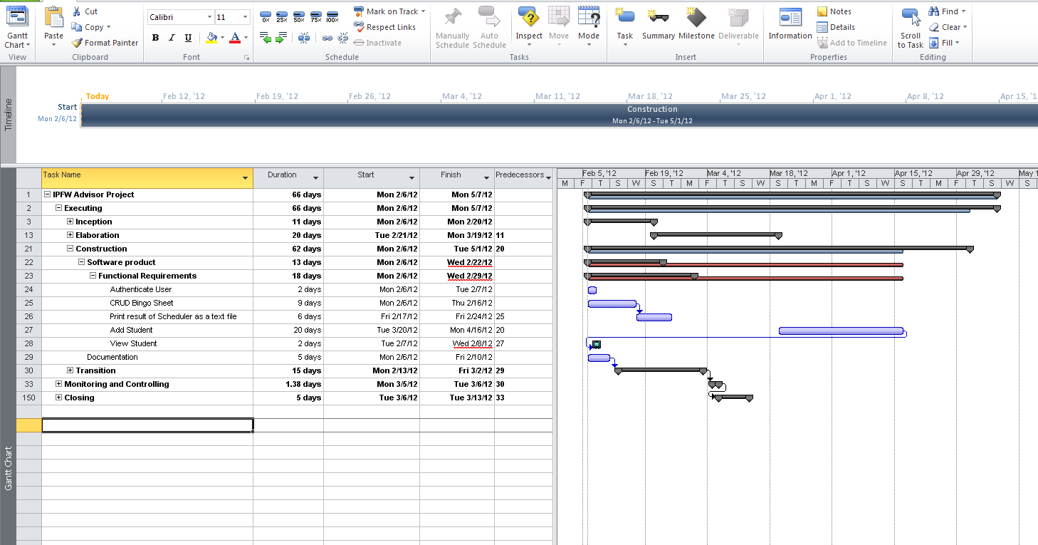
Working GANTT Chart

Slide 22
Questions?
To Reply to Any Concerns or Comments,

Slide 23
MyIPFWAdvisor
Thank You For Listening!

Slide 24

Project Demo

