Slide 1

MyIPFWAdvisor
Project Status Presentation,
24 February 2012

Slide 2
Who Are We?
Marat Kurbanov
  Project Leader, Application Architect, Web Developer
Trent Forkert
  Asst. Project Leader, System Architect, System Dev.
Alek Bouillon
  Network Architect, Web Developer
YeiSol Woo
  Database Manager, Business Logic Dev.
Connor Becker
  Documentation Manager, Business Logic Dev.

Slide 3
Outline
Project Recap
Member Status Reports
  Marat
  YeiSol
  Connor
  Trent
  Alek
Project Status
Questions

Slide 4
Project Recap
For Those Not Familiar With The Subject,

Slide 5
What is MyIPFWAdvisor?
The goal of the MyIPFWAdvisor project is to create an intelligent software system that will guide a student through course schedule construction from matriculation through graduation.
This will alleviate some of the pressure that advisors have been subjected to in recent years.
This will provide a standard first-response automated scheduling system for students.

Slide 6
Member Status Reports
To Get An Idea Of What We’ve Been Doing,

Slide 7
Marat Kurbanov

Slide 8
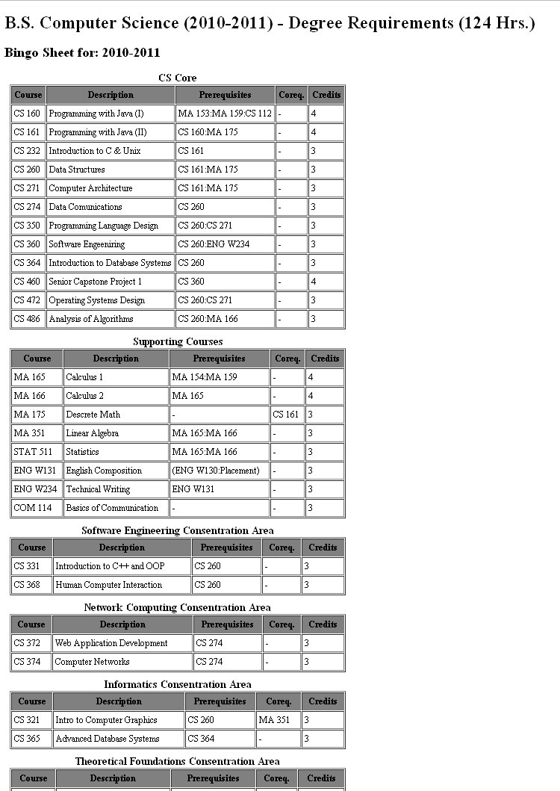
Display Bingo Structure

Slide 9
YeiSol Woo

Slide 10
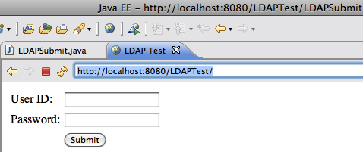
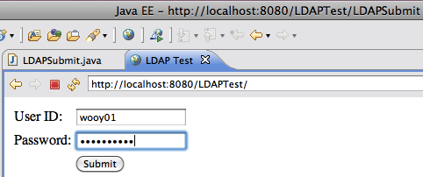
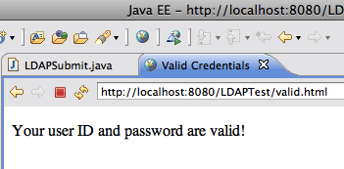
Verify Users’ Credentials
LDAP Bind is Successful !!

Slide 11
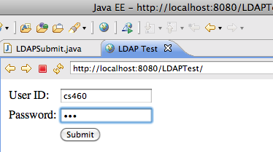
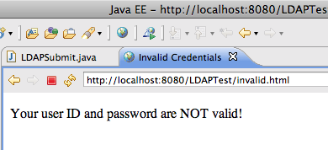
Verify Users’ Credentials
The LDAP bind is unsuccessful then the credentials are considered
invalid and no session is created for the user

Slide 12
For next couple of weeks…
Display a sample Bingo Sheet on the Web
Revise the Group Cmap

Slide 13
Connor Becker

Slide 14
Connor Becker
Data Model

Slide 15
Data Model
Representing bingo sheet “requirements” as database entries.
Using PostgreSQL 8.4 database server
Demo afterward, if time allows☺

Slide 16
Basic Flow of Data
When the system comes online, it queries the database for the root requirements for each degree.
  Using a lookup table for sub-requirements, it builds a hierarchy of requirements for each degree path
  Each sub-requirement has either sub-requirements to lookup or the id’s of “satisfiers” that could fulfill the req.
When a student logs in, the system queries the registrar’s database for courses the student has taken
  These are then encapsulated as “satisfier” objects in the system
  By reconciling these with the appropriate degree requirement hierarchy, a list of courses the student could take to finish the degree can be compiled

Slide 17
Trent Forkert

Slide 18
Trent Forkert
Still managing Git
Sugar CSP
Writing Business Rules

Slide 19
Sugar CSP
Understand Sugar CSP
How Prof Wolfe uses it
  Raw data -> usable calendar
"Become the expert"
  Answer team members' questions about Sugar

Slide 20
Writing Business Rules
Some Requirements can be complicated
Requirements with special rules
  Gen Ed
  Advanced Communication
  Lab Science
  No CS course with grade < C

Slide 21
Alek Bouillon

Slide 22
Alek Bouillon
Display Schedule on Screen

Slide 23
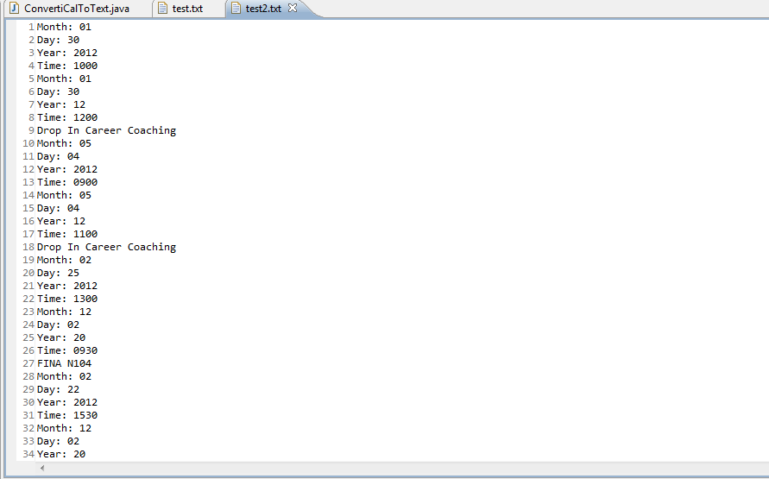
Alek Bouillon

Slide 24
Project Status
To Get An Idea of Where We’re Going,

Slide 25
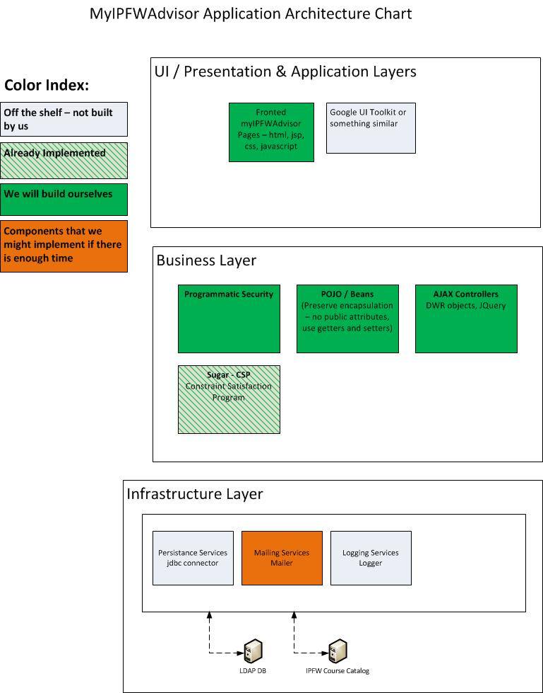
Application Architecture

Slide 26
Project Status
Waiting for Servers.......
  IPFW Registrar server finally back up yesterday
  Dr. Sedlmeyer and Trent to set up central PostgreSQL database server very soon
Working on connecting our individual work together

Slide 27
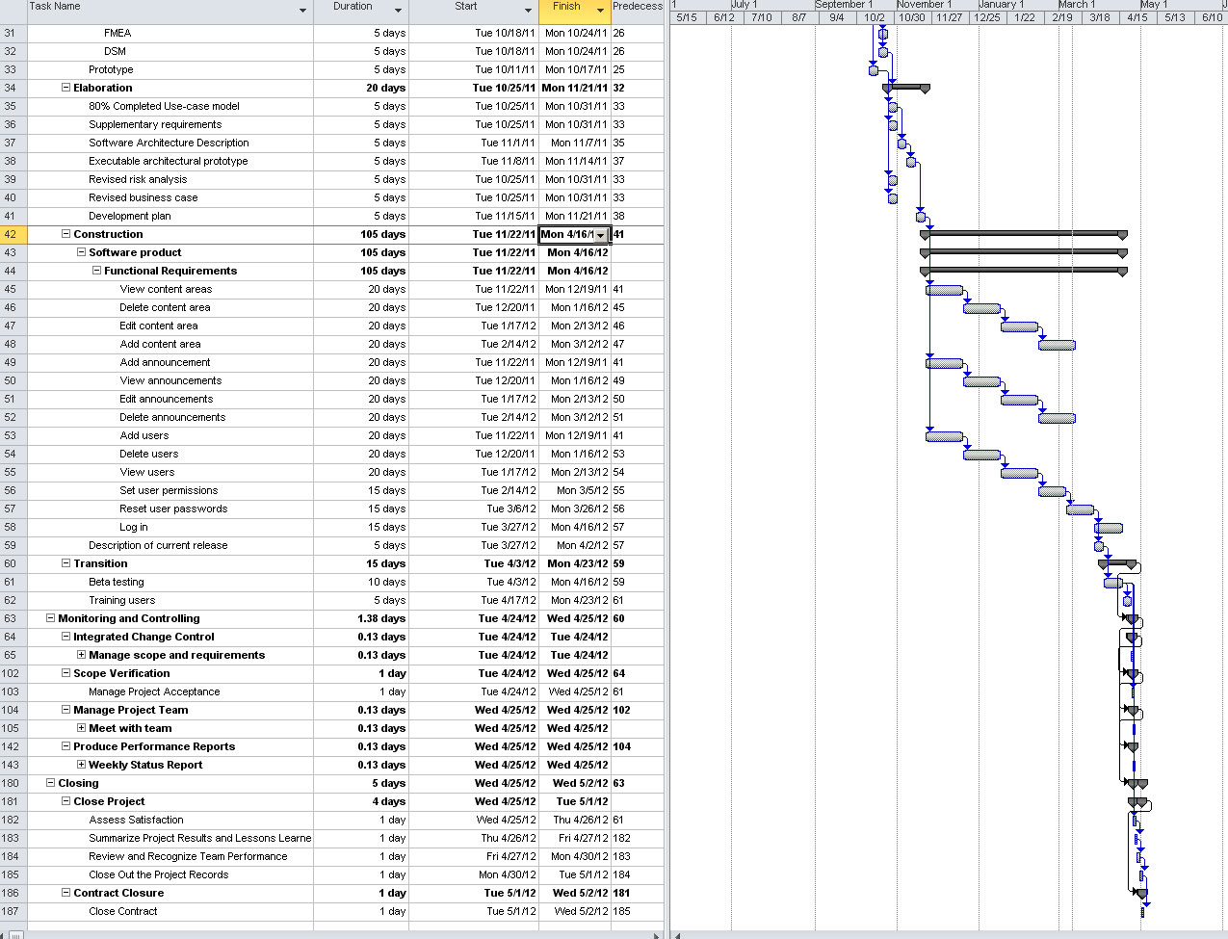
Gantt Chart

Slide 28
Questions?
To Reply to Any Concerns or Comments,

Slide 29
MyIPFWAdvisor
Thank You For Listening!

