Slide 1

MyIPFWAdvisor
Project Status Presentation,
2 April 2012

Slide 2
Who Are We?
Marat Kurbanov
  Project Leader, Application Architect, Web Developer
Trent Forkert
  System Architect, System Dev, Git Curator, DB Dev.
Alek Bouillon
  Network Architect, Web Developer
YeiSol Woo
  Web Developer, Business Logic Dev.
Connor Becker
  Asst. Project Manager, DB Dev., Business Logic Dev.

Slide 3
Outline
Project Recap
Member Status Reports
  Marat
  YeiSol
  Connor
  Trent
  Alek
Project Status
Questions

Slide 4
Project Recap
For Those Not Familiar With The Subject,

Slide 5
What is MyIPFWAdvisor?
The goal of the MyIPFWAdvisor project is to create an intelligent software system that will guide a student through course schedule construction from matriculation through graduation.
This will alleviate some of the pressure that advisors have been subjected to in recent years.
This will provide a standard first-response automated scheduling system for students.

Slide 6
Member Status Reports
To Get An Idea Of What We’ve Been Doing,

Slide 7
Marat Kurbanov

Slide 8
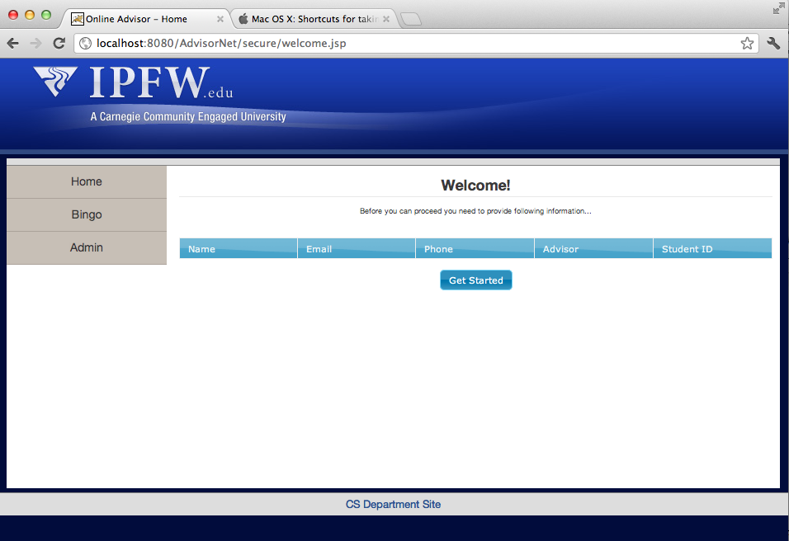
Welcome Page Prototype

Slide 9
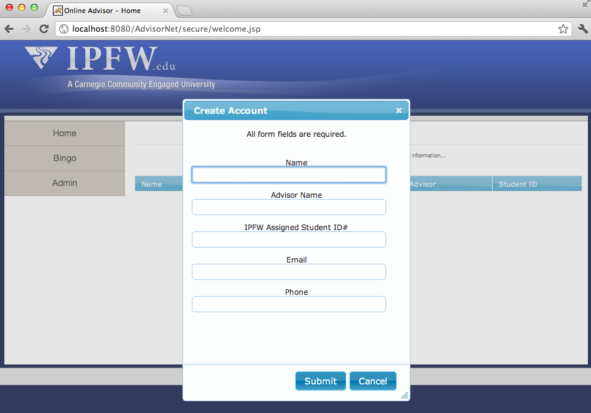
Create Student Profile Page

Slide 10
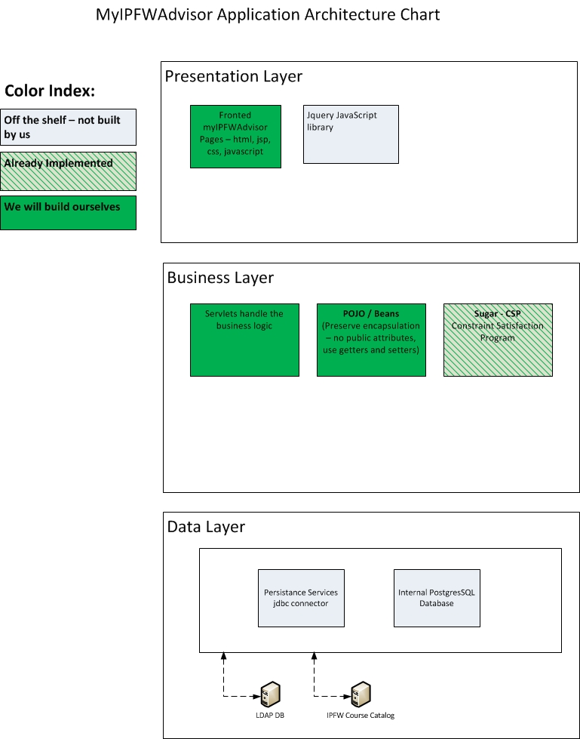
Application Architecture v-3

Slide 11
YeiSol Woo

Slide 12
Things I did for two weeks
Updating web design:
Create a general website template for myIPFW Advisor.
Change color scheme and style to better match IPFW’s style
Create some tabs on top to switch between different areas
Bingo sheet servlet to generate the sheet form the data model
Added a calendar to display the iCal calendars from the scheduler
Added a servlet filter to handle LDAP login for security

Slide 13
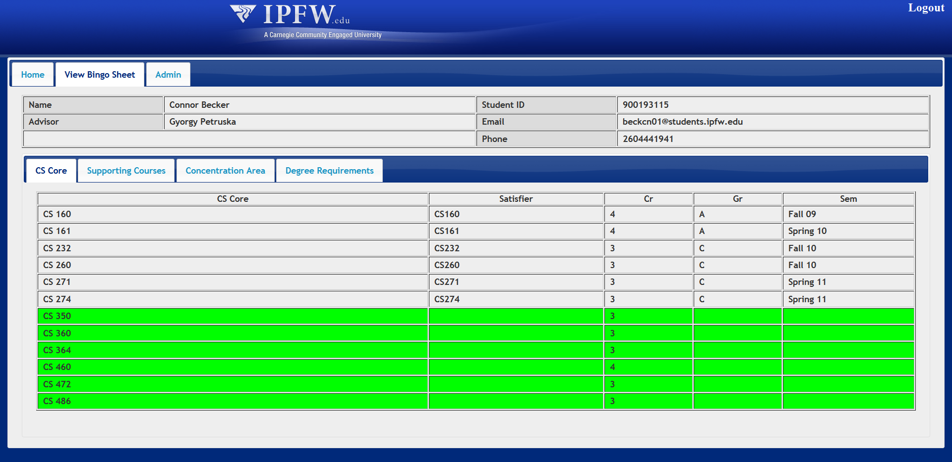
Displayed Bingo Sheet

Slide 14
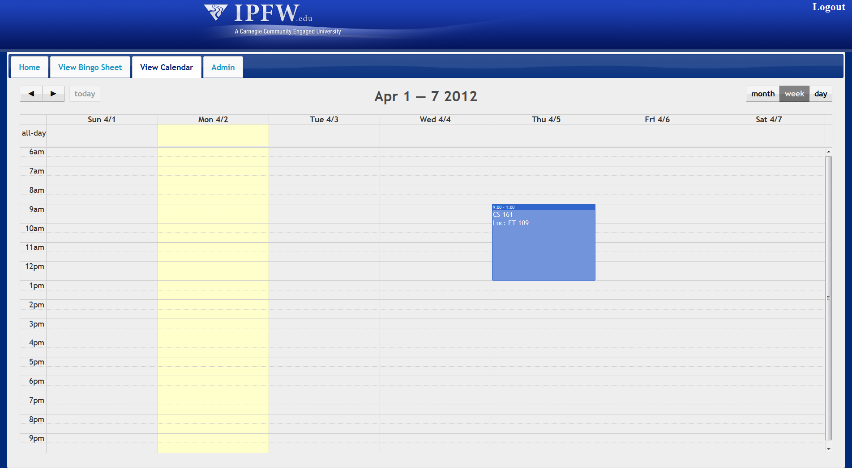
Displayed iCal

Slide 15
Connor Becker

Slide 16
Connor Becker
Combining BingoHeader, Requirement, and Satisfier
  Single class called “BingoSheet”
Designing and documenting API for BingoSheet, Requirement

Slide 17
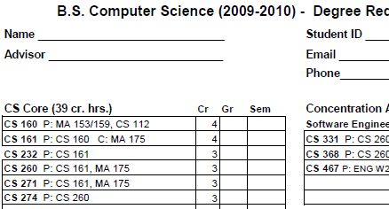
BingoSheet Class
BingoHeader
Requirements
Satisfiers
A F09

Slide 18
BingoSheet API
Defines access to resources, including object creation
  Since data is pulled from database and potentially could not exist, using factory methods to create objects—if this returns null, a protocol is in place to allow “new” object creation
This allows database access to take place behind the scenes, and for modularization of data
  Single bingo sheet header, etc.

Slide 19
Trent Forkert

Slide 20
Trent Forkert
Postgres/git maintenance
Business Rules
Bingo Selection UI

Slide 21
Business Rules
Gen Ed course information not in database
Fake Gen Ed rules
  10 hard-coded courses
  No actual SQL right now

Slide 22
Bingo Selection UI
HTML & JS version of the bingo sheet
User can select what course is used to satisfy a given requirement
Includes checkbox to enable/disable a given requirement
The information gathered will be passed to Sugar to generate the schedule

Slide 23
Alek Bouillon

Slide 24
Tasks
Extract course information from iCal file: done
Create a course from the information: done
Place the information into Schedule object: done
Display the schedule object on screen: done
Refine appearance and merge with project

Slide 25
Extract Info from iCal
Created a servlet to extract information
Servlet reads the file
Scans for specific tags and parses the info from them
Sends info to Schedule class to construct a class

Slide 26
Display Schedule
Created jsp to display schedule using jstl
Will look similar to summary schedule on myIPFW when completed

Slide 27
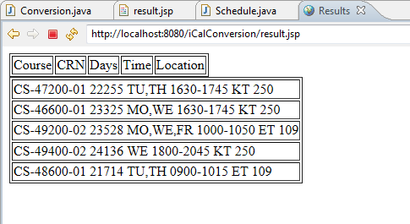
Display Schedule

Slide 28
Project Status
To Get An Idea of Where We’re Going,

Slide 29
Project Status
Finally connecting our individual work together!

Slide 30
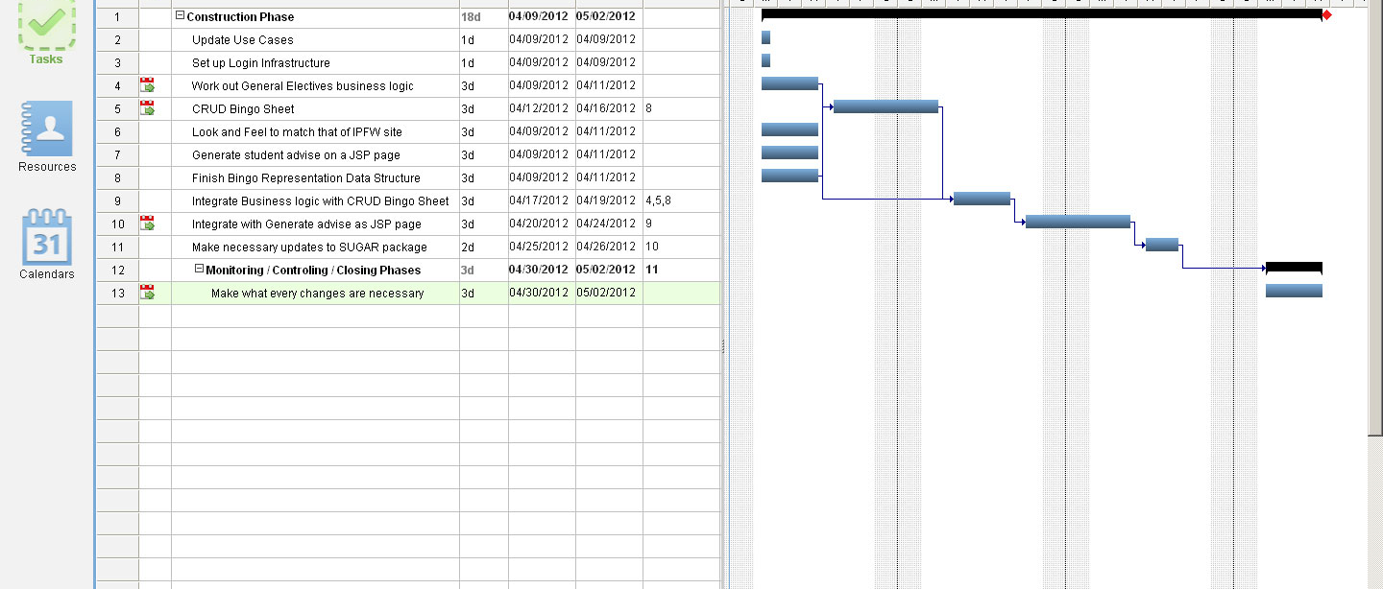
GANTT

Slide 31
Questions?
To Reply to Any Concerns or Comments,

Slide 32
MyIPFWAdvisor
Thank You For Listening!

