Slide 1


Simple Pleasures
Notes:
Narration (Title):
Simple Pleasures
Audio:
Nil
Transitions:
Style: Shape . . . Duration: .50. . . Slide Range: Throughout
Animations:
Nil
Shots List:
Transitions / Effects:
Audio:

Slide 2
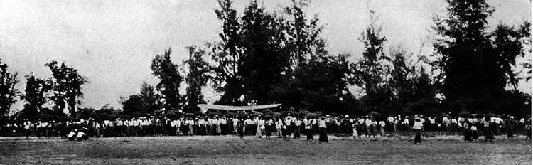
Notes:
Narration:
It was a cold and rainy day in Adelaide. A parade marched steadily towards the aerodrome to honor Australian born, Charles Kingsford Smith, who had recently flown 10,000 miles across the Pacific to win the first England to Australia air race. To the bellowed commands of a regimental sergeant, a stony-faced police corps marched resolutely forward, trying not to acknowledge the water that poured from the brims of their hats or the sodden uniforms that clung to their skin.
Audio:
Music: Pachelbel's Canon in D major . . . Beginning
Transitions:
. . . Throughout
Animations:
Nil

Slide 3
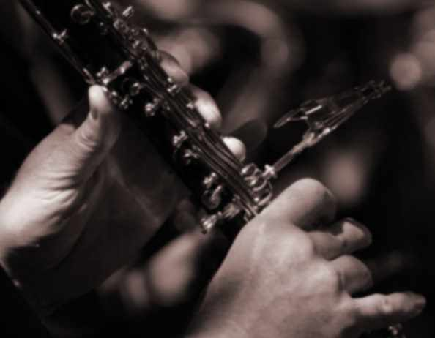
Notes:
Narration:
A man stood on a verandah watching the parade and with a wry twinkle in his eye began a rousing clarinet rendition of 'A Policeman's Lot is Not a Happy One.'
Audio:
. . . Continuing
Transitions:
. . . Throughout
Animations:
Emphasis Effect: Grow/Shrink . . . Duration: 5.00

Slide 4
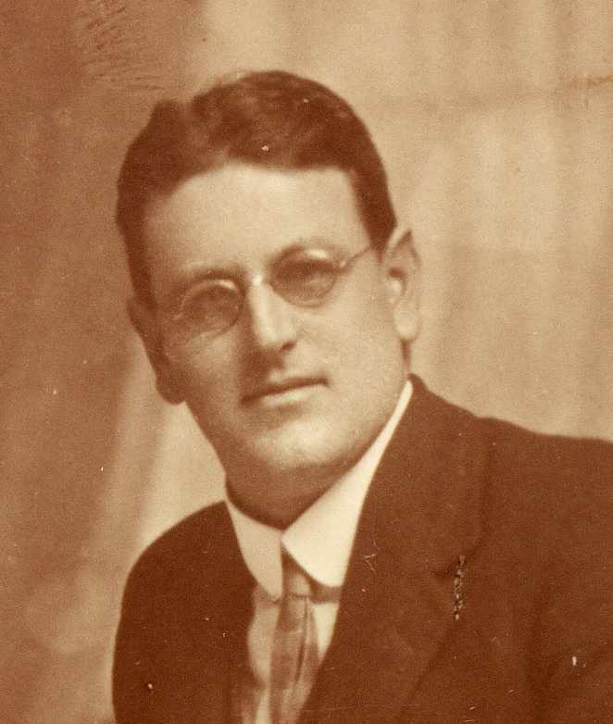
Notes:
Narration:
The man? - My grandfather - Charles Frederick Howard Stevens. An accountant by trade, this was no ordinary man. Charles was an actor, sportsman, organist, conductor, and toast of the town. Crowds would flock to the Town Hall to enjoy his Bach Society concerts. Crowds would flock to congratulate him after his performances with celebrated guests such as Percy Grainger, and crowds would follow him home after choir rehearsal, with hopes of supper and a rollicking sing-along around the piano in his parlor.
Audio:
. . . Continuing
Transitions:
. . . Throughout
Animations:
Emphasis Effect: Grow/Shrink . . . Duration: 2.00

Slide 5
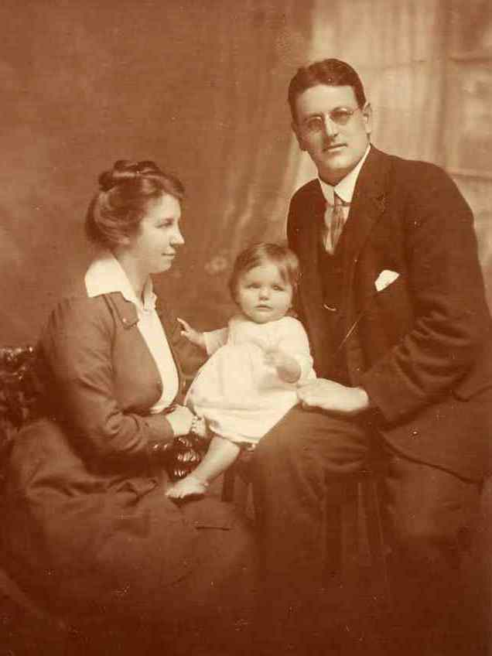
Notes:
Narrations:
Into this colorful world was born my father - a quiet child - strangely ill-fitted for the life that he was to inherit.
Audio:
. . . Continuing
Transitions:
. . . Throughout
Animations:
Nil

Slide 6
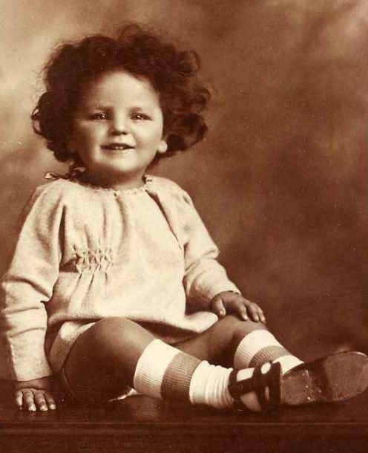
Notes:
Narration:
Amidst the bustle and glamour of his father's remarkable life, dad found pleasure in the simpler things in life …
Audio:
. . . Continuing
Transitions:
. . . Throughout
Animations:
Nil

Slide 7
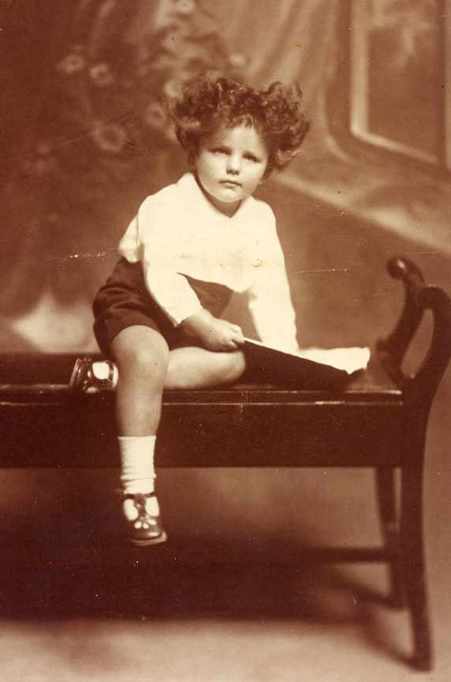
Notes:
Narration:
his books,
Audio:
. . . Continuing
Transitions:
. . . Throughout
Animations:
Nil

Slide 8
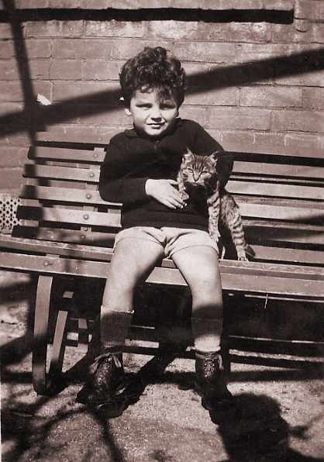
Notes:
Narration:
his kitten,
Audio:
. . . Continuing
Transitions:
. . . Throughout
Animations:
Nil

Slide 9
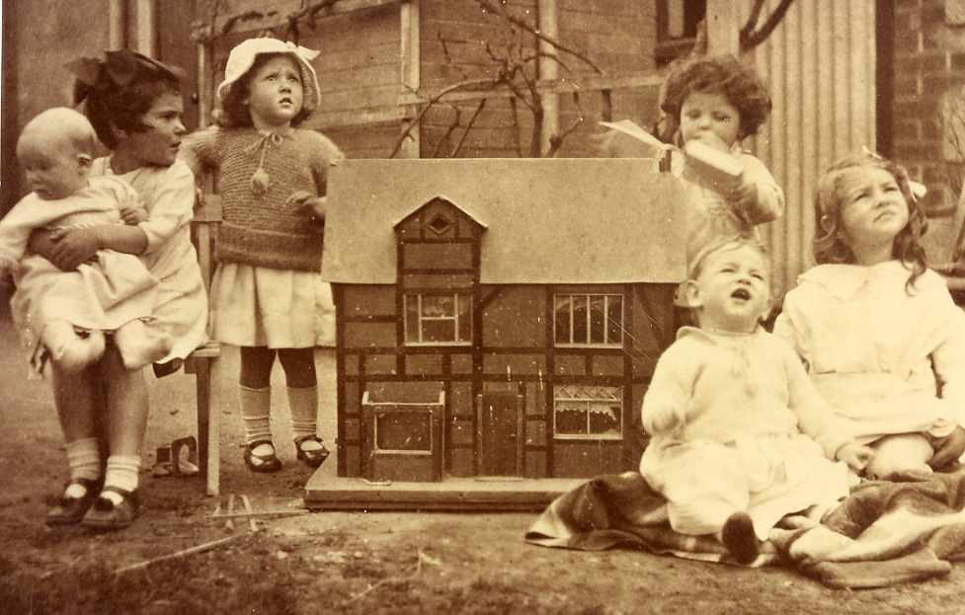
Notes:
Narration:
playtime with his young cousins,
Audio:
. . . Continuing
Transitions:
. . . Throughout
Animations:
Nil

Slide 10
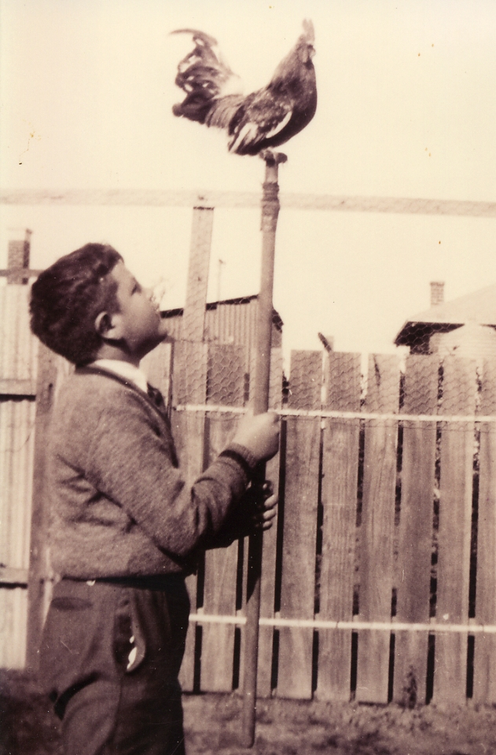
Notes:
Narration:
and his pet rooster. He looked forward to visits from the ice man, and the gruff old vendor of the rabbit truck, and sleepy church picnics when he and his friends would ride on a jinker into the botanic gardens.
Audio:
. . . Continuing
Transitions:
. . . Throughout
Animations:
Emphasis Effect: Grow/Shrink . . . Duration: 2.00

Slide 11
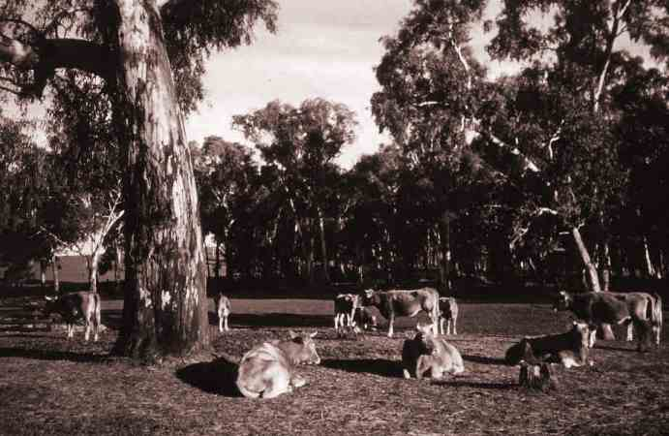
Notes:
Narration:
It was the quiet moments in life that my father recalled most fondly - watching the cows at his uncle's farm, making a box kite with his cousin Biddy,
Audio:
. . . Continuing
Transitions:
. . . Throughout
Animations:
Nil

Slide 12
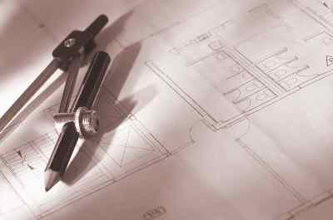
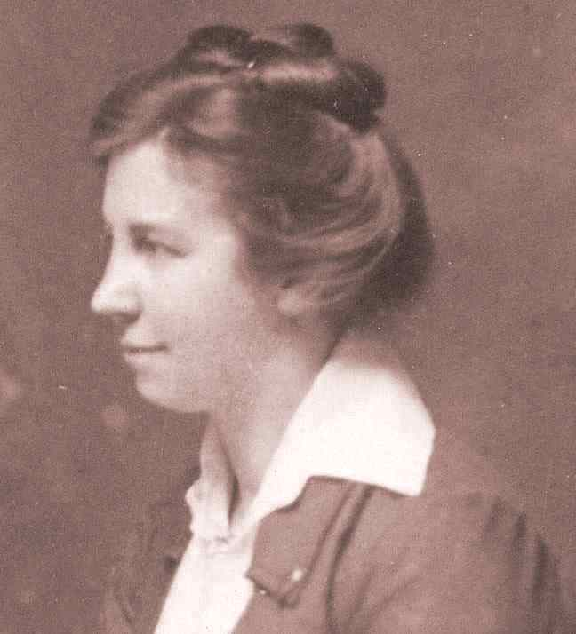
Notes:
Narration:
and stolen moments seated at his mother's side as she drew up blueprints for the houses that she designed.
Audio:
. . . Continuing
Transitions:
. . . Throughout
Animations:
Nil

Slide 13
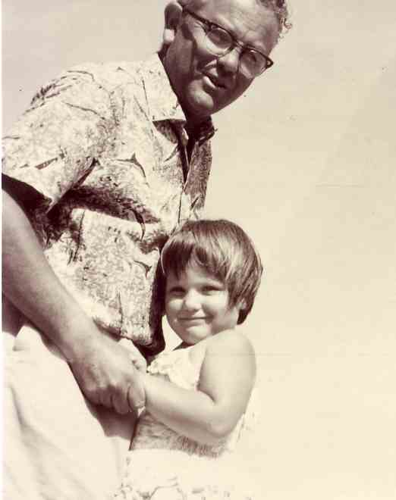
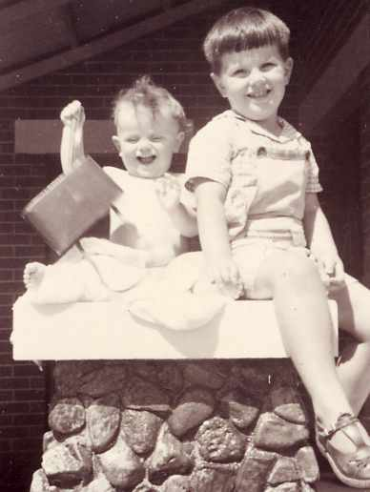
To be continued …..
Notes:
Narration:
Years later, with a family of his own, my father was to pass on this legacy of simple pleasures.
Audio:
. . . Continuing
Transitions:
. . . Throughout
Animations:
Dad and Me: With Previous Emphasis Effect: Spin . . . Direction: From Bottom . . . Duration: 2.00
Boys: After Previous Entrance Effect: Fly In . . . Direction: From Bottom . . . Duration: 3.00
Entrance Effect: After Previous Entrance Effect: Fly In . . . Direction: From Bottom . . . Duration: 3.00

Slide 14
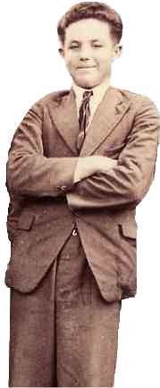
Credits
Photographs are from the family archives of:
Charles Frederick Howard Stevens
John Ockley Stevens
Brenda Smith
Additional photographs:
clipart.com:
<http://www.clipart.com>
Pachelbel’s Canon in D major arranged for four hands piano:
MIDI DataBase
<http://www.mididb.com>
Notes:
Narration:
Nil
Audio:
Transitions:
Animations:
With Previous: Credits (Animation Scheme)

