Slide 1
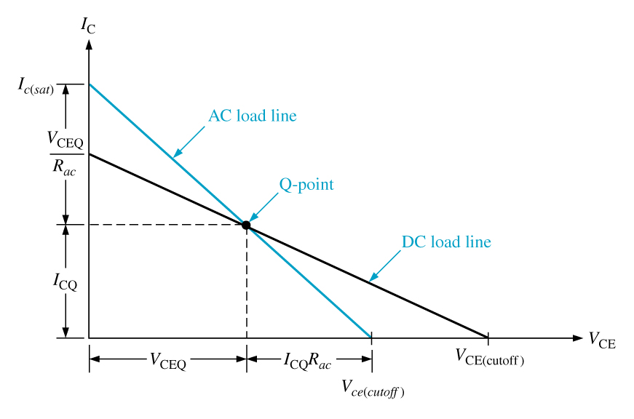
The AC Load Line
The endpoint values on the ac load line are found using:

