Slide 1
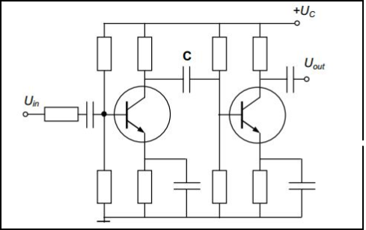
Two-stage amplifier
To improve amplifier performance, stages are often cascaded where the output of one drives another.

