Slide 1
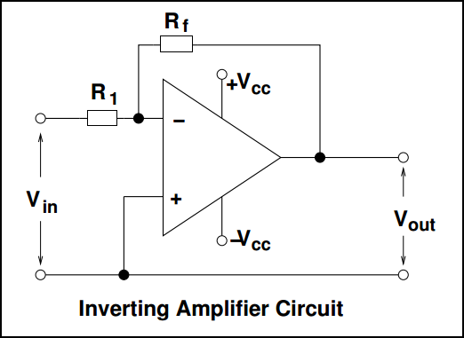
Inverting amplifier
It inverts and scales the input signal. As long as the op-amp gain is very large, the amplifier gain is determined by two stable external resistors (the feedback resistor R_{f} and the input resistor R₁)
and not by op-amp parameters which are highly temperature dependent:

