Slide 1
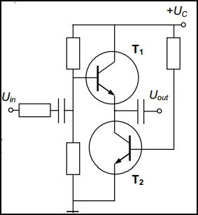
cascode amplifier
An amplifier with the same dc current flowing through both devices. The lower transistor T2 having CE connection plays a role of an active load for the upper CB-connected transistor -T1, therefore, the input impedance of the amplifier is raised. The common base resistive divider defines the dc mode of operation. whereas the coupling capacitor determines the ac mode.
The main idea of this circuit is the decrease of parasitic coupling between the input and the output because the constant voltage of the base T1 supplies T2. Accordingly, the collector of T2 is short circuited and its amplification is near 1. The circuit is preferable in the resonant amplifiers, particularly in the high frequency receivers.

