Slide 1
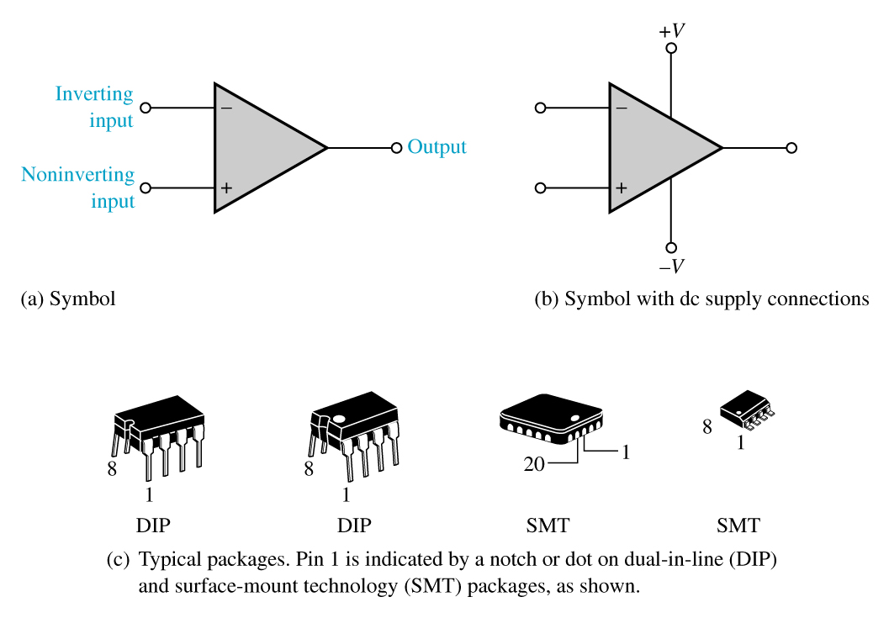
Operational Amplifiers
A high-gain dc amplifier that has extremely high voltage gain, high input impedance, and low output impedance is called an operational amplifier.
The term “operational” is used because these amplifiers were initially used in mathematical operations.

Slide 2
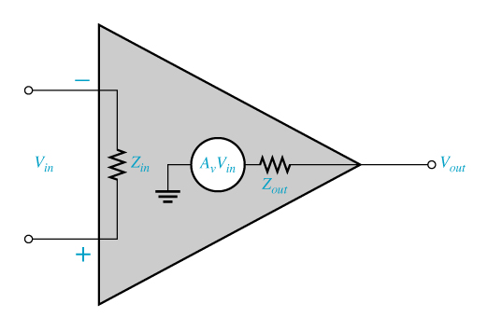
Practical op-amp characteristics
Op-amps have both voltage and current limitations.
For example:
Peak-to-peak output voltage is usually limited to slightly less than the difference between the two supply voltages.
Output current is limited by internal restrictions such as power dissipation and component ratings.
Characteristics of a practical op-amp are high voltage gain, high input impedance, low output impedance, and wide bandwidth

Slide 3
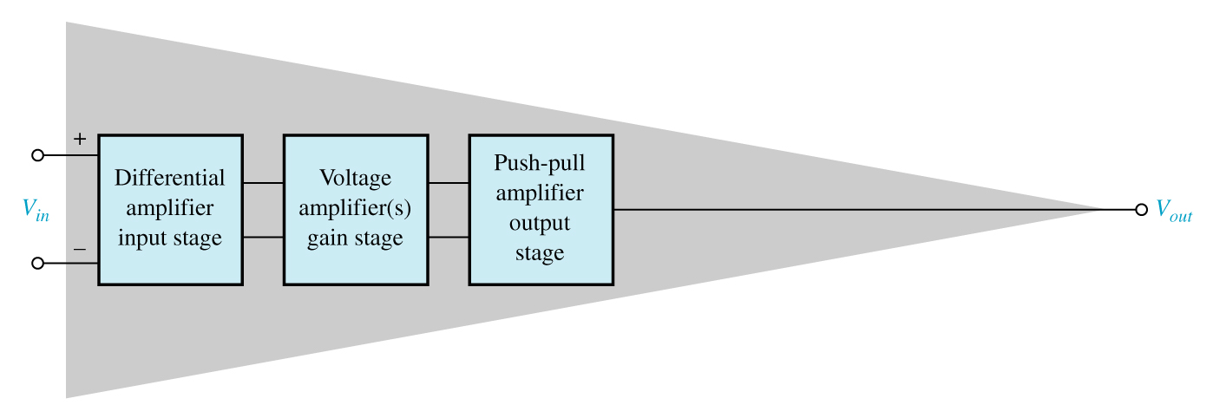
Op-Amp Internal Block Diagram
A typical op-amp is made up of three types of amplifier circuits: a differential amplifier, a voltage amplifier, and a push-pull amplifier.

