Slide 1
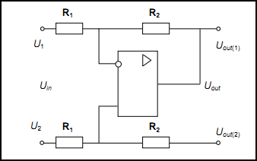

Feedback differential amplifier
An op amp connected as a diff amp with the balanced supply is demonstrated. It amplifies Uin, that is the difference between U1 and U2. The output voltage is given by Uout=KUin
where K = R2 /RI. When U2 is zero. the circuit becomes an inverting amplifier with
When both inputs are presented,

