Slide 1
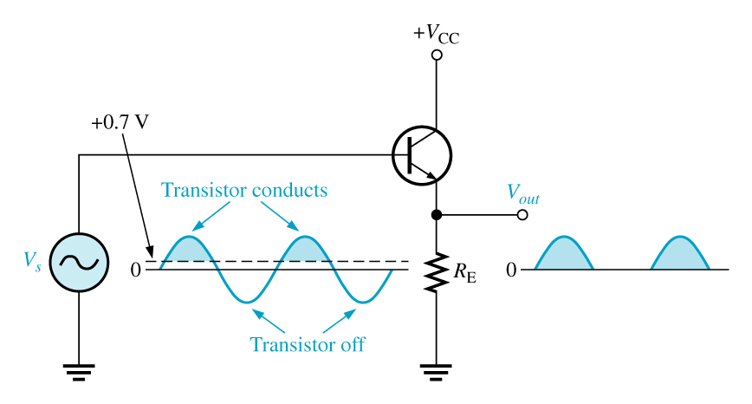
Class b amplifier
An amplifier that has two transistors, each biased to operate in the linear region for 180° of the input cycle and in cutoff for the other 180°.
Since a transistor operating in class B conducts for only 180º of its input cycle, two transistors are required to replicate a complete cycle of the amplifier input; one amplifies the positive cycle and the other amplifies the negative cycle.

Slide 2
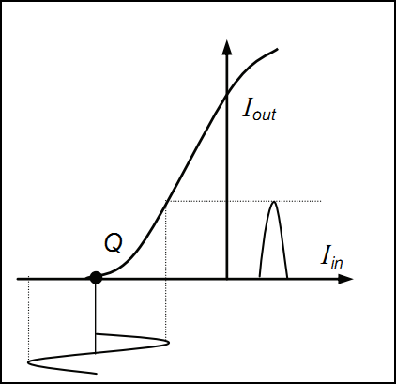
The efficiency is higher (45 to 70%) than in class A amplifier, for this reason they are often used as the balanced output stages.
The output current is almost zero, when the alternating signal is removed or negative. With a sinusoidal signal applied, the output consists of series of half-sine waves

