Slide 1
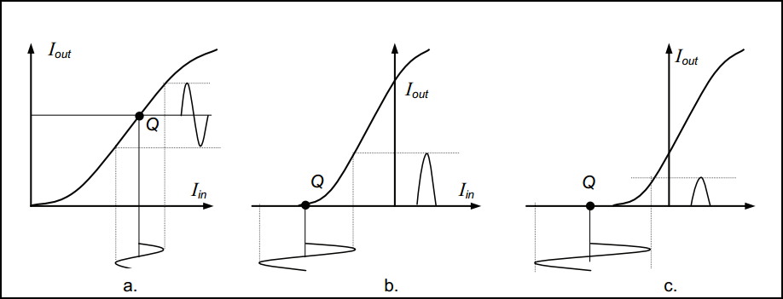
Classes of amplifiers
Amplifiers are classified according to the polarity and properties of the output current or voltage. Their characteristics cover one, two, or four quadrants on the axes plane.
It is common knowledge that amplifiers are divided into three general classes: A. B, and C, depending on the type of service in which they are to be used.

