Slide 1
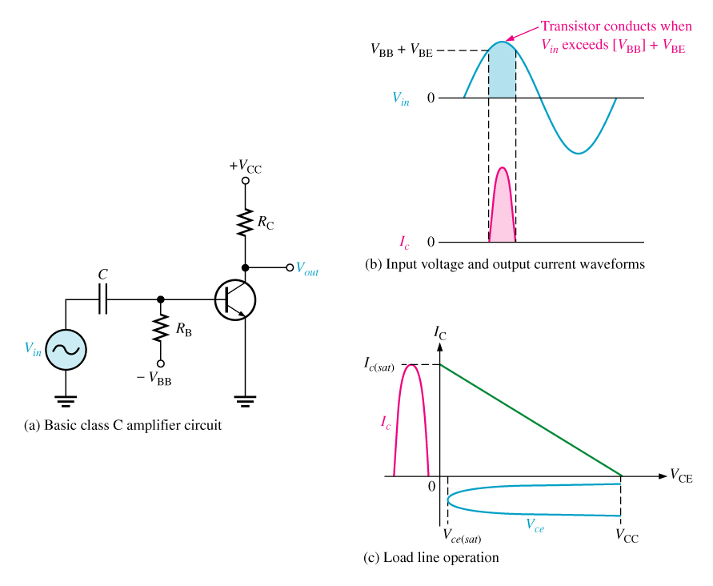
Class C amplifier
An amplifier having a single transistor that conducts for fewer than 180º of the ac input cycle.

Slide 2
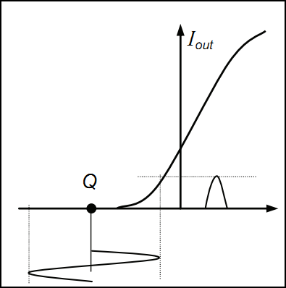
A class C amplifier operates with a negative bias essentially less than cutoff. It passes the current during the part of the positive alternation only.
The output current has narrow width and its shape distortion is maximum.
Its high efficiency (70 to 90 %) is the primary considerations at radio frequencies higher than 20 kHz.

