Slide 1
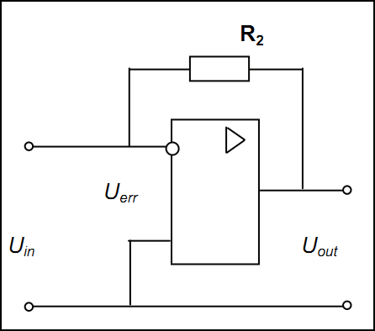
Current Feedback op amps
Current Feedback op amps enable operation at higher speeds. Traditionally they have wider bandwidths and higher slew rates than voltage feedback amplifiers and do not feature a Gain Bandwidth restriction associated with Voltage Feedback op amps.
An amplifier with the inverting voltage feedback is illustrated below:
Here, the output voltage drives a feedback resistor R2, which is connected to the inverting input, and the voltage gain is independent on the error. Instead of acting like a voltage amplifier, an amplifier with an inverting voltage feedback acts like an ideal current-to-voltage converter, a device with a constant ratio of output voltage to the input current.

