Slide 1

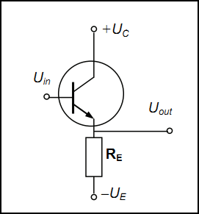
Emitter follower
The voltage gain is ultra stable and close to 1, current gain is much higher and bith are defined as:
The output impedance of this circuit is significantly lower than the input impedance. That is, the circuit is especially useful to decrease the output resistance of the electronic device. Another benefit of the circuit is that almost no distortion of the signal occurs. That is why the emitter follower is often used as an intermediate stage of a power amplifier for current amplification.

