Slide 1
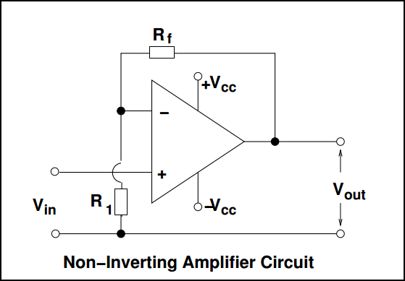
Non-Inverting amplifier
Amplifies a voltage (multiplies by a constant greater than 1).
The gain of the inverting amplifier is given by:

