Slide 1
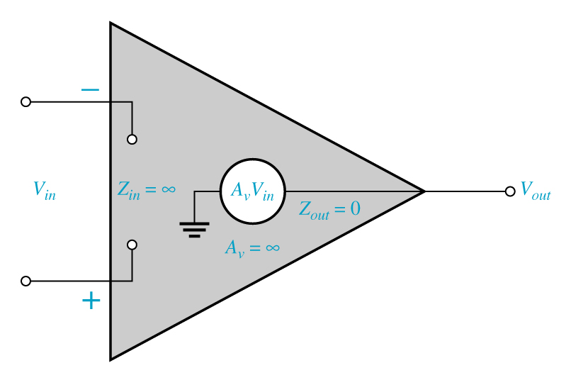
Ideal Op-Amp Characteristics
The op-amp is an IC amplifier that has the following ideal characteristics:
Infinite voltage gain
Infinite input impedance
Zero output impedance

Slide 2
Some of the general characteristics of the IC version are:
High gain, on the order of a million
High input impedance, low output impedance
Used with split supply, usually +/- 15V
Used with feedback, with gain determined by the feedback network

