Slide 1
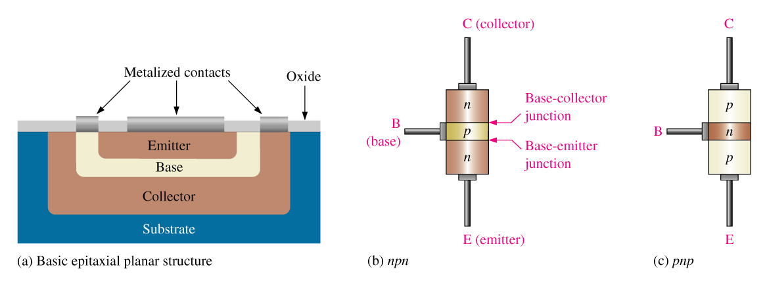
Bipolar Junction Transistors (BJTs)
The bipolar junction transistor (BJT) is constructed with three doped semiconductor regions called emitter, base, and collector. These three regions are separated by two pn junctions: The base-emitter junction and the base-collector junction.

Slide 2
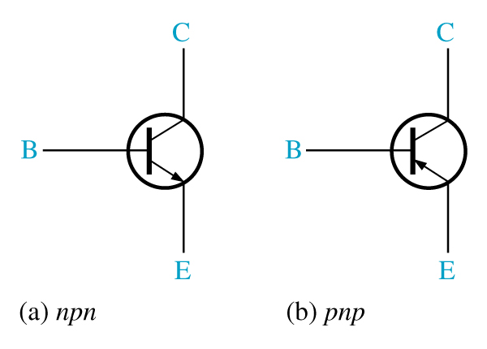
BJT Symbols
The transistor symbol indicates the structure of the component.
The transistor on the left is an npn transistor. It has n-type emitter and collector materials, and a p-type base material.
The transistor on the right is a pnp transistor. It has p-type emitter and collector materials, and an n-type base material.

