Slide 1
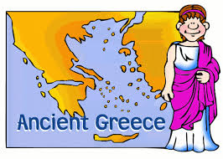
Landscapes in Ancient Greece

Slide 2
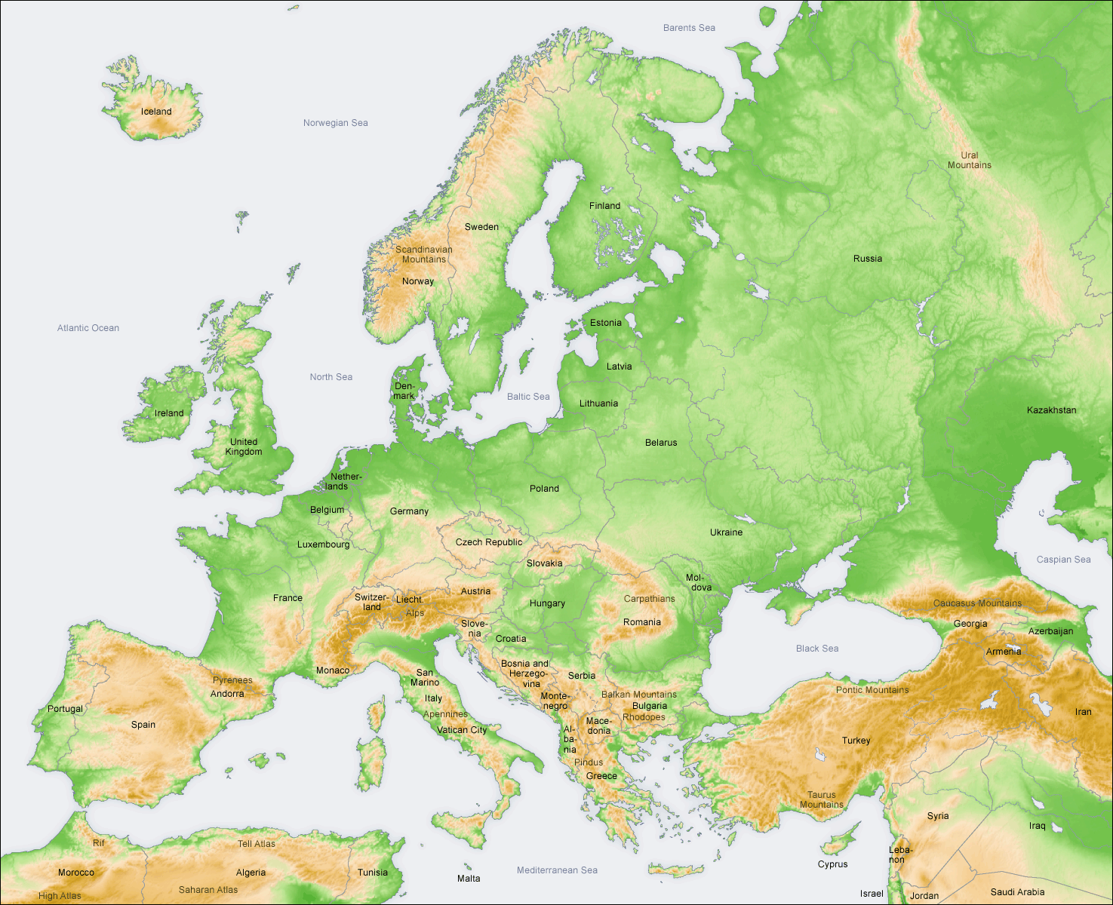
Greece is a small country in south-east of Europe.
Greece is near the Mediterranean Sea.

Slide 3
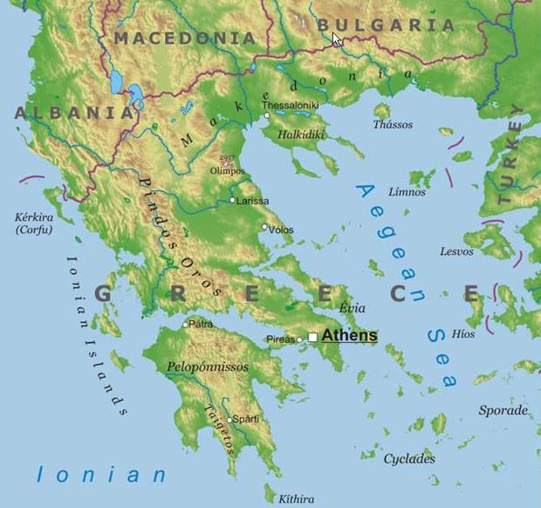
The main part of Greece is a peninsula.
The rest of Greece is made up of islands.

Slide 4
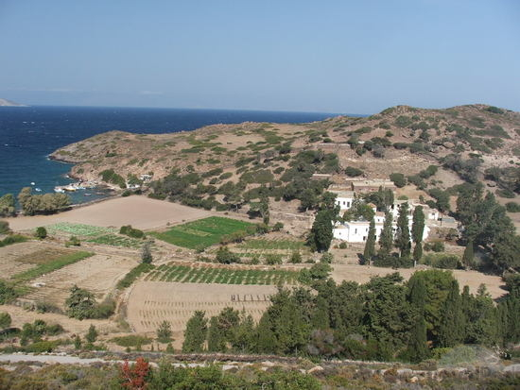
Greece has a Mediterranean climate: winters are not cold and summers are hot and dry.
There is not much *spring water in Greece.
*spring water: water for people, animals and plants.

Slide 5
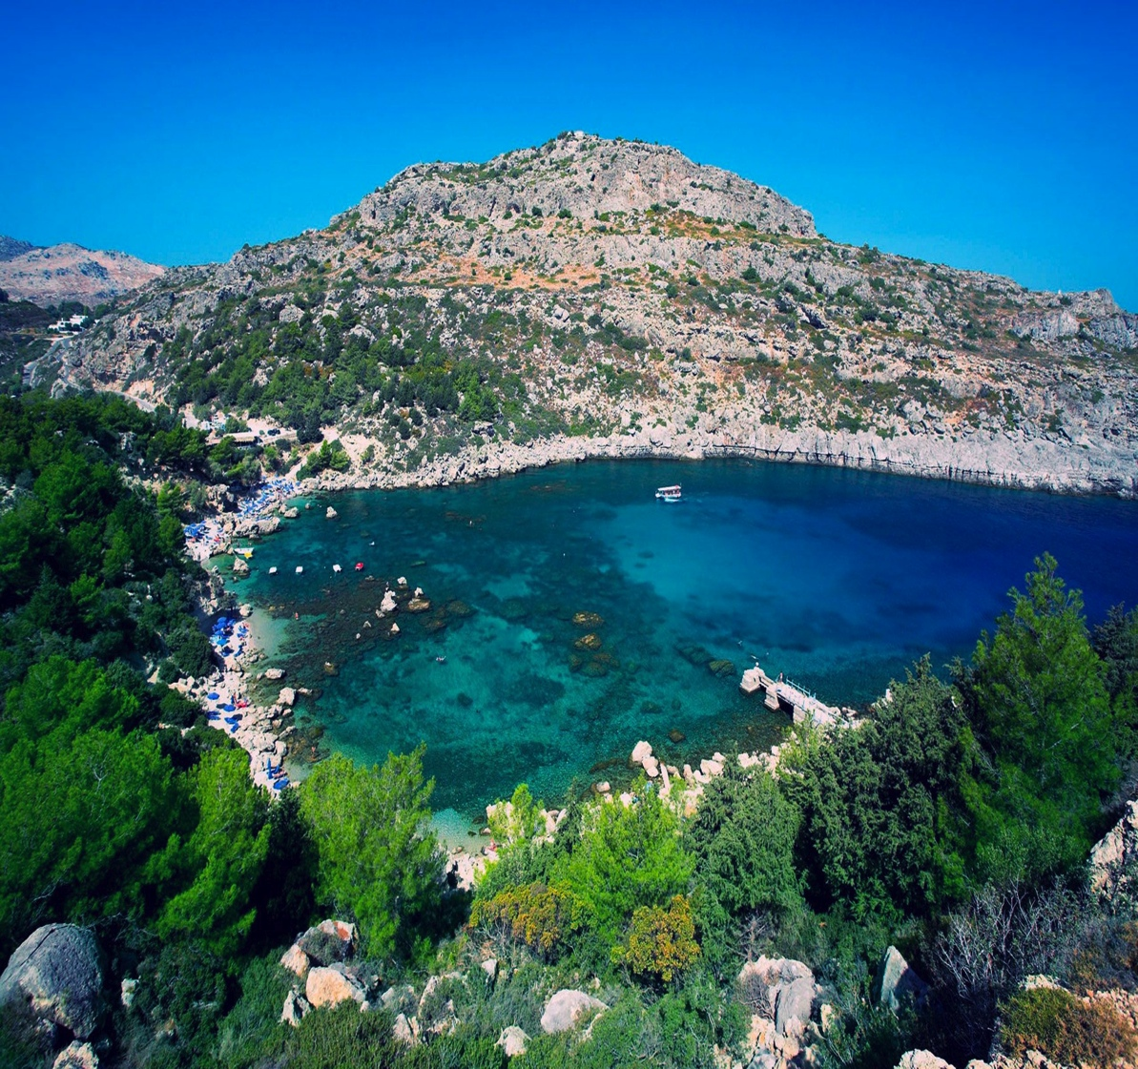
Greece landscape is very scenic.
There are many mountains, valleys and coasts.

Slide 6
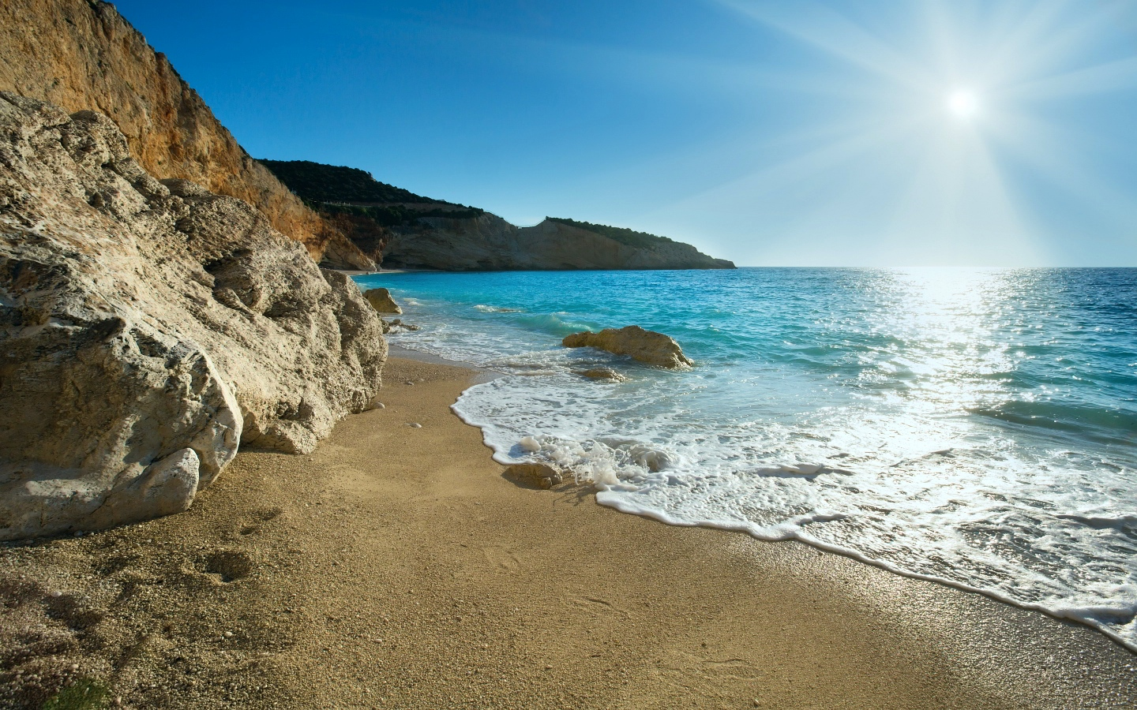
No part of Greece is far from the coast.

Slide 7
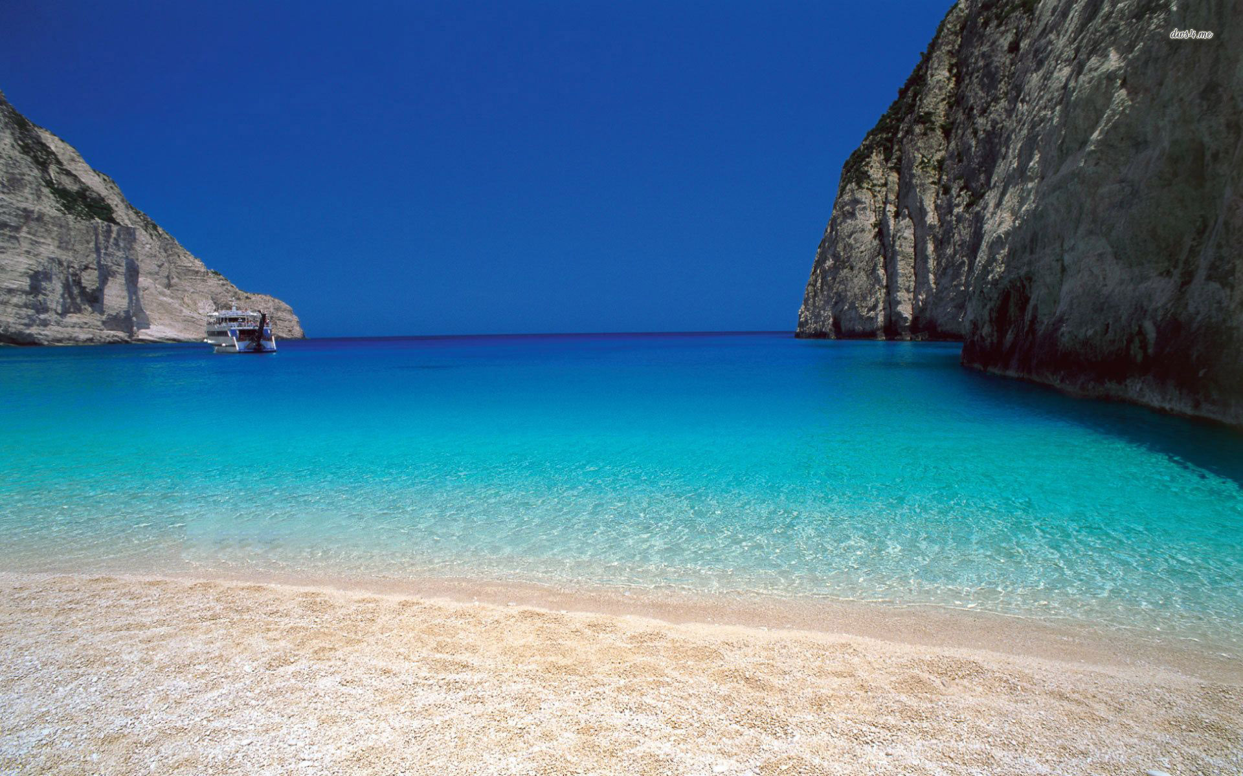
The Mediterranean sea looks blue and bright.

Slide 8
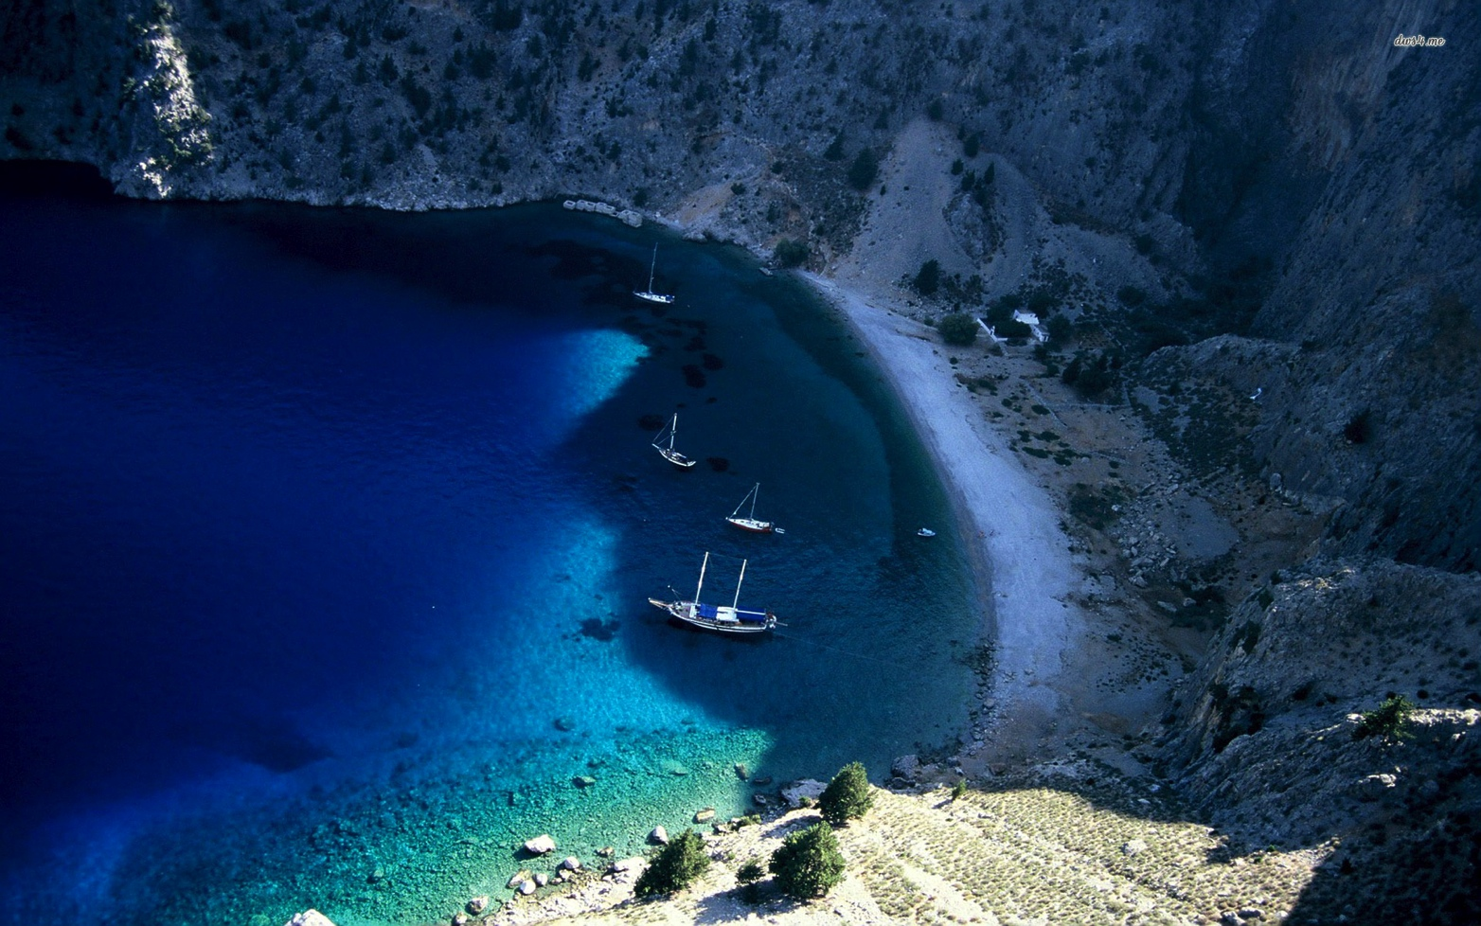
There are a lot of islands *surrounding Greece.

Slide 9
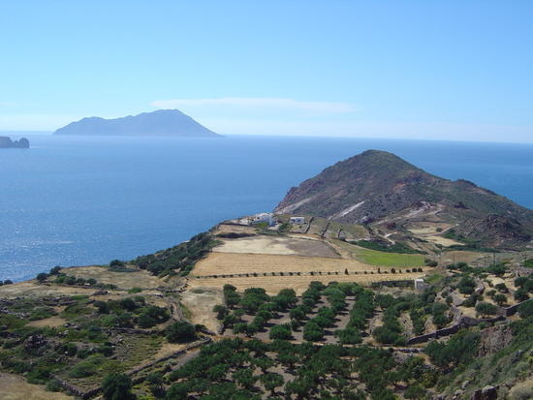
Greece is mountainous and the weather is hot and dry, so it is difficult to farm.

Slide 10
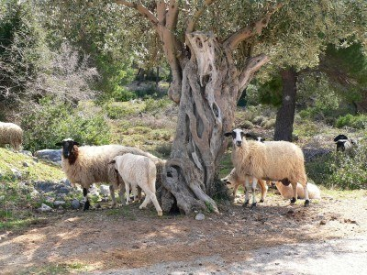
Grapes, figs, dry fruits and olives are some of the few plants which can survive Greece summer.
Ship and goats are the animals which provide of meat to Greek people.

Slide 11
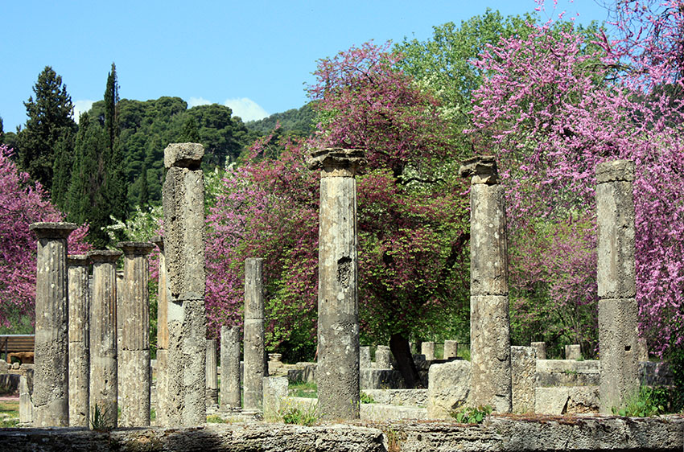
You can find many temples and runes from Ancient Greece in Greece landscape.

Slide 12
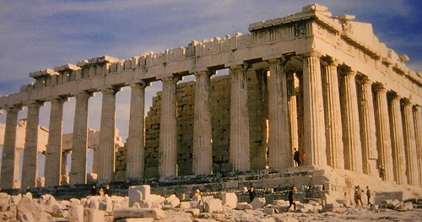
Main facts:
Mediterranean Sea
Sun
Mountains
Olives trees, figs, wine
Ship and goats
Ruins

Slide 13
Thanks to:
mrdonn.org
primaryhomeworkhelp.co.uk
British Museum

