Slide 1
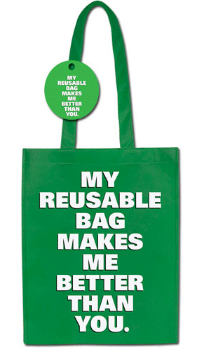
Reuse
Despite efforts to reduce the amount of waste generated, consumers and businesses still create substantial waste. Much of this waste can immediately be reused to minimize the strain on the environment and municipal waste management. For example, consumers can refill a purchased bottle of water with water from home to minimize the number of plastic bottles being discarded. Consumers have a financial incentive here as well, as municipal water is far cheaper than bottled
water.

