Slide 1
COMPOSTING PROCESS
NAME:
GRADE:
SCHOOL:

Slide 2
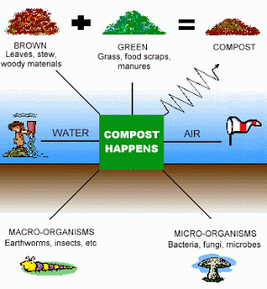

Slide 3
Complete the graphic at the end of this PPT by explaining how the compost process works. Look at the next slide and the proposed web page to complement your notes.
http://www.recyclenow.com/reduce/home-composting/making-compost/composting-easy-step-step-guide-0

Slide 4
COMPOSTING PROCESS
STEP 1
STEP 2
STEP 3
STEP 4
STEP 5
STEP 6
STEP 7

