Slide 1
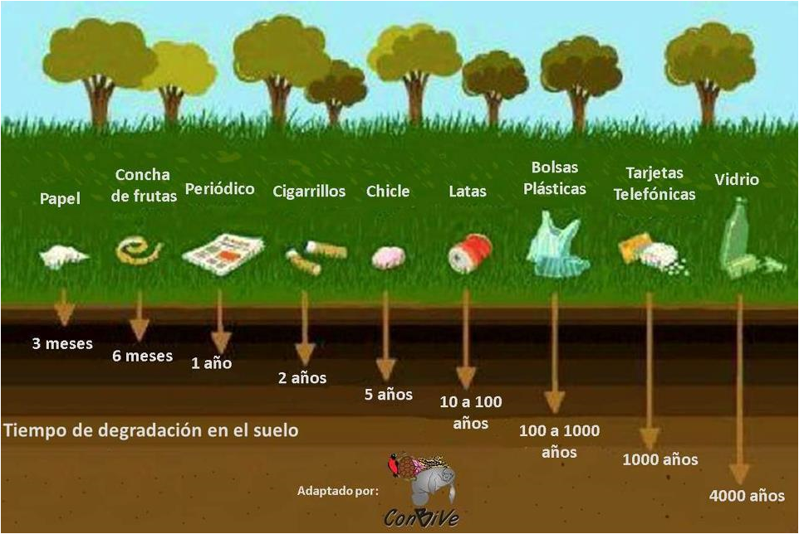

Slide 2
Look at the information in the last slide and do a chart in english showing the object and the time spent in degrading. (Follow the example)
OBJECT | TIME TO BE DEGRADED
PAPER | THREE MONTHS

