Slide 1
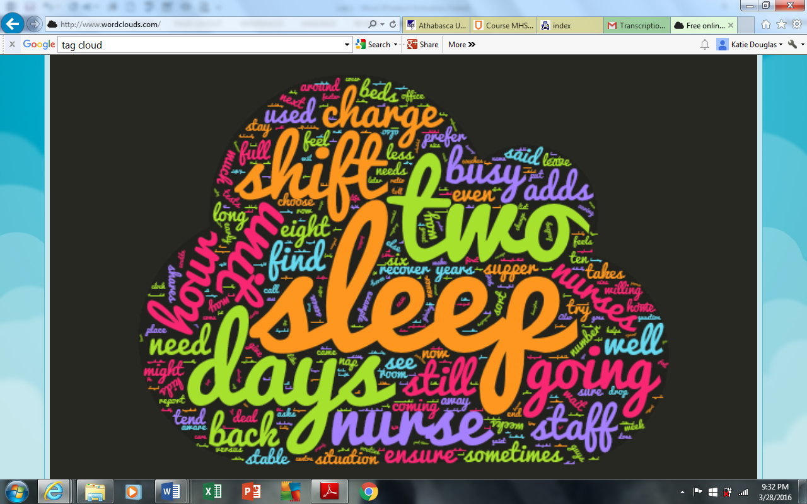
Exploring Nurses Resiliency to Shift Work
Nurs 603 : facilitating inquiry
Winter 2016
Melanie thompson, Diane cooper, and Katie douglas

Slide 2
Background and Literature Review
Shift work:
Defined as working between 7pm and 6am
Inadequate sleep is common among shift workers
Often requires one to sleep during the day
Sleeping during daylight hours – Poor quality of sleep, more feeling of wakefulness, and shorter rest periods
Nurses have identified that they are getting insufficient sleep
Evidence supports sleep breaks on night shift can prevent sleep deprivation

Slide 3
Mixed Methods Study Exploring Nurses Resiliency to Shift work
Aim of this study
Examine nurses’ perception of sleep patterns and explore factors that affect adequate rest periods and recovery from shift work
Other objectives
Exploring nurses’ perception of quality versus quantity of sleep
Examining preferred shift schedules to accommodate sleep
Looking at the breaks allowed to night shift workers
Hypothesis
Nurses working rotating shifts experienced sleep deprivation in some form and have become resilient to adverse effects of poor quality and quantity of sleep

Slide 4
Ethical Considerations
For the purpose of this assignment, approval from an ethics committee was not required
The course facilitator reviewed focus group and survey questions prior to commencing the study
For the focus group, consent was verbally obtained by all participants
Voluntary completion of the survey implied acceptance of participation terms and consent

Slide 5
Lab One: Qualitative Analysis
Purpose
This study aims to gain insight into the phenomenon of what strategies nurses use to stay resilient to the challenges of providing round the clock health care using a phenomenological research approach

Slide 6
Research Methodology
Participants
The participants for the focus group consisted of three lab group members presently enrolled in the Athabasca University’s NURS/MHST 603 Facilitating Inquiry course.
Procedure
Six open ended questions.
In person focus group conducted by Lab group members who were both the researchers and participants
The focus group was recorded electronically and a transcript of the discussion was created for the purpose of analysis.

Slide 7
Methodology Continued
Limitations
Small and convenient sample size
Researchers and focus group participants were one in the same. This is a conflict of interest as the focus group dialogue may have been tainted by prior discussions

Slide 8
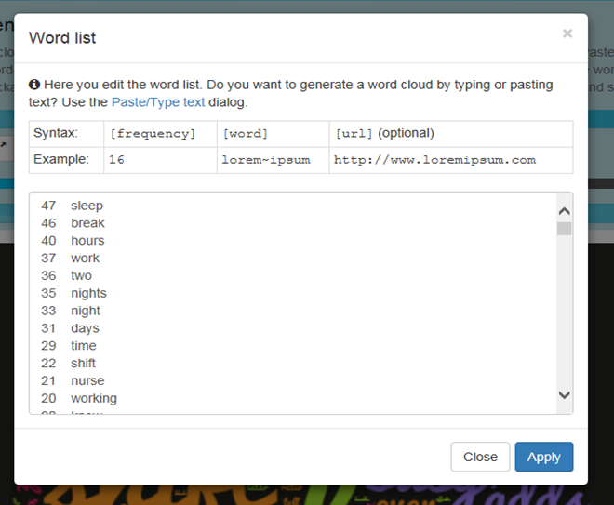
Research Analysis
The focus group transcript was put through a free online software called WordClouds to count the frequency of how many times a specific word was stated and to generate a visual illustration based on the word frequencies.

Slide 9
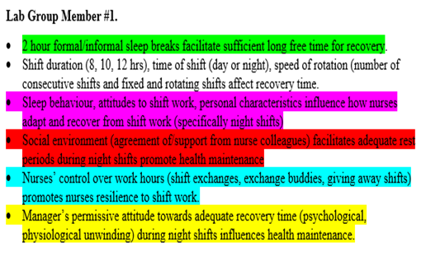
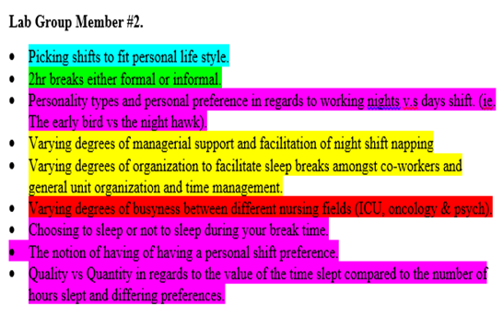
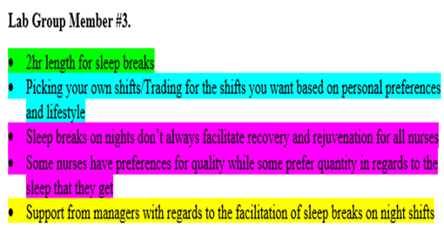
Analysis Continued
Each lab group member independently reviewed the focus group transcript and identified key words and quotes to create their own list of cluster meanings.

Slide 10
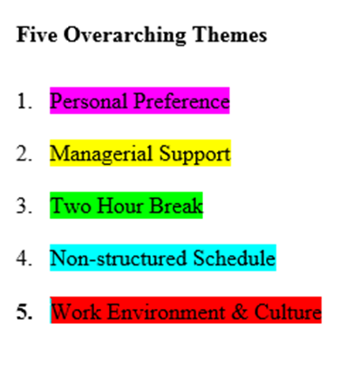
Analysis Continued
These individual cluster meaning lists were then compared and were further coded to create a final list of five overarching themes. Each overarching theme was then analyzed for meaning and results.

Slide 11
Research Results

Slide 12
Lab Two: Quantitative Analysis
Purpose
To What Extent Do Internal and External Factors Impact Nurses’ Perception of Their Sleep Patterns

Slide 13
Research Methodology
Sample
Convenient sample of 17 course participants
Procedure
Inviting graduate students enrolled in Facilitating Inquiry course to complete on-line questionnaire using Google Forms template

Slide 14
Methodology Continued
Limitations
Convenient sample
Small sample size
Use of subjective information only (standardized questionnaires not incorporated into survey questions)
Variations in shift type (days vs nights) and hours worked
Study design (cross-sectional studies do not yield cause and effect relationships)

Slide 15
Research Results
Findings via auto summary produced by Google Forms and Excel spreadsheet computations
Internal Factors:
Personal Preferences
Sleep Quality versus Sleep Quantity
Diurnal versus Nocturnal Traits
Preferences for working day shifts versus working night shifts

Slide 16
Research Results Continued
External Factors
Perception of management’s attitudes towards break or rest times
Collegial support that facilitate taking breaks during night shifts
Speed of rotation (number of consecutive shifts worked)
Participants’ perception of their control over the scheduled shifts

Slide 17
Research Discussion
Research findings limited by sample size and composition of sample (53% of participants worked day shifts only)
Respondents unanimously indicated that break times influenced the quality of patient care
Findings present an opportunity for organizations to review and improve practices around break times/rest periods during night shifts
Management should create a culture where taking breaks is important for maintaining nurses’ health, promoting rejuvenation and enhancing patient care and safety

Slide 18
Recommended Strategies
Management should integrate models on recovery with shift models (shift duration and time of the shift) to better ascertain adequate rest times (Merkus, Holte, Huysmans, Van Mechelen, & Van der beek, 2015)
Management should dedicate space for employees to have rest periods (Alspach, 2008)
Management should adopt more flexible scheduling practices that empower individuals and offer nurses more control over their scheduled shifts and the number of consecutive shifts worked

Slide 19
References
Alspach, G. (2008). Napping on night shift: Slacker or savior? Critical Care Nurse, 28(6), 12-19.
Bixby, J. (June 2008). Awake, Alert and Ready to work. RT: The Journal for Respiratory Care Practitioners, 21(6), 24-28.
Chan, M.F. (January 2009). Factors Associated with perceived sleep quality of nurses working on rotating shifts. Journal of Clinical Nursing, 18(2), 285-293.
Google Forms (2016). Google Privacy and Terms. Retrieved from https://www.google.ca/intl/en/policies/privacy/
Lin, S.H., Liao, W.C., Chen, H.Y., & Fan. J.Y. (2014). The impact of shift work on nurses’ job stress, sleep quality, and self-perceived health status. Journal of nursing management, 22, 604-612.
Merkus, S.L., Holte, K.A., Huysmans, M.A., Van Mechelen, W., & Van der beek. A.J. (2015). Nonstandard working schedules and health: The systematic search for a comprehensive model. BMC public health, 15, 1-15. Doi:10.1186/s12889-015-2407-9

