Slide 1
Mixed Methods Analyses: Work/School-Life Balance Of Graduate Students
Group A Participants: Duaa, Charyle, Stephanie & Tamara
Athabasca University
April 1, 2016

Slide 2
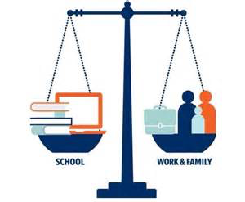
Purpose
To evaluate the experience of students in relation to work/school-life balance while completing graduate studies.

Slide 3
Background
Literature Review:
  Factors affecting work/school-life balance include academic, financial, and personal stressors (El-Ghoroury et al., 2012).
  Coping strategies include adequate support system, regular exercise, maintaining hobbies (El-Ghoroury et al., 2012).
  Maintaining work/school-life balance correlates with program completion (as cited in Kalman et al., 2009)
  Insufficient research examining work/school-life balance of graduate students in health disciplines (El-Ghoroury et al., 2012).

Slide 4
Research Methodology
Exploratory Design, Mixed-method analyses:
  Phase One: Qualitative data was gained through a focus group interview involving group members and an assigned principal investigator.
  Themes extracted from focus group interview and served as the basis for the quantitative study.
  Phase Two: A self-administered survey was developed using Fluid Surveys and distributed to peers currently enrolled in “Facilitating Inquiry”. Quantitative data was acquired and reduced to charts for analyzing.
  (Leedy & Ormrod, 2013)

Slide 5

Phase 1: Focus Group
Teleconference conducted on January 31, 2016
Principal investigator selected based on birthday month, rest of group members were participants.
Interview was dictated by 3 out of 4 group members.

Slide 6

Focus Group Limitations
Small sample size (n=3)
Participants novice experience in conducting and participating in qualitative research.

Slide 7
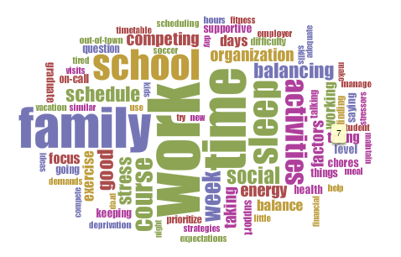
Qualitative Data
(Sinclair & Rockwell, 2016)

Slide 8
Qualitative Data Analysis
Deductive content analysis:
  moving from general to specific categorization and coding.
  Subcategories => Generic Category => Main Category
  Interview responses were grouped together and placed into sub-categories.
  From the sub-categories, common themes (main categories) emerged.
  Meaning was extracted.
  (Elos & Kyngas, 2007).

Slide 9

Themes
From sub-categories, main categories from the focus group responses emerged:
Responsibilities
Stressors
Coping Strategies
Organizational Strategies

Slide 10
Phase 2: Survey
Self-administered survey
Participants: A convenience sample of working graduate students/peers enrolled in “Facilitating Inquiry”.
Procedure:
  Survey developed using FluidSurvey and emailed to participants along with a consent.
  Likert rating scale, measuring the extent to which participants agree or disagree, was used for most questions (Leedy & Ormrod, 2013).

Slide 11

Quantitative Data Analysis
Objectivity was maintained.
Deductive reasoning was used to logically verify the initial themes and conclusions.
Quantitative data was reduced to charts.
(Leedy & Ormrod, 2013)

Slide 12

Survey Sample
Survey Sample:
  17 graduate students received the survey via email, 88% response rate, regarded as very good response (Coughlan, Cronin, & Ryan, 2009).
  Convenience sample = 15 participants.
  Demographic: All 17 individuals that received the self-administered survey were female gender, this was known to researchers, not identified in the survey.
  The course instructor did not receive/complete the survey, as he did not meet the criteria of the study.

Slide 13

Survey Results
  Stress:
    Majority of participants (80%, n=12) self-reported stress level 7-9/10.
  Competing factors for time:
    Fifty-three percent (n=8) identify job & domestic responsibilities as competing factors for time.
  Sixty-seven percent (n=10) identify that
  competing factors contribute to stress.
  Sixty percent (n=6) disclose that energy level
  & lack of sleep impacts work/school/life balance.

Slide 14

Survey Results (continued)
Coping strategies:
  Organization & support system 26.7% (n=4)
  Sleep & time off 20% (n=3)
  Exercise 6.7% (n=1)

Slide 15

Survey Limitations
Time constraints for survey completion = 5 days
Response rate 88% (n=15)
Small sample size (n=15)
Similarities among participants

Slide 16

Conclusion
Mixed-methods analysis optimal approach for research question.
Common factors impacting work/school-life balance = job & domestic responsibilities.
Coping strategies: Organization & support system.
Considering the female-only sample selection, further research will be required for conclusions that are generalizable to the whole population (Coughlan, Cronin, & Ryan, 2009).

Slide 17
References
Coughlan, M., Cronin, P., & Ryan, F. (2009). Survey research: Process and limitations. International Journal of Therapy and Rehabilitation, 16(1), 9-15.
El-Ghoroury, N.H., Galper, D.I., Sawaqdeh, A., & Bufka, L.F. (2012). Stress, coping, and barriers to wellness among psychology graduate students. Training And Education In Professional Psychology, 6(2), 122-134. doi:10.1037/a0028768
Elo, S. & Kyngas, H. (2007). The qualitative content analysis process. Journal of Advanced Nursing, 62(1), 107-115. doi: http://0-dx.doi.org.aupac.lib.athabascau.ca/10.1111/j.1365-2648.2007.04569.x
Kalman, M., Wells, M., & Gavan, C. (2009). Returning to school: Experiences of female baccalaureate registered nurse students. Journal Of The New York State Nurses Association, 40(1), 11-16.
Leedy, P. D., & Ormrod, J. E. (2013). Practical research: Planning and design (11th ed.). Upper Saddle River, NJ: Pearson.
Sinclair, S., & Rockwell, G. (2016). Voyant tools. Retrieved from http://voyant-tools.org/tool/Cirrus/

