Slide 1
Video Remote Interpreter Devices Project

Slide 2
Contents
A- Video Remote Interpreter Overview
B-Background on Hospital A and current state of interpretation services
C- Software Components & Hardware Components
D- Placement and number of input-output devices
E- Implementation Plan
F- Education Plan
G- Evaluation Plan
H- Potential Issues/ Solutions

Slide 3
Overview: Video Remote Interpreter (VRI)
Patients with limited English proficiency (LEP) face unique challenges when navigating an English language-based healthcare system (Freeman, 2015; Ramos et al., 2014)
-Decreased access to health care
-Decreased quality of care
-Reduced bond with care providers
-Decreased satisfaction, due to miscommunications
(Access Alliance, 2009; Freeman, 2015; Ramos et al., 2014)

Slide 4
Overview: Video Remote Interpreter (VRI)
Resulting in:
Increased medical errors
Decreased provision of evidence-based medical care
Increased health care costs &
Poor patient outcomes
(Ramos et al., 2014)

Slide 5
Overview: Video Remote Interpreter (VRI)
Poor experiences undermine principles of Canadian healthcare system, which stresses access to quality health care for all. Critically important that patients able to access information in language can understand. (Access Alliance, 2009)
Through implementation of video remote interpretation (VRI) project, access to professional interpretation services will be available 24/7, including American Sign Language. Ensures accurate medical vocabulary used, patient privacy maintained, medical errors are reduced- overall improving patient outcomes. (Ramos et al., 2014)

Slide 6
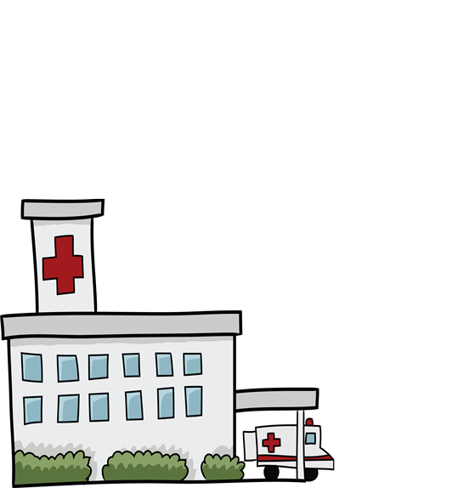
Background on Hospital A
Located in a primarily English speaking region of Canada
300 inpatient beds, >100,000 Emergency Department visits/year
Serves as community referral centre for the region
Busy ambulatory care clinic
Patients see different specialists and specialty departments (e.g. physio or occupational therapy)
Most hospital staff identify English as their primary and only language
2% identify proficiency in French and less than 0.5% identifying proficiency in another language

Slide 7
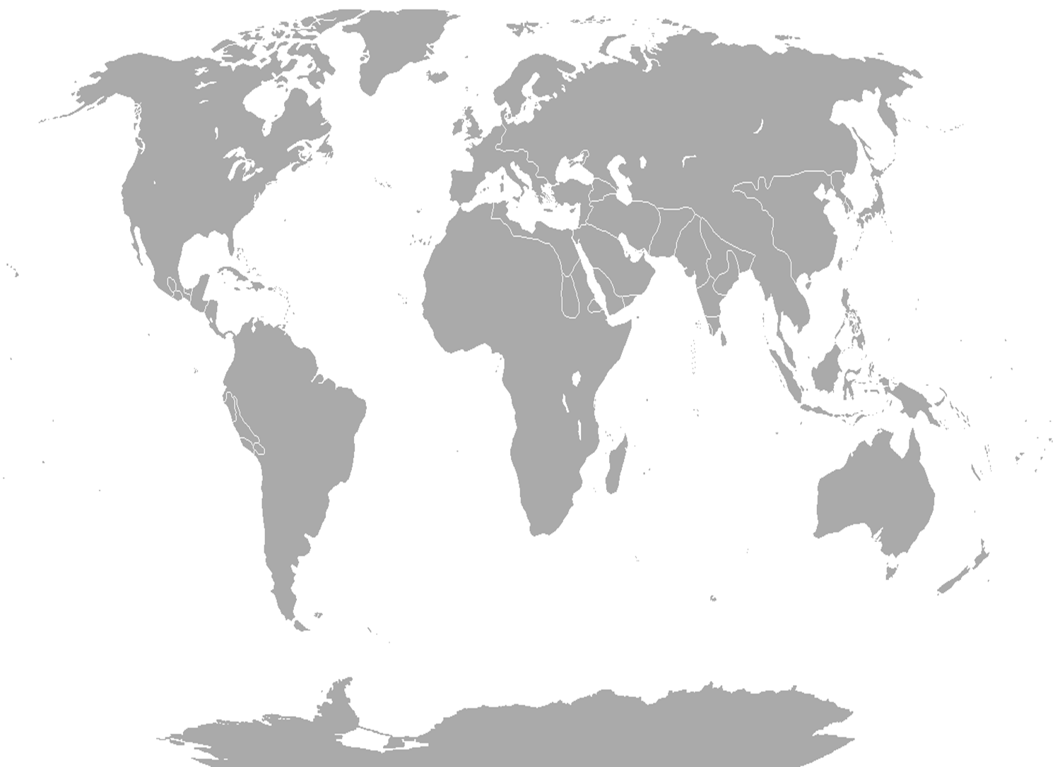
Many newcomers to region in last several years, bringing many different languages and cultures.
French, Spanish, Arabic, Hindi and Mandarin most commonly interpreted languages at Hospital A.
Implementation of VRI devices is a valuable project in order to meet Hospital A’s identified vision and values

Slide 8
Hospital A Vision and Values
Our Vision
Exceptional Care. Strong Partnerships. Healthy Communities.
Our Values
We CARE. We LEAD.
Collaboration Accountability Respect Excellence
Lead by Example Empower Achieve Results Develop Others

Slide 9
Current State of Accessing Interpreter Services at Hospital A
Emergency department
Informal interpretation services provided by family, untrained staff, other patients, visitors.
Call 13-6400 to ask if qualified interpreter available from registered working staff.
Inpatient departments
Complete Interpretation Request Form on Hospital A website for specific date and time requests.
Informal interpretation services including family, untrained staff, patients, visitors (used for day to day translation)
Call 13-6400 to see if a qualified interpreter available from registered working staff.
Outpatient departments
Determine need for interpreter services before appointment confirmed
Complete the interpretation Request Form on Hospital A website for specific date and time requests.
Call 13-6400 to see if a qualified interpreter available from registered working staff. If not then informal interpretation services including family, untrained staff, and visitors used.

Slide 10
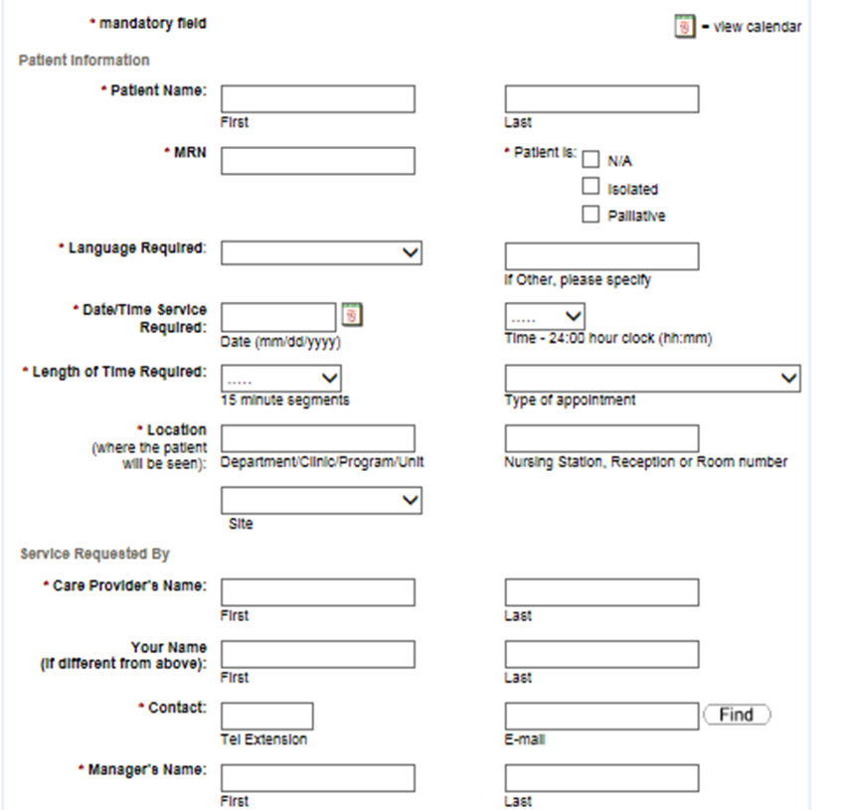

Slide 11
Software and Hardware Components

Slide 12
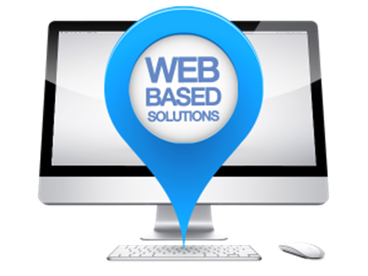
Software
VRI is a web based solution. The only software required is a web browser.

Slide 13
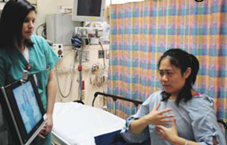
Software
The application
Confidential (a secure login required, privacy standards met)
Face-to-face service (live video and audio stream)
On-demand (24/7). No appointment booking required.

Slide 14
Hardware
Central Processing Unit (CPU)
64 bit, dual processor, hex-core, 2.26 gigahertz (or higher)
32 gigabytes of memory (at a minimum)

Slide 15
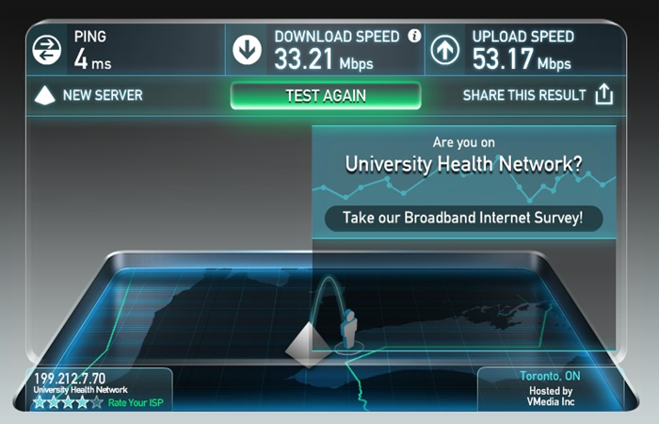
Hardware
Network Access via WiFi
A wireless connection which mean portable
Application requires minimum bandwidth of 1.13 megabytes/second

Slide 16
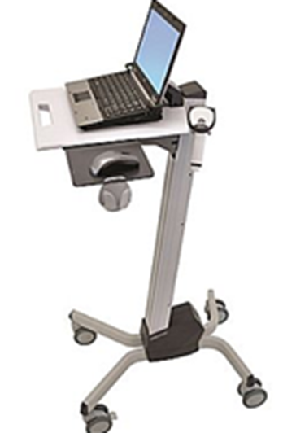
Hardware
Mobile Cart
Ergonomically designed
Easy to use
Adjustable height

Slide 17
Device Placement and Requirements

Slide 18
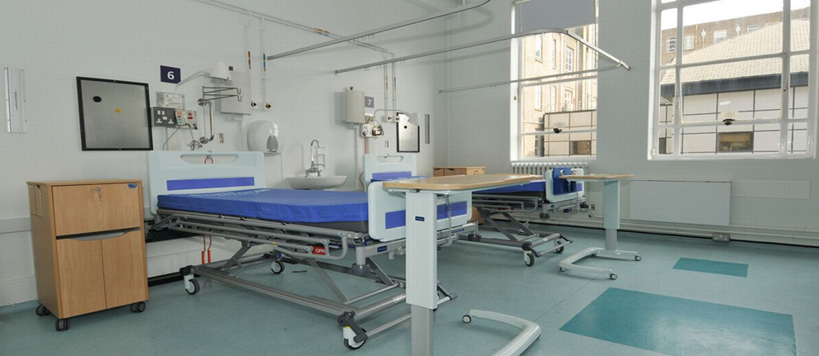
How to Decide Numbers of Devices and Storage Locations
LEP patients often begin experiences with healthcare system in Emergency Department (Wallbrecht, Hodes-Villamar, Weiss, & Ernst, 2014)

Slide 19
VRI Devices Numbers and Locations
LEP patients often spread out in hospital. Decision made to store devices in high-use units, geographically distanced from each other. Allows all clinical staff to be able to access a device close to their work area.
Total of four mobile VRI devices purchased.
stored in Emergency Department, inpatient unit, ambulatory care clinic and welcome centre in hospital lobby
Devices may be accessed by any clinical staff member and taken to required location

Slide 20
Hospital A Floor Plan Denotes location of VRI device

Slide 21
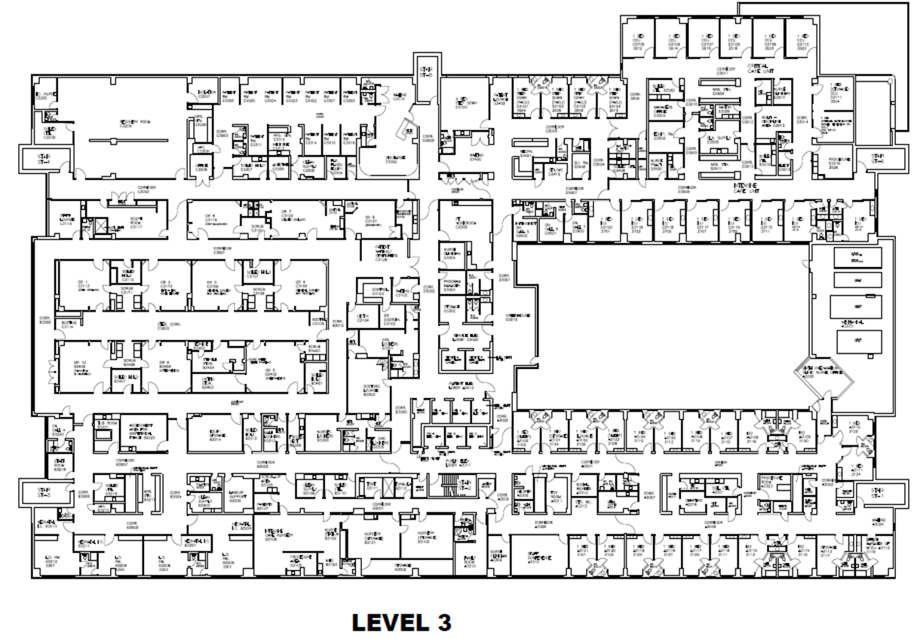

Slide 22
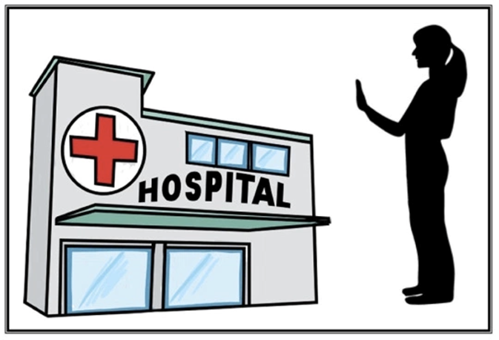
Needs of VRI Devices
Devices run wirelessly and will be supported on current hospital wireless network
2.0Mps bandwidths on a Cisco router

Slide 23
Implementation Plan

Slide 24
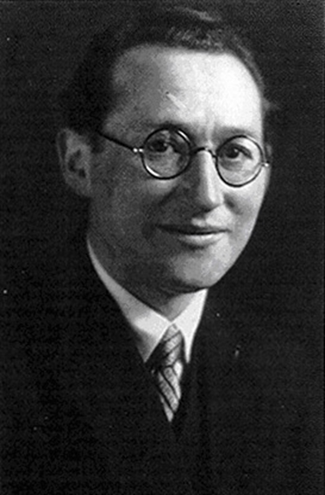
Applying Lewin’s Change Theory to Project Implementation
Lewin’s change theory serves as a framework for project implementation due to its adaptability to informatics projects (Kaminski, 2011).

Slide 25
Lewin’s Change Theory (Lewin, 1951)
Unfreezing
Planning for the change. Getting participants excited for the change.
Moving
Doing the training and actual change implementation. Seeing tangible results.
Refreezing
Ensuring the change becomes normalized and ingrained into the organizational culture

Slide 26
Lewin’s Change Theory Applied to VRI Device Project Implementation
Unfreezing
Qualitative surveys sent to patients/staff for feedback on interpreter services.
Examination of current/future workload ensuring no additional work for clinical staff to access VRI.
Meetings between planning team, IT, clinical staff to determine training and project roll-out.
Moving
VRI device training conducted by unit champions/educators/super users over two weeks.
VRI devices arrive at hospital and are deployed to appropriate areas for storage and use.
End-users access devices as required.
Refreezing
Follow-up qualitative surveys sent to patients/staff for six months post go-live.
Planning team examines survey results to determine if devices meeting organization needs and plan next steps.
Policies/procedures updated.
VRI devices regularly accessed by users for interpreter services.

Slide 27
Gantt Chart for VRI Project Implementation

Slide 28
Through the utilization of Lewin’s change theory and moving carefully through the phases of change, project success is ensured and end-users are more likely to smoothly adapt to the transition (Kaminski, 2011).

Slide 29
Education and Training

Slide 30
Education and Training
Educational model
Train the trainer
Identify Team
Educators as champions
Identify super-users on each unit
Training and Support
Educators train super-users
Super-users train staff
Resources
Super-users on the units
Training guide accessible online and with the VRI

Slide 31
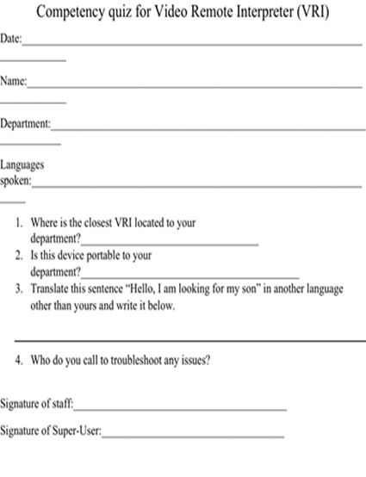

Slide 32
Evaluation Plan
Including Cost-Benefit

Slide 33
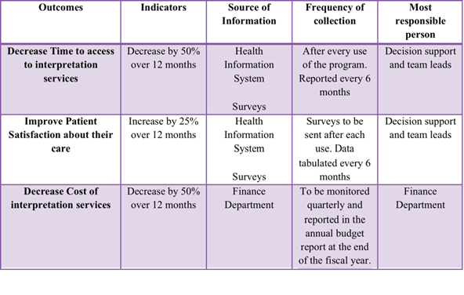
Evaluation Plan
Goal is to increase access to healthcare for LEP individuals.

Slide 34
Evaluation Plan
Pre-implementation qualitative surveys to be sent out to determine the need and identify gaps in translation using current systems.
Survey sent to patients in their identified primary language.

Slide 35
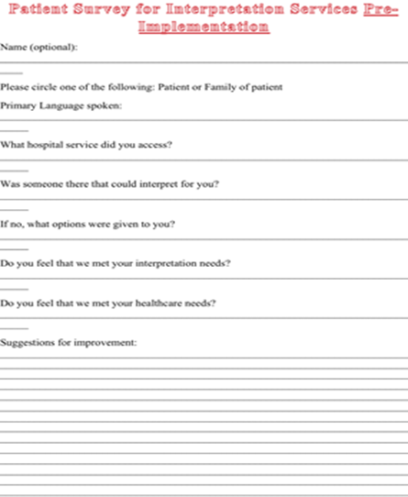
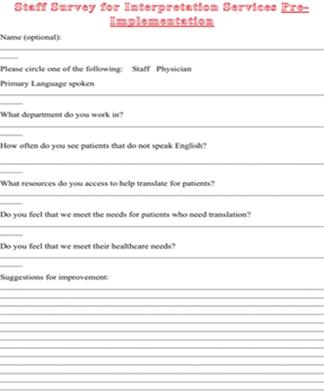

Slide 36
Evaluation Plan
Post-implementation qualitative surveys given out to staff and patients to determine improvement in services and decrease in communication gaps using VRI.

Slide 37
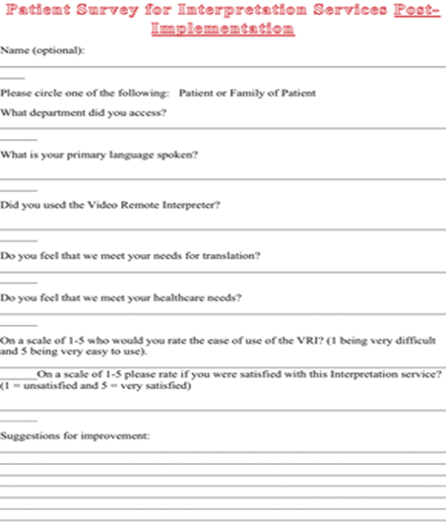
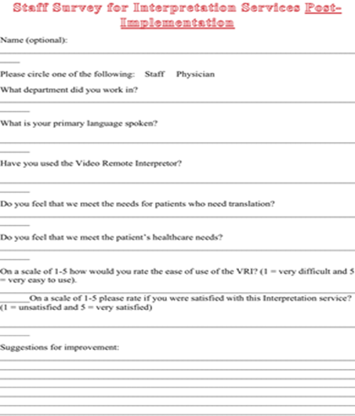

Slide 38
Cost Benefit Analysis
Little research available on cost to healthcare system when interpretation services not adequately provided (Access Alliance, 2009). However, quality of care for patient and increased patient satisfaction scores are priceless.

Slide 39
Cost-Benefit Analysis
Initial start up costs of $28K for training and equipment would quickly be equalized by the savings of $16K annually for the life of the software.
Costs for initial training would be a one time fee as continued training would be rolled into regular annual recertification planning.

Slide 40
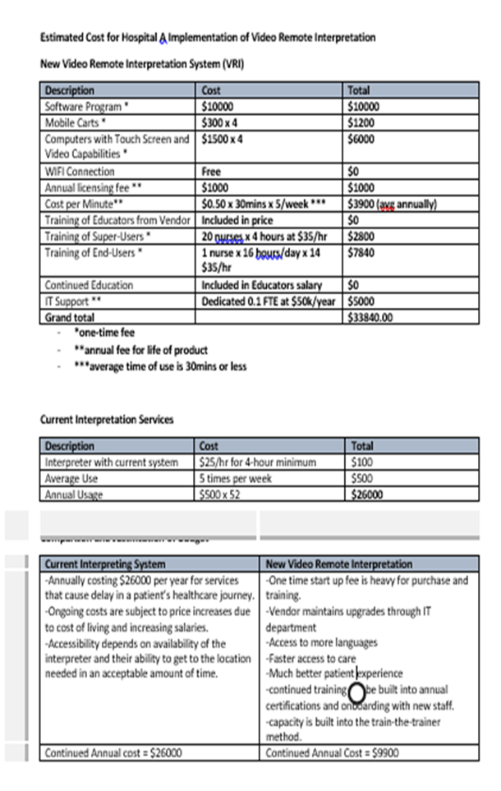

Slide 41
Potential Issues and Proposed Solutions

Slide 42
Privacy/ Security/ Legal Issues and Solutions

Slide 43
Social Issues and Solutions

Slide 44
Ergonomic Issues and Solutions

Slide 45
Thank You!

Slide 46
References
Access Alliance, (2009). Literature review: Costs of not providing interpretation in health care (Access Alliance Publication LR004). Retrieved from http://accessalliance.ca/wp-content/uploads/2015/03/Lit_Review_Cost_of_Not_Providing_Interpretation.pdf
Freeman, R.R. (2015). Primary care for limited English-speaking patients and parents. Journal of the American Association of Nurse Practitioners, 27, 167-176. doi: 10.1002/2327-6924.12148
Kaminski, J. (2011). Theory applied to informatics – Lewin’s change theory. Canadian Journal of Nursing Informatics, 6 (1), 1-5. Retrieved from http://cjni.net/journal/?p=1210
Lewin, K. (1951). Field theory in social science; selected theoretical papers. New York, NY: Harper & Row.
Ramos, R., Davis, J.L., Antolino, P., Sanz, M., Grant, C.G., & Green, B.L. (2014). Language and communication services: a cancer centre perspective. Diversity and Equality in Health and Care, 11, 71-80.
Wallbrecht, J., Hodes-Villamar, L., Weiss, S., & Ernst, A.A. (2014). No difference in emergency department length of stay for patients with limited proficiency in English. Southern Medical Journal, 107(1), 1-5. doi: 10.1097/SMJ.0000000000000037

