Slide 1
Health Information Exchange for Emergency and Trauma Unit 1
Emergency
Trauma Unit
Patients
Data
Staff

Slide 2
Problem
Each unit uses different Clinical Information Systems (CIS) for important reasons.
ER CIS is compatible with Ambulance and Paramedic system (e- Critical/Clinibase)
Trauma Unit is specific for long term stay and used throughout the hospital (Sunrise Clinical Manager (SCM)).
Operational consequences:
duplication of tasks
increased potential for errors
increased workload for nursing staff
decreased overall system efficiency
Potential for errors, missed information and poor patient care

Slide 3
Solution
Consult the staff
Test a new CIS and gain staff input
Make a plan
Develop a team
Integrate the platform for interoperability of hospital clinical information systems and cloud based storage and transfer of information.
dbMotion:
A Health Information Exchange (HIE)

Slide 4
Health Information Exchange (HIE)
Cloud-based hospital information systems are becoming more widespread and are an effective mechanism to facilitate HIE and provide better healthcare services to patients (Reddy & Reddy, 2014).
HIE is a common theme in developing frameworks for sharing and exchanging health information across the many healthcare providers involved in a patient’s care, and to ensure smooth transitions from one setting to the next (British Columbia Ministry of Health, 2015; Frisse et al., 2011; Health Quality Ontario, 2013).

Slide 5
Team
Leader (Experienced ER Nurse) / Informatics Consultant
Management Team/IT Team
Staff (ER and Trauma Unit)

Slide 6
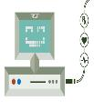
5 –phases with ‘10 Considerations’ Integrated
1) Discussion Phase:
Clarify problem(s) that the technology is meant to help tackle
Build consensus
2) Testing Phase:
Consider Options
Choose systems that meet the clinical needs and is affordable
3) Change Phase:
Plan appropriately
4) Implementation/Rollout:
Don’t forget the infrastructure
Train Staff
5) Evaluation Phase:
Continuously evaluate the process
Maintain the system
Stay the course
(Cresswell et al., 2013)
Create a plan and a realistic timeline

Slide 7
Timeline
Discussion Phase
Testing Phase
Change Phase
Rollout Phase
Evaluation Phase
1 month January 1st 2016- February 1st 2016
1 Month July 1st – July 31st 2016
6 Months July 31st 2016- January 31st 2017
6 months February 1st- July 1st 2016
1 Year
July 31st- July 31st 2017

Slide 8
PROBLEM:
ER operates on Clinibase and e-Critical whereas trauma operates on Sunrise Clinical Manager (SCM). Transfer of patients from ER to the trauma unit currently involves verbal communication and re-entry of information, duplicating tasks, and risk of medication errors.
Phase 1: Discussion
Initial meetings with the Management team and clarify problem(s) that the technology is meant to help tackle.
Build consensus: work through the risk analysis and system analysis and align goals and objectives.
Involved staff in solution of dbMotion
Most cost effective that will allow for Health Information Exchange (HIE).
Ensure the system functions as designed
Technical and user testing
Phase 2: Testing
- Consider Options
- Choose systems that meet the clinical needs and is affordable
Phase 3: Change
Consider Technology Acceptance Model (TAM).
Change issues, perceived ease of use and other concepts were tackled prior to implementation.
Planning appropriately
Shift from testing to training and Implementation, ‘going live’.
Initiation of Staff Training

Slide 9
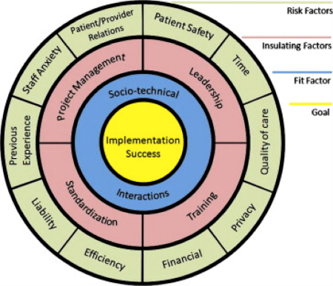
Risk Analysis
Performing a work-flow analysis to ensure how and when work and productivity will be effective by the integration of a new system (Yen & Bakken, 2012).
Fig. 1: Environmental risk analysis diagram (Ludwick & Doucette, 2009).

Slide 10
System Analysis
Gassert Model for Defining Information System Requirements for Nursing (MDISRN) was used for analyzing system requirements for nursing and other staff, which resulted in positive feedback, supporting the implementation of dbMotion.
Nurse User Element
Information Processing Element
Nursing Information Systems Element
Nursing Information Element
Systems Goals Element
(Gassert, 1996)

Slide 11
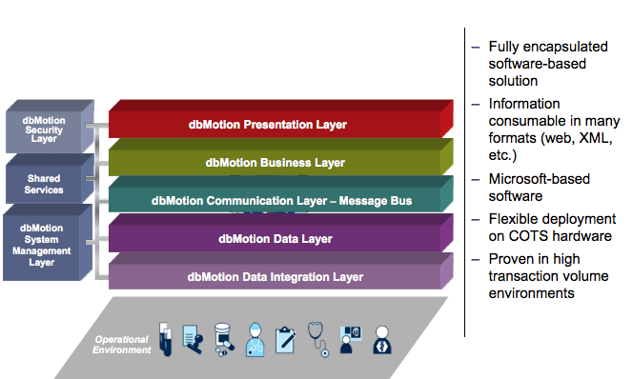
Hardware and Software Selection
Hardware
The dbMotion system will operate on the facility’s current Windows based system, software, and wireless network. Current desktop computer systems are HP Elite 8200MT Intel Core i7-2600-3.4, 8GB Memory,2TB Hard Drive, DVDRW, Windows 7 Pro 64 Bit(MAR)
Software
Complements the current CIS used by staff, minimizing drastic change in systems.
Provides the Link of patient patient without the need to re-enter information.

Slide 12
For more information visit: dbMotion

Slide 13
Phase 4: Implementation
Change issues and change management began early in the technical process in order to make adjustments before the system implementation began (Lorenzi & Riley, 2003).
Realistic timeline
Consideration of Technology Acceptance Model (TAM)
Involvement of staff/Open Communication
Effective Management Team
Leadership
Adequate Training
Successful Implementation
Discussions about the ease of use and how to maintain effective communication channels during the implementation process is vital (Dimension Data, 2015; Maillet, Luc, & Sicotte, 2015).

Slide 14
Education/Training Plan
1^{st:} Management and unit Clerk training
6 Months Prior:
- Super-user training
- dbMotion Testing Orientation
- Formal onsite training certification and informal web-based modules.
During rollout:
- Super users available onsite for assistance
- Practice online modules and help center available
2^{nd:} Nurses and Doctors
3^{rd:} Additional staff
Hands-on clinical education with the platform is beneficial and can improve patient outcomes (Creswell et al., 2013).

Slide 15
Phase 5:
Evaluation plan
The value assessment will include quantitative and qualitative components to ensure a well-rounded evaluation of effects.
Utilize the Agency for Healthcare Research and Quality (AHRQ) (2015) for evaluating HIE projects:
Step 1: Select Evaluation Team
- Management Team, IT Team and Staff
Step 2: Characterize the HIE Project
-Goals and objectives must be articulated
Step 3: Assess the value of the HIE system
- Is there financial benefit, clinical and patient benefit?
Step 4: Develop evaluation plan
- Solidifying goals and objectives for evaluation plan

Slide 16
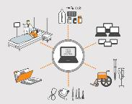
Closing remarks
To better serve the patients of University of Alberta Hospital, lower costs and improve work productivity the solution of dbMotion a HIE/cloud computing system will be implemented to link patient data, history and current up to date information from ER and a follow up trauma unit so there is continuity of care.
If successful remaining units of the hospital will follow suit, with the hope of complete interoperability and data sharing without completing changing current Clinical information systems.

Slide 17
References
Agency for Healthcare Research and Quality (AHRQ) (2015).
British Columbia Ministry of Health. (2015). Enabling effective, quality population and patient-centred care: A provincial strategy for health information management and technology. Retrieved from http://www.health.gov.bc.ca/library/publications/year/2015/IMIT-policy-paper.pdf
Cresswell, K. M., Bates, D. W., & Sheikh, A. (2013). Ten key considerations for the successful implementation and adoption of large-scale health information technology. Journal of the American Medical Informatics Association, 20(1), 9-13.
Dimension Data (2015). A guide to a successful clinical information system implementation. Dimension Data Pamphlet: A Best Practice Guide, 1-7.
Frisse, M., Johnson, K, Nian, H., Davison, C., Gadd, C., Unertl, K., …Chen, Q. (2011). The financial impact of health information exchange on emergency department care. Journal of American Medical Informatics Association, 19, 328-333.
Gassert, C.A. (1996). Defining information requirements using holistic models: Introduction to a case study. Holistic Nursing Practice, 11, 64-74.
Health Quality Ontario. (2013). Electronic tools for health information exchange: an evidence-based analysis. Ontario Health Technology Assessment Series, 13(11), 1-76.
Lorenzi, N. M., & Riley, R. T. (2003). Organizational issues= change. International Journal of Medical Informatics, 69(2), 197-203.
Ludwick, D. A., & Doucette, J. (2009). Adopting electronic medical records in primary care: Lessons learned from health information systems implementation experience in seven countries. International Journal of Medical Informatics, 78(1), 22-31.
Maillet, É., Mathieu, L., & Sicotte, C. (2015). Modeling factors explaining the acceptance, actual use and satisfaction of nurses using an Electronic Patient Record in acute care settings: An extension of the UTAUT. International journal of Medical Informatics, 84(1), 36-47.
Reddy, G.N., & Reddy, G.J. (2014). Study of cloud computing in healthcare industry. International Journal of Science and Engineering Research, 4(9), 8-71.
Yen, P. Y., & Bakken, S. (2012). Review of health information technology usability study methodologies. Journal of the American Medical Informatics Association, 19(3), 413-422. http://jamia.oxfordjournals.org/content/19/3/413#ref-14

