Slide 1
Lesson Evaluations
Tor Siong Hoon
2014

Slide 2
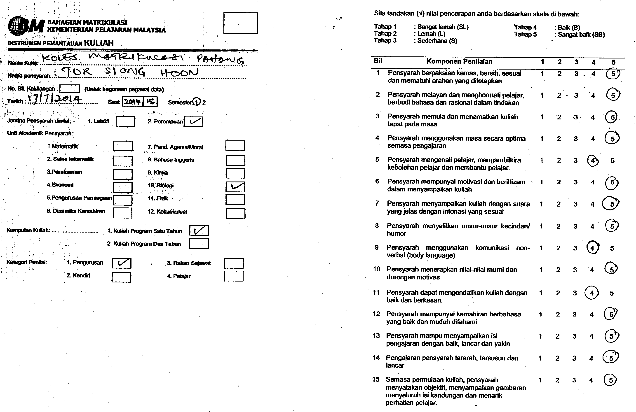
Deputy Director of KMPh

Slide 3
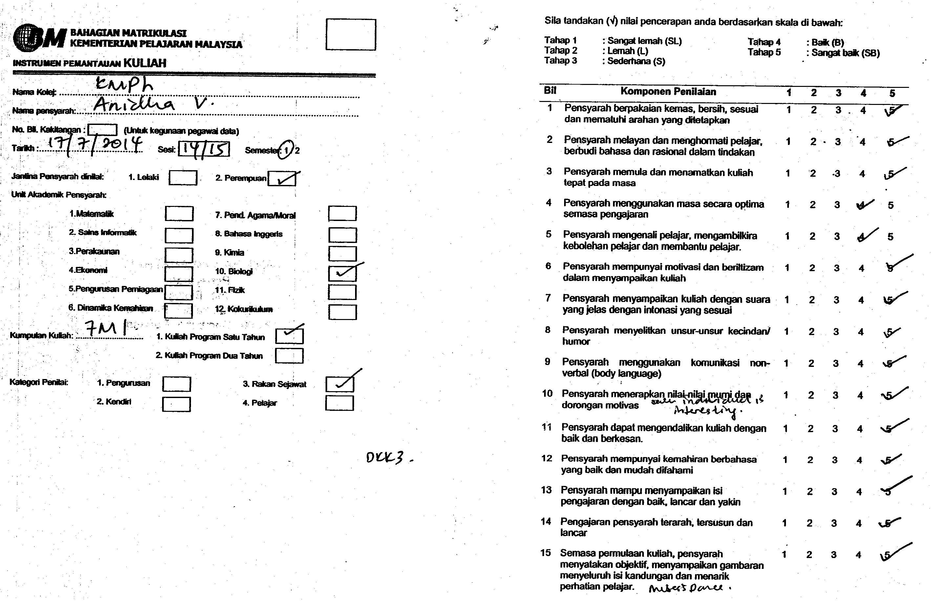
Biology Lecturer

Slide 4
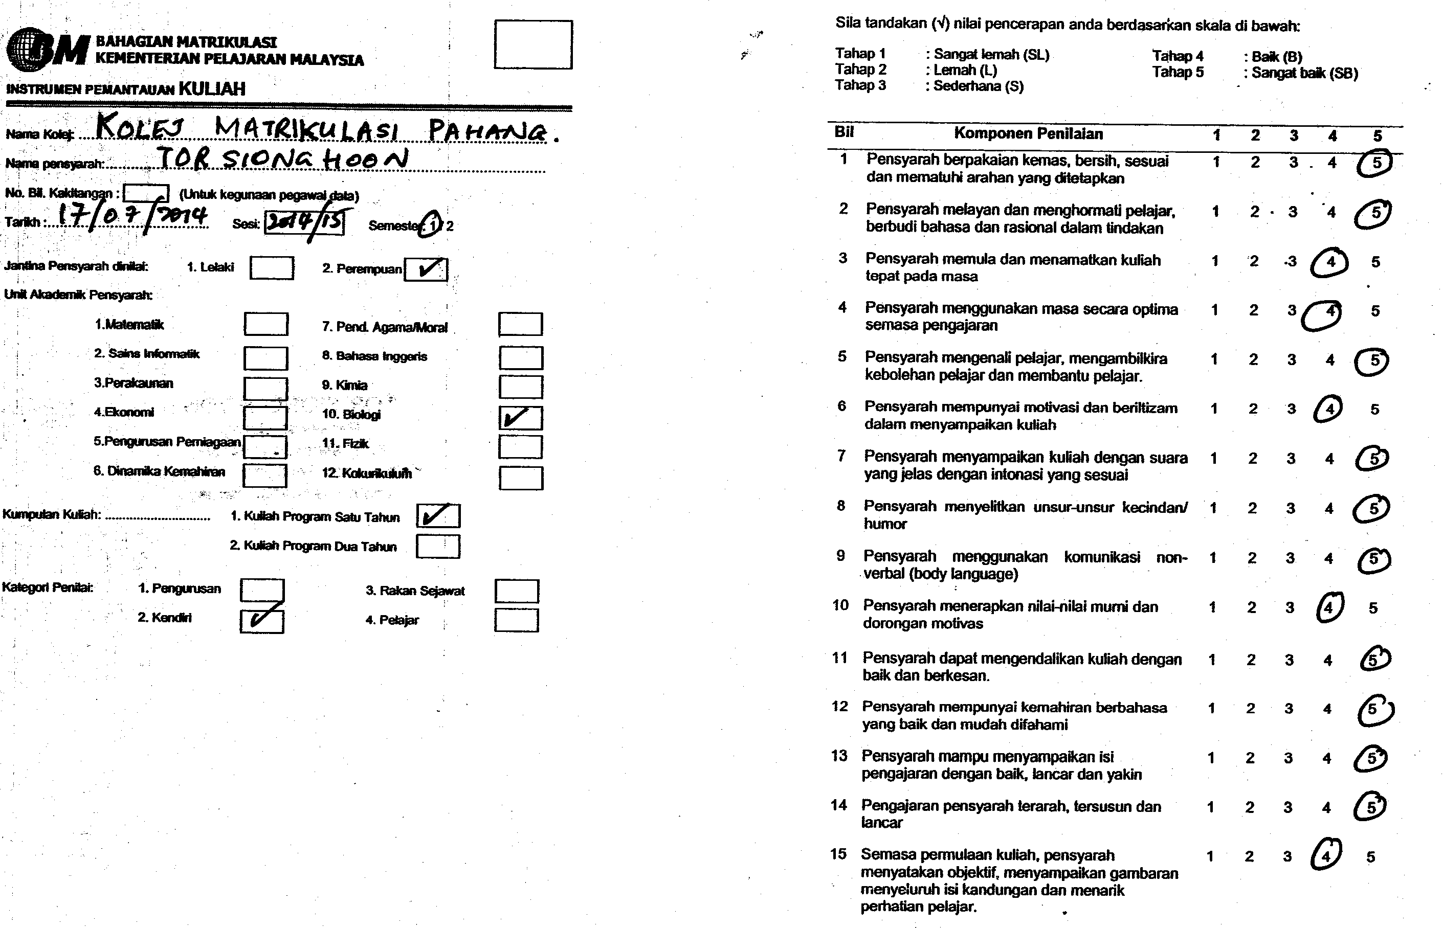
Self Evaluation

