Slide 1
Activity in Pairs
Follow the instructions carefully
DON’T FORGET TO PRESS F5 TO WATCH THE ANIMATIONS

Slide 2
This is a story…

Slide 3
Lucas is a boy who moved to a new town
He was very sad because he lost all his friends

Slide 4
When he and his family arrived at the new town, he decided to go to play in the park in front of his home.
There, he knew Sara; a nice girl.

Slide 5
After three hours playing and talking, Sara told to Lucas she would celebrate her birthday in two days.
So she invited to Lucas, her new friend…

Slide 6
Now, Lucas have problems, because he doesn’t know the town, and where to find a gift for her.
Also, Sara gave to him an invitation with the address of her house, and some clues of the posible gift he could give to her
Dear Lucas:
I’m gratefully to invite you to my birthday N°9. The day is Sunday 10th at 15:oo hrs. My address is Jackson St. East N° 345,in front of High School. Don’t miss, please.
Sara
PD: I love fairytales, I don’t like to recieve clothes as a gift, I like music, I hate dolls and teddy bears

Slide 7
In pairs: look the map and according the clues that Sara wrote on the invitation help Lucas to find the best gift to his new friend…

Slide 8
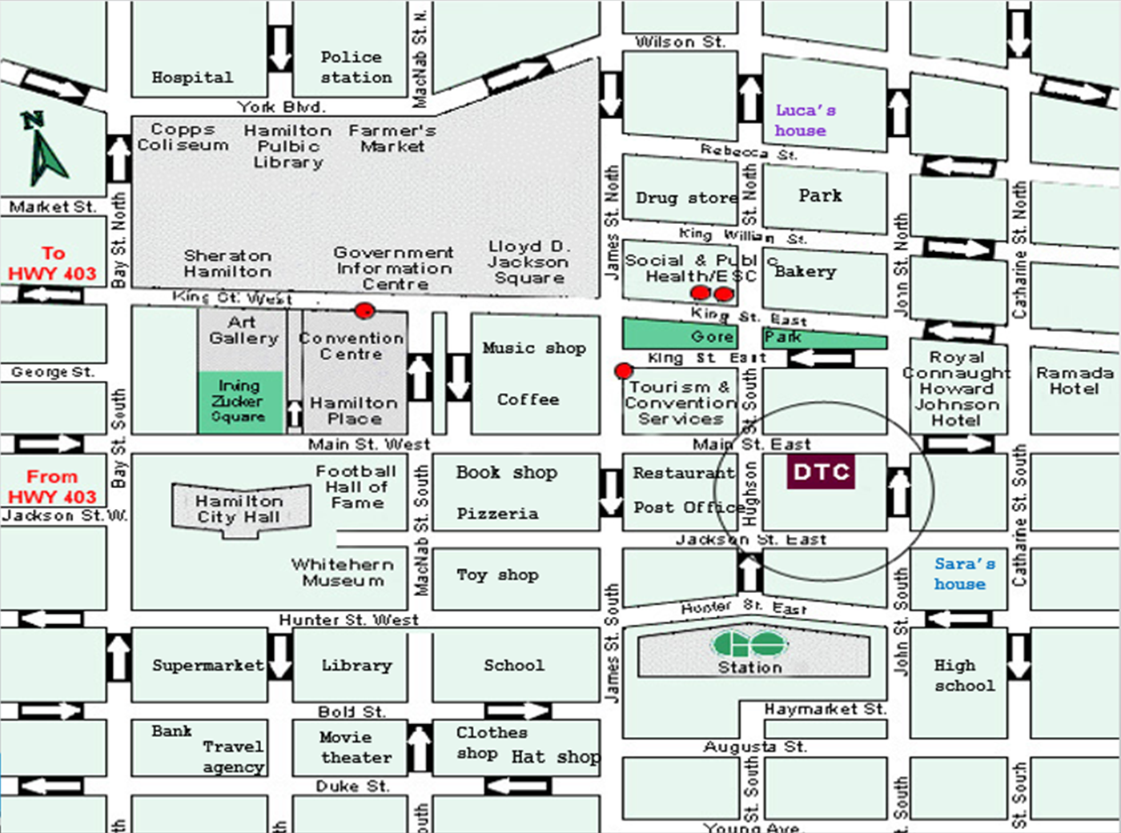
When you have the idea of the gift, locate the Luca’s house and using the expressions you learn before help Lucas to go to the shop you chose…

Slide 9
After that… help to Lucas to go to Sara’s house

Slide 10
To report this…
Write a report including:
Cover (title, names, and grade)
The photo of the map indicating the way Lucas did when he went to buy the gift (draw a color line on the map ) and the way he did when he went to Sara’s house (draw an other color line on the map)
Also write the description of each way including all the expressions you learnt before (nouns, verbs, prepositions, adverbs)

